Slide 1
Biology 177: Principles of Modern Microscopy
Lecture 10:
Scattering, clearing and adaptive optics
Andres Collazo, Director Biological Imaging Facility
Wan-Rong (Sandy) Wong, Graduate Student, TA

Slide 2
Lecture 10: Scattering, clearing and adaptive optics
Scattering and absorption of light
How to deal with scattering and absorption
Obstacles to transparency
Techniques for making samples transparent
History of clearing
Modern approaches: CLARITY and beyond
Adaptive optics

Slide 3
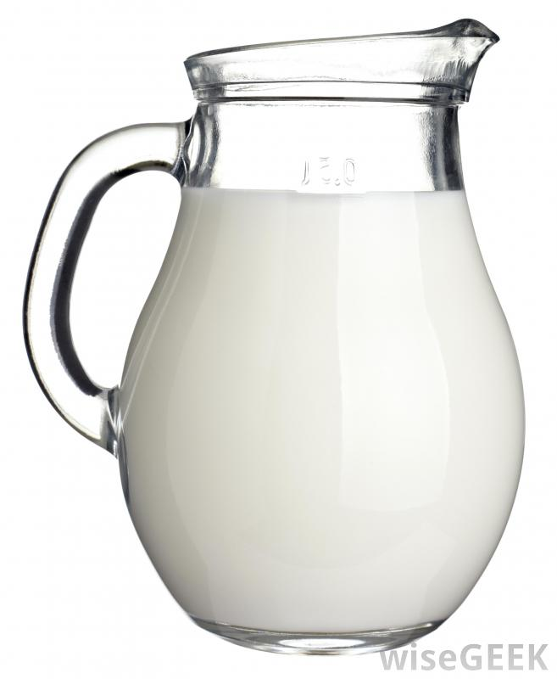
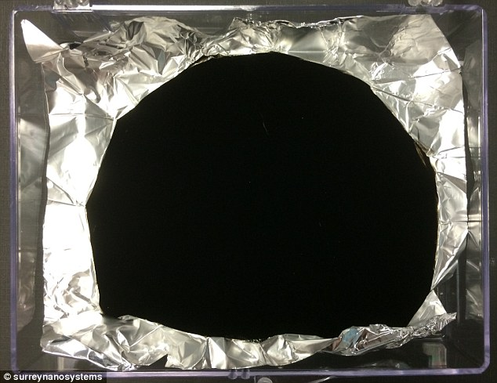
Opaque materials can either scatter or absorb light
Scattering
  Milky
  Common for many biological materials we want to image
Absorption
  Black
  Pigment containing cells one of few biological examples
Vanta black absorbs 99.965% of light
Notes:
http://www.dailymail.co.uk/sciencetech/article-2690424/Scientists-discover-new-black-British-researchers-devise-material-dark-looks-like-black-hole.html
http://www.iflscience.com/technology/new-super-black-material-absorbs-99965-light

Slide 4
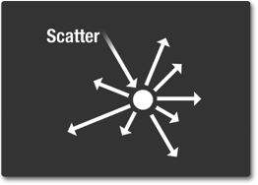
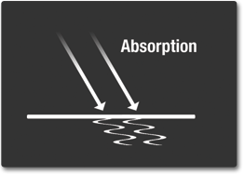
Scattering and Absorption of Light
Scattering
  Physical process causing light to deviate from a straight path
Absorption
  Photons of light transfer their energy to material they hit
Notes:
http://missionscience.nasa.gov/ems/03_behaviors.html

Slide 5
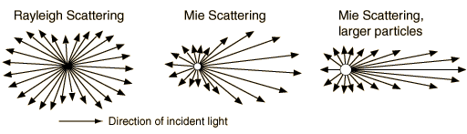
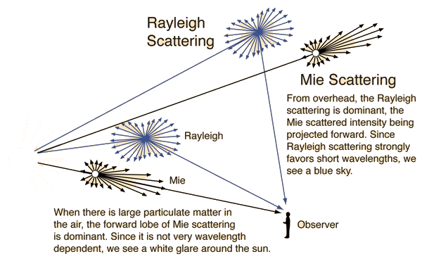
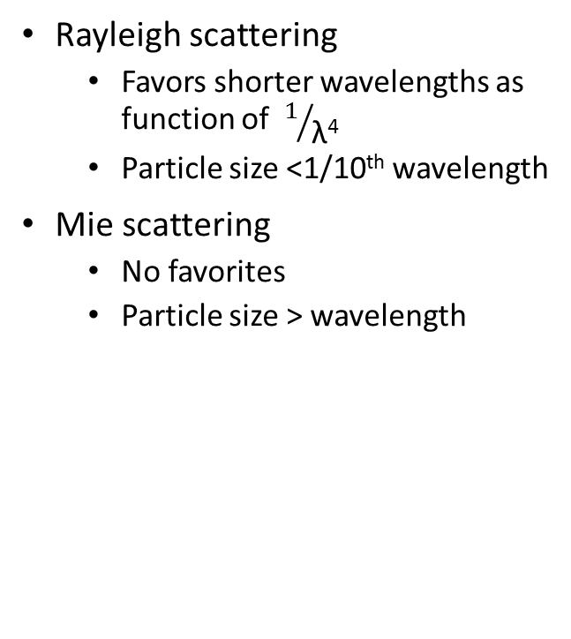
Scattering: color of sky dependent on particle size
Rayleigh scattering
  Favors shorter wavelengths as function of $1/{\text{λ}\text{4}}$
  Particle size <1/10th wavelength
Mie scattering
  No favorites
  Particle size > wavelength
Notes:
http://hyperphysics.phy-astr.gsu.edu/hbase/hframe.html

Slide 6
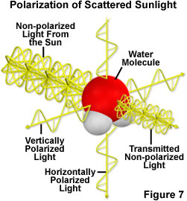
Rayleigh scattering results in polarized light
Over 50% is horizontally polarized.
Insects can see this polarization and use it to navigate
Even when sun not visible: like cloudy days or at night
Notes:
http://www.microscopyu.com/articles/polarized/polarizedlightintro.html
https://en.wikipedia.org/wiki/Rayleigh_sky_model

Slide 7

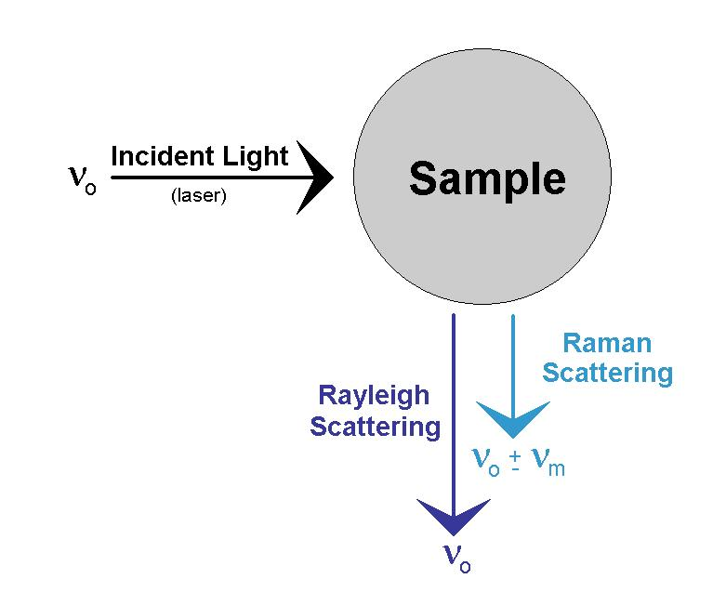
Another type of scattering
Most light is scattered at same frequency and wavelength but some scatters with different frequency.
Notes:
Raman spectroscopy valuable for microscopy, produces polarized light with useful information.
https://en.wikipedia.org/wiki/Raman_spectroscopy#Microspectroscopy
When photons are scattered from an atom or molecule, most photons are elastically scattered (Rayleigh scattering), such that the scattered photons have the same energy (frequency and wavelength) as the incident photons. A small fraction of the scattered photons (approximately 1 in 10 million) are scattered by an excitation, with the scattered photons having a frequency different from, and usually lower than, that of the incident photons.^{[4]}
http://www.thephysicsmill.com/2014/03/23/sky-blue-lord-rayleigh-sir-raman-scattering/

Slide 8
For light microscopy, how do we deal with scattering and absorption?

Slide 9
For light microscopy, how do we deal with scattering and absorption?
Histology: Fixing and sectioning
Only look at the surface of samples
Only look at transparent samples
Clearing: make our samples transparent
Use longer wavelengths, better penetration but not without its problems
Use a different imaging modality, ultrasound or MRI
Adaptive optics: stick with visible light but fix problem

Slide 10
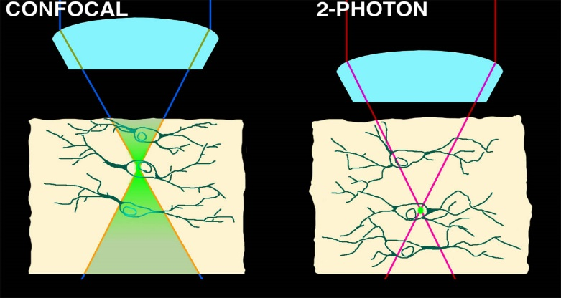
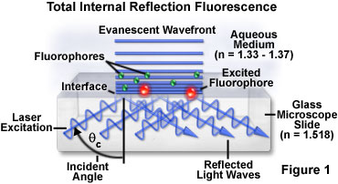
For light microscopy, how do we deal with scattering and absorption?
Histology
Transparent embryos
Transparent adult
Transparent adult
Longer wavelengths
Only image surface

Slide 11
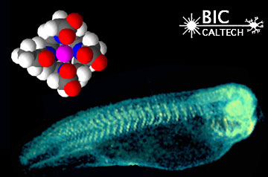
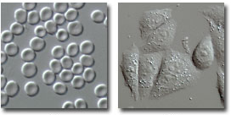
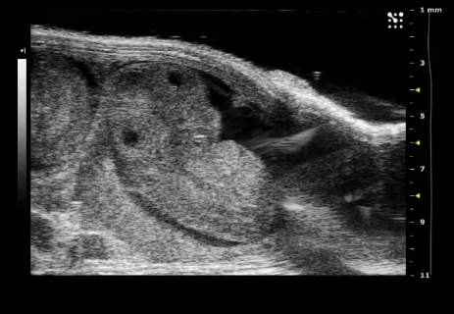
For light microscopy, how do we deal with scattering and absorption?
Cell culture transparent
MRI
Ultrasound
Notes:
http://www.olympusmicro.com/primer/techniques/dic/dicphasecomparison.html
http://umanitoba.ca/faculties/medicine/units/cacs/sam/8479.html

Slide 12
For light microscopy, how do we deal with scattering and absorption?
Histology: Fixing and sectioning
Only look at the surface of samples
Only look at transparent samples
Clearing: make our samples transparent
Use longer wavelengths, better penetration but not without its problems
Use a different imaging modality, ultrasound or MRI
Adaptive optics: stick with visible light but fix problem

Slide 13
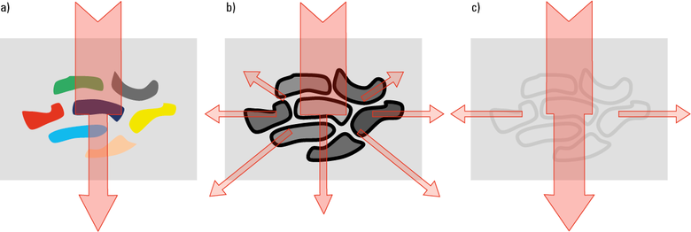
Obstacles to transparency
Absorption and scattering
Differences in refractive index
Notes:
Fig. 2: a) Low transparency through absorbing pigments; b) Low transparency due to effective scattering at surfaces with changing refractive index; c) High transparency after equalization of refractive indices.
http://www.leica-microsystems.com/science-lab/clearing-procedures-for-deep-tissue-imaging/

Slide 14
Refraction - the bending of light as it passes from one material to another.
Snell’s Law: η1 sin θ1 = η2 sin θ2
θ1
θ2
θ1
n₁
n₂
n₁

Slide 15
Scattering worsens as go deeper into tissues
Causes distortions along Z-axis even with optical sectioning as seen with Confocal microscopy
Matching refractive index (η) of objective to the media containing specimen helps to avoid Z-axis artifacts
η = speed of light in vacuum /speed in medium
Material Refractive Index
Air 1.0003
Water 1.33
Glycerin 1.47
Immersion Oil 1.518
Glass 1.52
Diamond 2.42

Slide 16
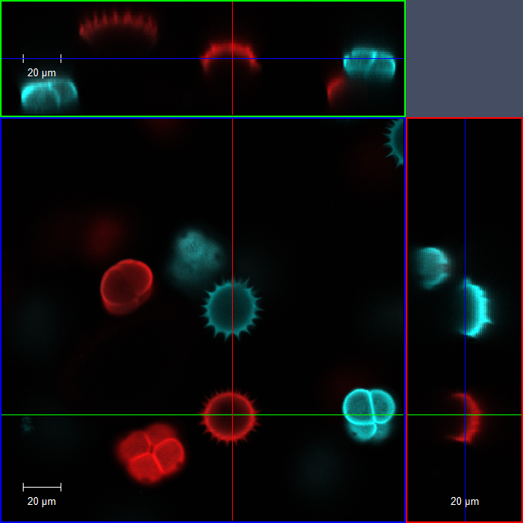
Matching refractive index (η) and increasing numerical aperture (N.A.) to avoid Z-axis distortions
20x Dry
0.8 NA
Notes:
20x objective zoomed 2x for 40x equivalent image

Slide 17
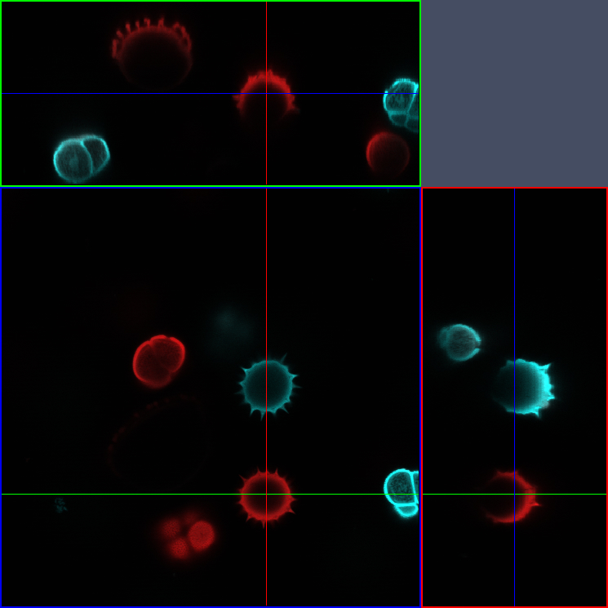
Matching refractive index (η) and increasing numerical aperture (N.A.) to avoid Z-axis distortions
40x Oil
1.3 NA

Slide 18
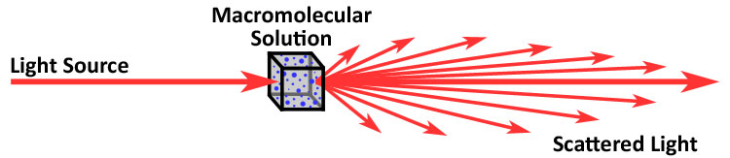
But objective can correct for only a few changes in refractive index
Biological samples, especially thick ones, can have a wealth of different refractive indices
Macromolecular samples great at scattering light
Notes:
In fact scattering most precise way to measure molecular weight of macromolecules
http://www.polyanalytik.com/gpc-light-scattering.php

Slide 19
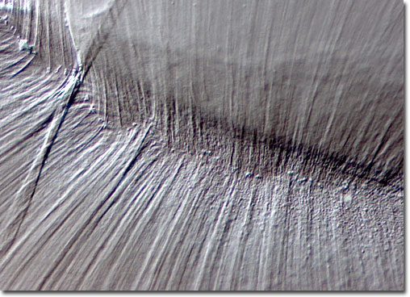
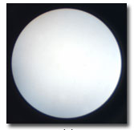
Kohler illumination can help minimize scattering
Important for DIC (Nomarski) microscopy and maximizing resolution
Aperture only crucial if your sample fills the whole field of view.
Condenser aperture must be opened to just within field of view. Can you tell why?
Notes:
http://www.olympusmicro.com/primer/techniques/dic/dicphasecomparison.html

Slide 20
Obstacles to transparency
Absorption by pigments
Differences in refractive index
Which is the more challenging problem?
Notes:
Fig. 2: a) Low transparency through absorbing pigments; b) Low transparency due to effective scattering at surfaces with changing refractive index; c) High transparency after equalization of refractive indices.
http://www.leica-microsystems.com/science-lab/clearing-procedures-for-deep-tissue-imaging/

Slide 21
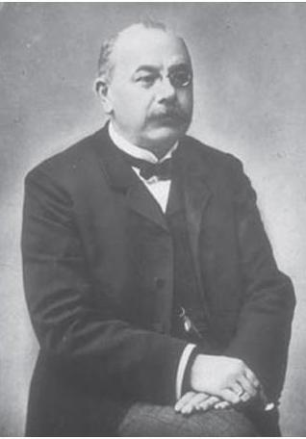
Clearing tissues goes back to 1914
Werner Spalteholz was German anatomist who developed first clearing protocol
Treatment with benzyl alcohol and methyl salicylate
Werner Spalteholz
(1861-1940)
Notes:
Shultze in 1897 first did clearing with KOH
http://www.leica-microsystems.com/science-lab/clearing-procedures-for-deep-tissue-imaging/#c135933
http://translate.google.com/translate?hl=en&sl=de&tl=en&u=http%3A%2F%2Fde.wikipedia.org%2Fwiki%2FWerner_Spalteholz

Slide 22
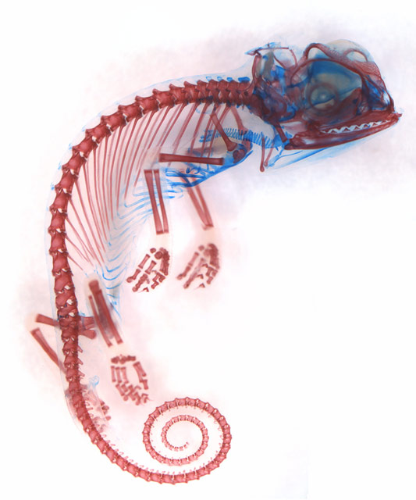
Cleared and stained specimens
Alizarin red labels bone, alcian blue labels cartilage
Popular skeletal preparation
Long used by Anatomists and Systematists
6th Place in 2013 Nikon Photo Competition
Dorit Hockman
Notes:
http://www.nikonsmallworld.com/people/image/dorit-hockman/1
Chamaeleo calyptratus (veiled chameleon) embryo showing cartilage (blue) and bone (red)
- see: Bone
Technique:
Brightfield

Slide 23
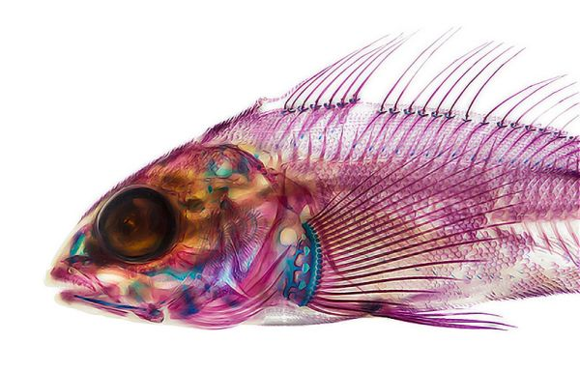
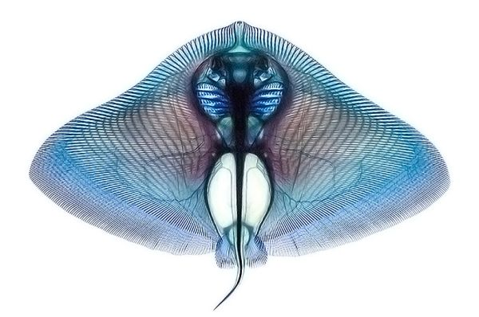
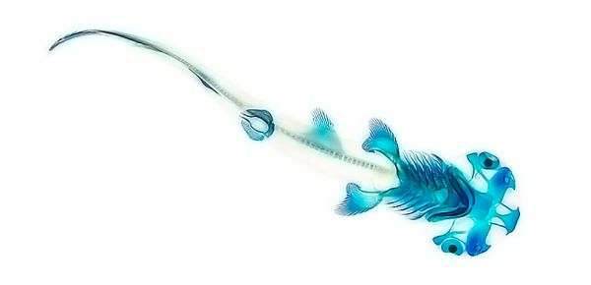
Cleared and stained specimens
Technique goes back to at least the 1930’s
Modern protocol from Dingerkus and Uhler (1977)
Important because allowed study of intact internal skeleton
Notes:
http://randommization.com/2014/01/03/dyed-fish-show-anatomy/
http://bestiarumosteo.blogspot.com/2014/02/clearing-and-staining_27.html
http://archive.org/stream/clearingstaining04davis/clearingstaining04davis_djvu.txt

Slide 24
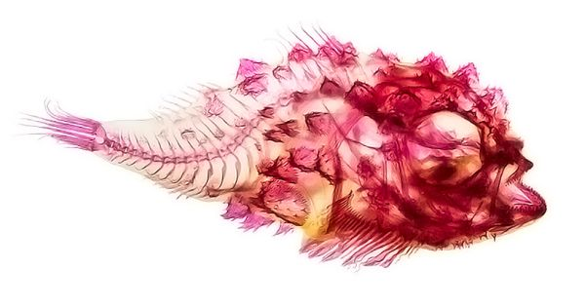
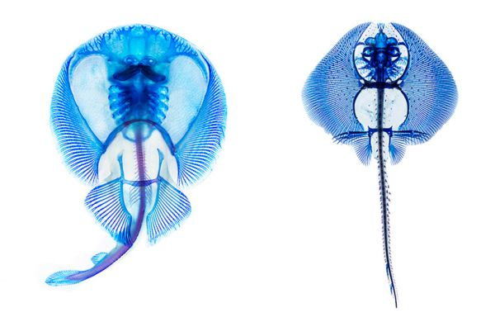
Cleared and stained specimens
Make animals transparent with strong alkali solution (KOH) and glycerin
Remove pigment with hydrogen peroxide, ultra-violet light, or other bleaching agents
Embryos and larva fast but adults can take weeks
Notes:
http://randommization.com/2014/01/03/dyed-fish-show-anatomy/
Marks, S.B., Collazo, A., 1998. Direct development in Desmognathus aeneus (Caudata : Plethodontidae): A staging table. Copeia, 637-648.
http://archive.org/stream/clearingstaining04davis/clearingstaining04davis_djvu.txt

Slide 25
Clearing techniques
Major task of clearing methods is to "equalize" the refractive index without destroying 3D structure and without degradation of possibly present fluorochromes.

Slide 26
How to reduce refractive index differences
Remove water and replace it with an organic compound that has a higher refractive index
Increase refractive index of aqueous phases by adding water-soluble compounds, such as glucose, fructose or urea.
Replace water with polar solvents with higher refractive index
Notes:
http://www.leica-microsystems.com/science-lab/clarity/clearing-procedures-for-deep-tissue-imaging/

Slide 27
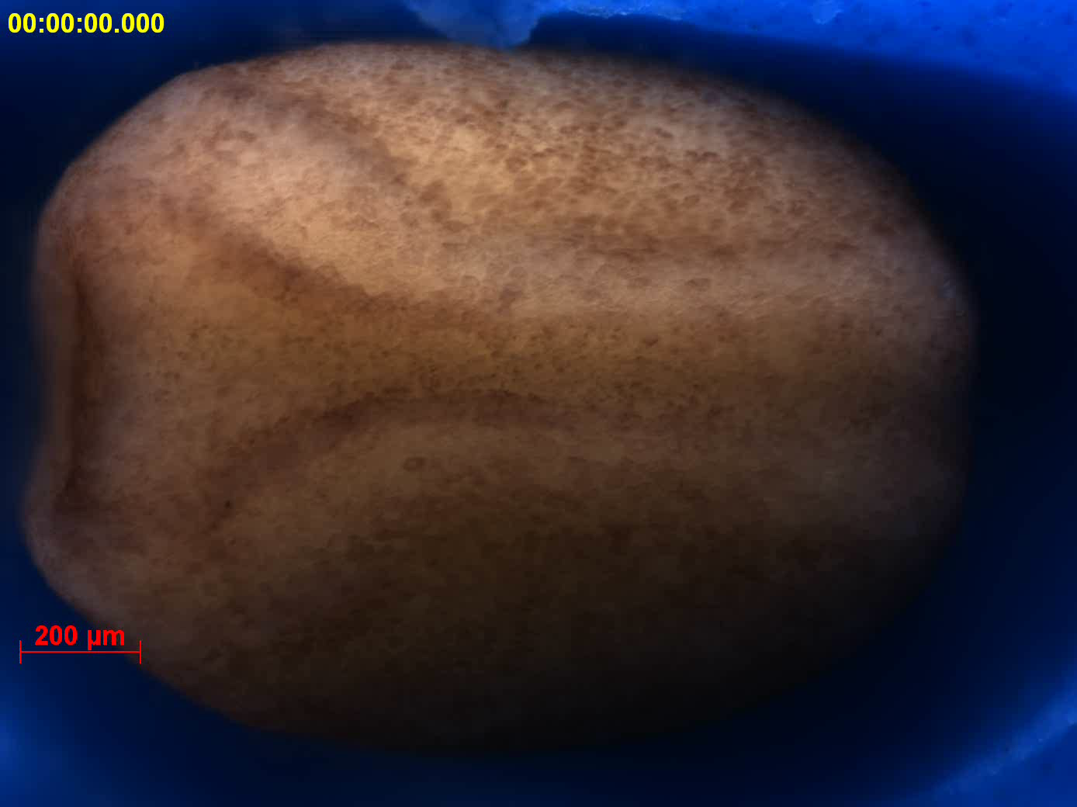
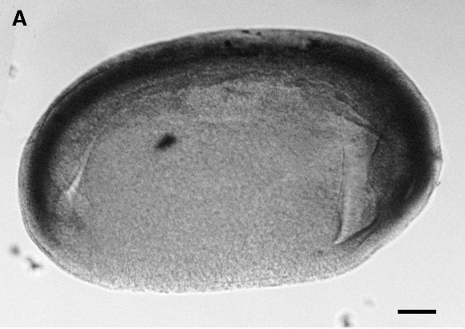
Remove water and replace it with an organic compound that has a higher refractive index
Benzyl alcohol and benzylbenzoate (BABB)
Dibenzyl ether (DBE)
Dehydrate with ethanol or tetrahydrofuran
Notes:
Xenopus embryos not very transparent
Hemmatibrivanlou, A., Frank, D., Bolce, M.E., Brown, B.D., Sive, H.L., Harland, R.M., 1990. Localization of Specific Messenger-Rnas in Xenopus Embryos By Whole-Mount Insitu Hybridization. Development 110, 325-Continues.
Hemmati-Brivanlou, A., Frank, D., Bolce, M.E., Brown, B.D., Sive, H.L., Harland, R.M., 1990. Localization of specific mRNAs in Xenopus embryos by whole-mount in situ hybridization. Development 110, 325-330.

Slide 28
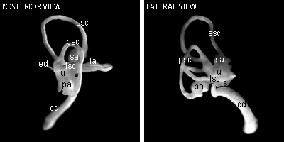
Remove water and replace it with an organic compound that has a higher refractive index
Solvent | Refractive Index (η)
Water | 1.33
BABB | 1.56
Methyl salicylate | 1.52
Dibenzyl ether | 1.56
2,2’-thiodiethanol | 1.52
Glycerol | 1.47
Notes:
http://www.nature.com/neuro/journal/v16/n8/full/nn.3447.html

Slide 29
Benzyl alcohol and benzylbenzoate (BABB) can preserve some fluorophores
Collaboration with Eric Birgbauer, Winthrop University
Notes:
Retino-tectal projections in whole Chicken brains. Collaboration with Eric Birgbauer, Winthrop University

Slide 30
Comparison of clearing methods
(from iDISCO paper)
Method¹ | Year | Main clearing & refractive index matching agents | Cost² | Clearing capability | Ease of implementation | Time to clear | Compatibility with immunostaining
ScaleA2 | 2011 | Urea | Inexpensive | Good | Very easy | Months | May be limited³
ClearT2 | 2012 | Formamide | Inexpensive | Moderate | Very easy | 1 day | Compatible
3DISCO | 2012 | Benzyl Ether | Inexpensive | Very good | Very easy | 1 day | Compatible
CLARITY | 2013 | SDS & Focusclear | More expensive⁴ | Good | More difficult⁴ | Weeks⁴ | May be limited³
SeeDB | 2013 | Fructose | Inexpensive | Moderate | Moderate⁵ | Several days | Compatible
CUBIC | 2014 | Multiple Compounds | Inexpensive | Not fully tested | Moderate⁵ | Weeks | Not fully tested
Renier, N., Wu, Z., Simon, David J., Yang, J., Ariel, P., Tessier-Lavigne, M., 2014. iDISCO: A Simple, Rapid Method to Immunolabel Large Tissue Samples for Volume Imaging. Cell 159, 896-910.
Notes:
1 References: ScaleA2 (Hama et al., 2011), 3DISCO (Ertürk et al., 2012a; 2012b; 2014), ClearT2
(Kuwajima et al., 2013), SeeDB (Ke et al., 2013), CLARITY (Chung et al., 2013; Tomer et al.,
2014; Yang et al., 2014), and CUBIC (Susaki et al., 2014).
2 We considered adult mouse brain a typical sample. Cost was considered inexpensive if clearing
can be achieved for less than $10 per sample, expensive for more than $100 per sample.
3 ScaleA2 and CLARITY may have limited compatibility with immunostaining due to the use of
urea and SDS, respectively, to which some antigens may be sensitive. For example, although
antibodies to TH, parvalbumin, GFAP, Iba1, Integrin 4 and -tubulin have been shown to be
compatible with CLARITY (Tomer et al., 2014; Yang et al., 2014), when we tested antibodies to
parvalbumin (Swant PV 25) and to six other antigens (GFP (Invitrogen A11122); FoxP2 (Abcam
ab16046); CaBP (Swant 300); ChAT (Millipore AB144P); NeuN (Millipore MAB377); and
vGluT2 (Millipore AB2251)) in the original CLARITY protocol, only that to parvalbumin
provided any signal in our hands. Whether these protocols are compatible in immunostaining
with a broad range of antigens remains to be explored more fully.
4 For CLARITY, our evaluation was mostly performed with the original protocol, which is
difficult to implement because of the need for custom electrophoresis equipment, and expensive
due to the large amounts of SDS needed and the cost of the mounting medium. Recent
modifications of the protocol (Tomer et al., 2014; Yang et al., 2014) used passive diffusion
rather than electrophoresis, which in our hands does indeed facilitate implementation but also
extends treatment significantly for large samples (~5-6 weeks for an adult brain), and so is
particularly useful for small samples. (Yang et al., 2014) also replace electrophoresis with
perfusion in a semi-intact preparation (which appears easier to implement and requires less SDS
solution) and describe a less expensive alternative to the final mounting medium (thereby
reducing expense); as that paper was published only recently, we have not yet had the
opportunity to evaluate those advances directly.
5 SeeDB and CUBIC are considered moderately difficult to implement owing to the difficulty of
preparing the clearing solutions to achieve optimal results. As well, the viscosity of the SeeDB
solution makes it difficult to handle the samples during imaging, especially in the SeeDB37
protocol, which requires heating during imaging.

Slide 31
DISCO methods use organic solvent
(Dibenzyl ether, DBE)
3DISCO (3D imaging of solvent-cleared organs)
iDISCO (immunolabeling-enabled three-dimensional imaging of solvent-cleared organs)
uDISCO (ultimate DISCO)
  Shrinkage good
Pan, C., Cai, R., Quacquarelli, F.P., Ghasemigharagoz, A., Lourbopoulos, A., Matryba, P., Plesnila, N., Dichgans, M., Hellal, F., Erturk, A., 2016. Shrinkage-mediated imaging of entire organs and organisms using uDISCO. Nat Methods 13, 859-867.
Collaboration with Adam Kimbrough in George Lab, The Scripps Research Institute
Notes:
Drug effects on mouse brain c-fos expression.
Collaboration with Adam Kimbrough in George Lab, The Scripps Research Institute

Slide 32
How to reduce refractive index differences
Remove water and replace it with an organic compound that has a higher refractive index
Increase refractive index of aqueous phases by adding water-soluble compounds, such as glucose, fructose or urea.
Replace water with polar solvents with higher refractive index
Notes:
http://www.leica-microsystems.com/science-lab/clarity/clearing-procedures-for-deep-tissue-imaging/

Slide 33
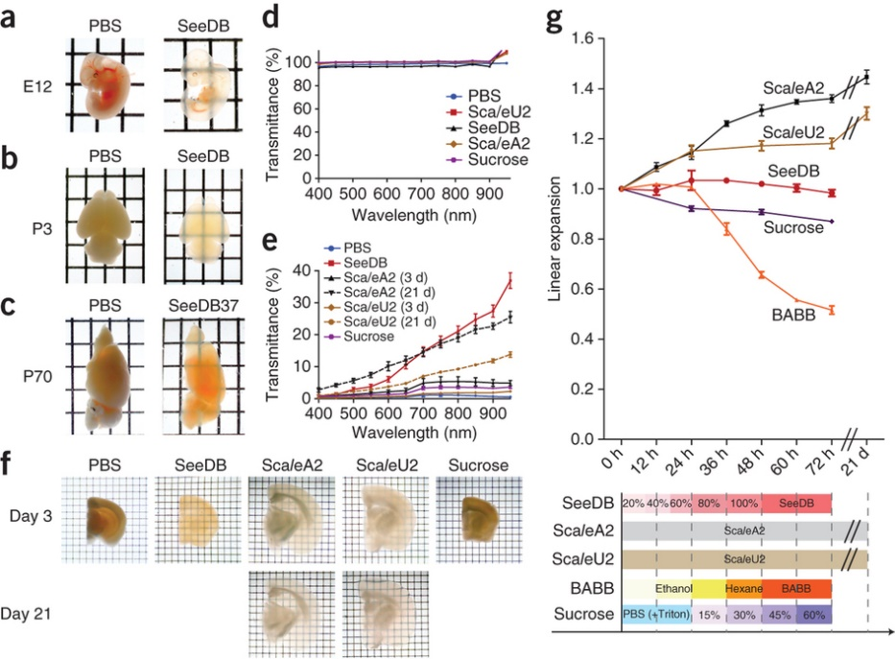
Increase refractive index of aqueous phases by adding water-soluble compounds
Sucrose
Fructose (SeeDB)
  Reaches 1.490 at 25 °C and 1.502 at 37 °C
Urea (Sca/e)
  Refractive indices 1.382, 1.387 and 1.380 at 589, 486 and 656 nm
Notes:
SeeDB (See Deep Brain)
(a) Whole embryos (E12) were cleared with SeeDB using a 3-d clearing protocol (g, bottom). (b) Neonatal (P3) whole-brain samples cleared with SeeDB (using an optimized protocol for neonatal brain, SeeDBp; Supplementary Fig. 4). SeeDB-treated samples kept their original morphology, whereas those treated with ScaleA2 often fell apart during incubation because ScaleA2 causes tissue sample fragility (data not shown). (c) Adult hemi-brain samples (P70) cleared with SeeDB37. The images presented in a–c are transmission images. (d) Transmittance curves of various clearing agents (mean ± s.e.m., n = 3 measurements). (e) Transmittance curves of mouse brain samples cleared with various clearing agents. Myelinated structures in adult brain cause non-homogeneous scattering; we used P21 mouse hemi-forebrain samples because they showed more homogeneous scattering. Transmittance was measured along the medial-lateral axis (the thickest part), which was 5.13 ± 0.19 mm (mean ± s.d., n = 3 hemi-forebrains) before clearing. Data are presented as the mean ± s.e.m. (n = 3 hemi-forebrains each). (f) Adult brain slices (P66, 1.5 mm thick) cleared with various clearing agents (transmission images). Note that white matter was fully cleared with SeeDB, but not with ScaleA2 or ScaleU2. (g) Sample expansion and shrinkage during the optical clearing. Hemi-forebrain samples (P21) were cleared with SeeDB, ScaleA2, ScaleU2, sucrose or BABB according to the timeline shown at the bottom. Optical clearing using ScaleA2 caused ~150% sample expansion per dimension. BABB caused ~50% linear sample shrinkage. In contrast, optical clearing with SeeDB did not cause obvious changes in sample volumes. Error bars indicate s.e.m. (n = 3 hemi-forebrains each). Grids are 2.6 × 3.2 mm (a–c) and 1 × 1 mm (f).

Slide 34
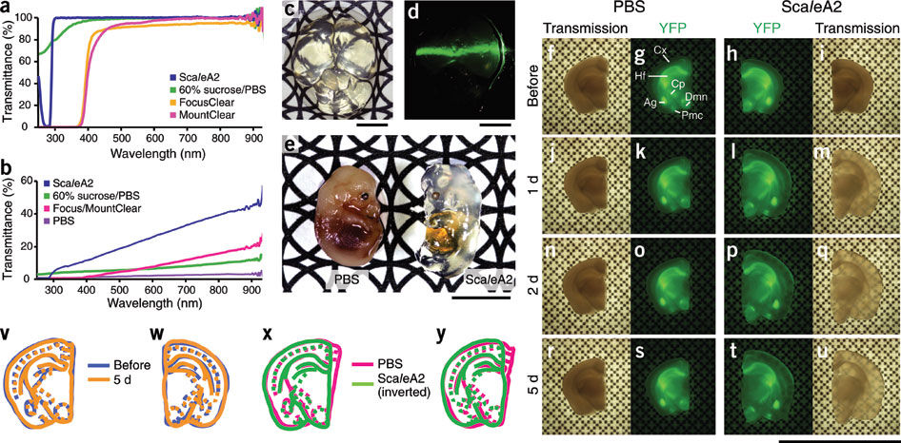
Increase refractive index of aqueous phases by adding water-soluble compounds
ScaleA2, composed of 4 M urea, 10% glycerol and 0.1% Triton X-100
Notes:
http://www.nature.com/neuro/journal/v14/n11/full/nn.2928.html

Slide 35
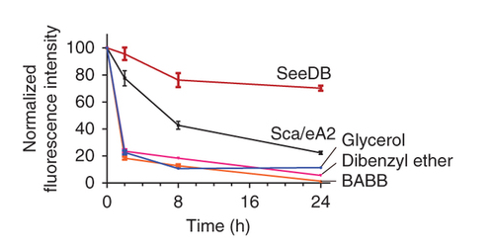
Increase refractive index of aqueous phases by adding water-soluble compounds
Advantages
  Does not shrink tissue
  Preserves fluorescence

Slide 36
How to reduce refractive index differences
Remove water and replace it with an organic compound that has a higher refractive index
Increase refractive index of aqueous phases by adding water-soluble compounds, such as glucose, fructose or urea.
Replace water with polar solvents with higher refractive index
Notes:
http://www.leica-microsystems.com/science-lab/clarity/clearing-procedures-for-deep-tissue-imaging/

Slide 37
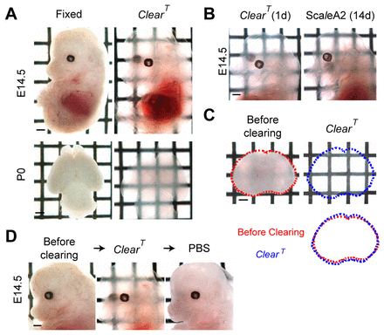
Replace water with polar solvents with higher refractive index
ClearT uses incubation with Formamide (η = 1.45)
Another variant ClearT² adds Polyethylene glycol to preserve GFP fluorescence
Notes:
http://dev.biologists.org/content/140/6/1364.full

Slide 38
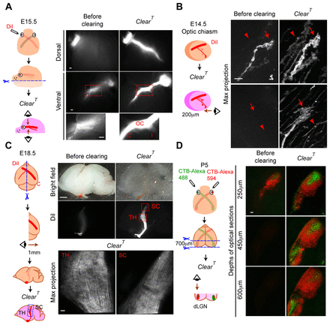
Replace water with polar solvents with higher refractive index
Advantages
  Preserves lipids because no detergent
  So lipophilic carbocyanine dyes (DiI) are retained
  Does not change tissue volume
  Fast
Notes:
http://dev.biologists.org/content/140/6/1364.full

Slide 39
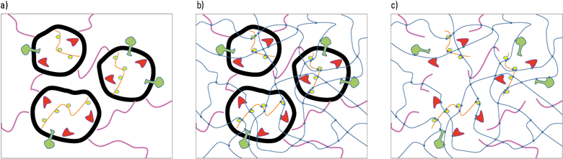
CLARITY is one of the newest clearing protocols
Make tissues transparent without destroying proteins
Notes:
Fig. 3: a) Biological tissue with membranes (thick black lines) supporting the spatial distribution of proteins (colored). b) After perfusion with polymer components, the proteins are pinned to a hydrogel (thin blue lines) with crosslinks (blue dots). c) After removal of the membranes, the tissue is transparent and even permeable to macromolecules, e.g. antibodies and fluorochromes. The proteins and other biomolecules are fixed to their in-vivo coordinates.

Slide 40
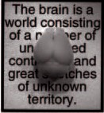
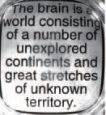
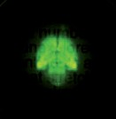
ARTICLE
doi:10.1038/nature12107
Structural and molecular interrogation of intact biological systems
Kwanghun Chung^{1,2}, Jenelle Wallace¹, Sung-Yon Kim¹, Sandhiya Kalyanasundaram², Aaron S. Andalman^{1,2},
Thomas J. Davidson^{1,2}, Julie J. Mirzabekov¹, Kelly A. Zalocusky^{1,2}, Joanna Mattis¹, Aleksandra K. Denisin¹, Sally Pak¹, Hannah Bernstein¹, Charu Ramakrishnan¹, Logan Grosenick¹, Viviana Gradinaru² & Karl Deisseroth^{1,2,3,4}
YFP
Chung et al. Nature 2013

Slide 41
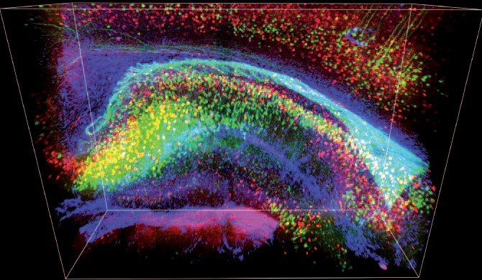
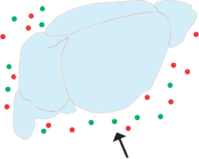
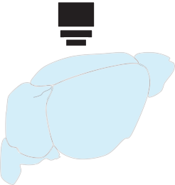
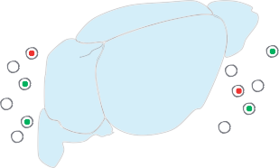
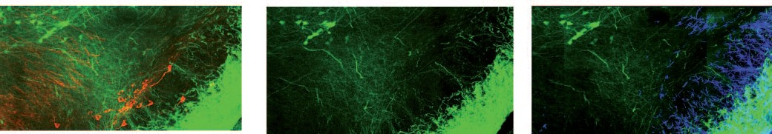
Compatible with immunostaining but
3D rendering
Cortex
Whole-tissue immunostaining
alv
CA1
Antibodies
DG
CA3
eYFP PV GFAP
Whole-tissue imaging
Detergent-mediated antibody removal
Projection
1st round e Projection
After elution f Projection
2nd round
SNR
eYFP TH
cp
eYFP TH (eluted)
eYFP GFAP
Chung et al. Nature 2013
Notes:
3 ScaleA2 and CLARITY may have limited compatibility with immunostaining due to the use of
urea and SDS, respectively, to which some antigens may be sensitive. For example, although
antibodies to TH, parvalbumin, GFAP, Iba1, Integrin 4 and -tubulin have been shown to be
compatible with CLARITY (Tomer et al., 2014; Yang et al., 2014), when we tested antibodies to
parvalbumin (Swant PV 25) and to six other antigens (GFP (Invitrogen A11122); FoxP2 (Abcam
ab16046); CaBP (Swant 300); ChAT (Millipore AB144P); NeuN (Millipore MAB377); and
vGluT2 (Millipore AB2251)) in the original CLARITY protocol, only that to parvalbumin
provided any signal in our hands. Whether these protocols are compatible in immunostaining
with a broad range of antigens remains to be explored more fully.

Slide 42
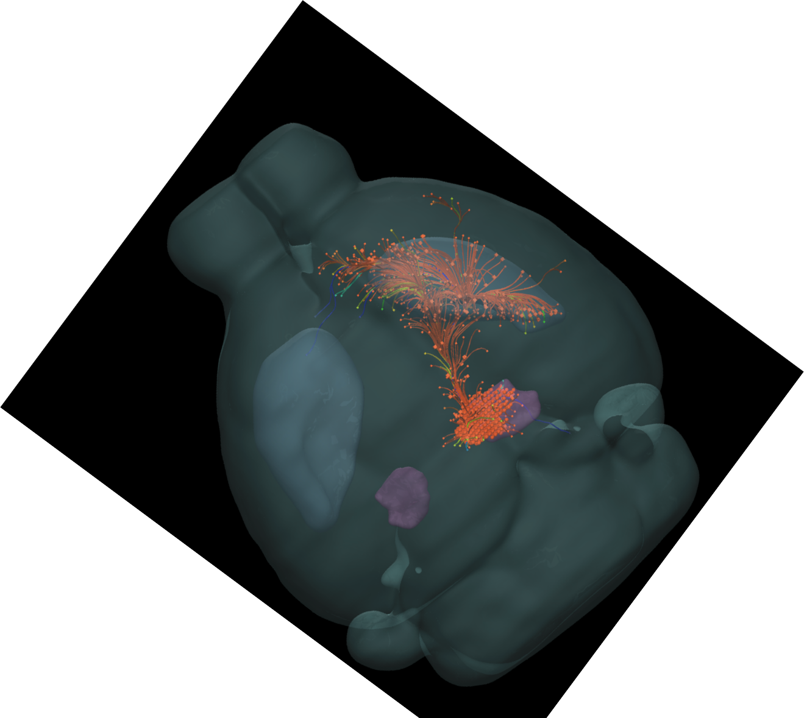
Motivation: circuit studies - tracing long-range axonal projections and single cell phenotyping
Allen Brain Explorer

Slide 43
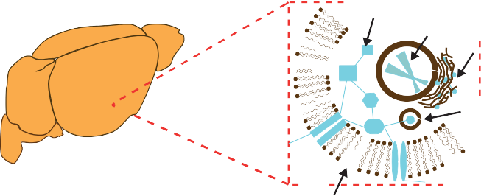

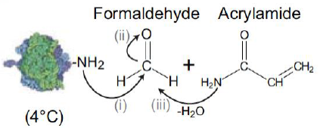

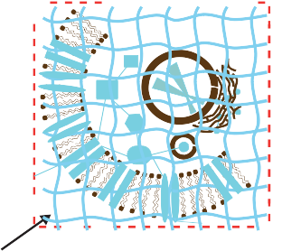

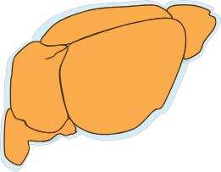

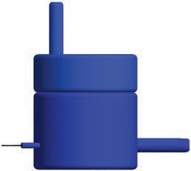





CLARITY: the basics
Step 1: hydrogel monomer infusion (days 1–3)
Proteins
+
2
o C
o
DNA
ER
+
H H
NH
NH
2
4 °C
Vesicle
Plasma membrane
NHCH₂NHCOC=C
Step 2: hydrogel–tissue hybridization (day 3)
CH CH₂
C O NHCH₂NH
NHCH₂NH
C O CH CH₂
37 °C
Hydrogel
Step 3: electrophoretic tissue clearing (days 5–9)
Temperature-controlled buffer circulator
Extracted lipids in SDS micelle
Top view: cut through
SDS micelle
Electrode
ETC
chamber
Buffer filter
Target tissue
Inlet port
Electrode connector
Electrode
Electrophoresis power supply
CLARITY for mapping the nervous system
Kwanghun Chung^{1,2} & Karl Deisseroth^{1–4}

Slide 44


Single-Cell Phenotyping within
Resource
Transparent Intact Tissue through Whole-Body Clearing
Bin Yang,¹ Jennifer B. Treweek,¹ Rajan P. Kulkarni,^{1,2} Benjamin E. Deverman,¹ Chun-Kan Chen,¹ Eric Lubeck,¹ Sheel Shah,¹ Long Cai,³ and Viviana Gradinaru^{1,}*
¹Division of Biology and Biological Engineering, California Institute of Technology, Pasadena, CA 91125, USA
²Division of Dermatology, Department of Medicine, David Geffen School of Medicine at UCLA, Los Angeles, CA 90095, USA
³Division of Chemistry and Chemical Engineering, California Institute of Technology, Pasadena, CA 91125, USA
*Correspondence: viviana@caltech.edu http://dx.doi.org/10.1016/j.cell.2014.07.017
without bisacrylamide
bisacrylamide
proteins
PACT- rapid clearing and staining of 1-2mm thick tissue slices
Yang et al. Cell 2013
Notes:
Figure S1.
PACT-Cleared A4P0 Tissue-Hydrogel Hybrid Using 8% SDS Shows Optimal Optical Transparency, Related to Figure 1, 3, and 4, and Table S2
(A–C) All samples were PACT cleared for 3 days. (A) Comparison of optical transparency of 3 mm mouse brain coronal blocks PACT cleared using different percentage of SDS and 10% sodium deoxycholate (arrows indicate incomplete clearing). (B) Scanning Electron Microscopy (SEM) images showing the pores of tissue hybridized with different hydrogel percentages; the histograms below indicate the distribution of the pore size for each condition. (C) Compared to A4P4, A4P0 tissue-hydrogel hybrids show greater tissue expansion and optical transparency (1 mm mouse brain slices). Samples for (B) and (C) were PACT cleared in 8% SDS. Images for (A) and (C) were taken using bright field camera.

Slide 45


PAssive CLARITY Technique (PACT)

Slide 46

Perfusion-assisted Agent Release in Situ (PARS)

Slide 47

Whole-body clearing and antibody delivery

Slide 48

CLARITY objective
LD SC Plan-Apochromat 20x/1.0 Corr M32
$$$$$

Slide 49


Adaptive optics: First used on telescopes
Improve performance of optical systems by reducing the effect of wavefront distortions:
Correct deformations of incoming wavefront by deforming a mirror in order to compensate for distortion
Notes:
"Deformable mirror correction" by 2pem - Own work. Licensed under CC BY-SA 3.0 via Wikimedia Commons - https://commons.wikimedia.org/wiki/File:Deformable_mirror_correction.svg#mediaviewer/File:Deformable_mirror_correction.svg
"Laser Towards Milky Ways Centre" by ESO/Yuri Beletsky (ybialets at eso.org) - no fallback page found for autotranslate (base=ESO-source/i18n, lang=en)This tag does not indicate the copyright status of the attached work. A normal copyright tag is still required. See Commons:Licensing for more information.. Licensed under CC BY 4.0 via Wikimedia Commons - https://commons.wikimedia.org/wiki/File:Laser_Towards_Milky_Ways_Centre.jpg#mediaviewer/File:Laser_Towards_Milky_Ways_Centre.jpg

Slide 50


Adaptive optics: Telescopes
First implemented in early 1990’s when computers advanced enough
MicroElectroMechanical Systems (MEMS) based deformable mirrors most widely used technology for wavefront shaping
Using natural or artificial guide stars
Notes:
"A Laser Strike at the Galactic Center" by Yuri Beletsky - NASA Astronomy Picture of the Day. Licensed under CC BY 4.0 via Wikimedia Commons - http://commons.wikimedia.org/wiki/File:A_Laser_Strike_at_the_Galactic_Center.jpg#mediaviewer/File:A_Laser_Strike_at_the_Galactic_Center.jpg
http://www.npr.org/2013/06/24/190986008/for-sharpest-views-scope-the-sky-with-quick-change-mirrors

Slide 51

Adaptive optics: from telescopes to microscopes?
Much easier for telescopes than for microscopes
Harder to compensate for biological tissues than for atmosphere
Approaches that don’t require wavefront sensor
Newest techniques do use wavefront sensor
Notes:
http://lyot.org/background/adaptive_optics.html

Slide 52

Adaptive optics for microscope
Problem of wavefront
Objective lens converts planar waves to spherical
Relatively simple change when no aberrations

Slide 53


Adaptive optics for microscope
(a) Schematic of focusing by a high-NA objective lens.
Principle of aberration correction: conjugate phase introduced in the back focal plane of objective is cancelled out by the specimen-induced aberrations
Booth M J Phil. Trans. R. Soc. A 2007;365:2829-2843
©2007 by The Royal Society
Notes:
(a) Schematic of focusing by a high-NA objective lens. Planar wavefronts in the pupil are converted into convergent spherical wavefronts in the focus. (b) The effects of focusing through a refractive index mismatch, where refraction at the interface distorts the wavefronts. (c) Focusing through a complex specimen, where refractive index variations introduce aberrations. (d) The principle of aberration correction—a conjugate phase introduced in the pupil is cancelled out by the specimen-induced aberrations.

Slide 54
Adaptive optics for microscope
No wavefront sensor
Using wavefront sensor
Retrieve information directly from image
Info on phase differences, multiple focal planes
Iterative process of optimization
Detector on other side of specimen
Shack-Hartman (SH) sensor (CCD or CMOS array with lenslets)
Near-infrared Guide star allows for deepest imaging (~700 μm)
Notes:
http://www.opticsinfobase.org/oe/fulltext.cfm?uri=oe-15-13-8176&id=138521

Slide 55
Adaptive optics for microscope
Two methods for adaptive optics without wavefront sensor
Search algorithm based
  Need information on aberrations and object structure
  Model free algorithm
Imaging based
  Predominantly independent of object structure
  Only need information on aberrations

Slide 56
Adaptive optics for microscope
Image based adaptive optics
  Modal: corrects wavefront across whole back focal plane of objective
  Zonal: wavefront measured and corrected in discreet zone
    Like astronomers.
Spatial light modulator for correcting wavefront

Slide 57


Spatial light modulator
Helps shape wavefront for adaptive optics
Notes:
Katz, O., Small, E., Silberberg, Y., 2012. Looking around corners and through thin turbid layers in real time with scattered incoherent light. Nat Photon 6, 549-553.
Figure 2 | Imaging through a highly scattering diffuser: experimental results. a,b, Images of a point source (50mm pinhole) placed 36.5 cm behind the
diffuser without correction (a, flat SLM phase pattern) and after optimizing the SLM phase pattern5 (b). The intensity enhancement obtained is h ≈ 800
(inset to b: optimized SLM phase pattern; the maximized applied phase is 3p). c, Conventional imaging through the diffuser with a colour camera
(inset: direct imaging without the diffuser). The object is a transmission plate of the letter ‘A’ illuminated by a white-light source (tungsten-halogen lamp).
d, Imaging of the same object through the diffuser using the optimized SLM phase-pattern. e, Same as d, but with the band-pass filter removed. The contrast
is reduced due to uncorrected spectral components27. f, As in d, but using spatially coherent monochromatic illumination (collimated HeNe laser beam) of a
40% smaller object. Speckle artefacts are apparent. Scale bars, 3 mm.
Figure 1 | Schematic of the experiment for imaging through thin scattering
layers. a, In conventional imaging, the image is formed by refocusing the
light from any point source at the object plane (at a distance u from the
lens) on the camera plane (at a distance v), using a lens. b, When a highly
scattering medium blocks the direct view of the object, the light from any
point source on the object is scattered, resulting in a diffuse light field and a
random speckle pattern on the camera. c, In the presented technique, an
SLM shapes the phase of the scattered light from a point source placed at a
distance R behind the medium, such that it interferes constructively at a
desired point on the camera and refocuses5. The SLM thus effectively
transforms the medium into a ‘scattering lens’ with focal length R. As result
of the memory effect17,18, the single wavefront correction is effective for
nearby points, and any object placed in the vicinity of the initial point-source
position is imaged directly on the camera in real time. A narrow-band-pass
filter (BP) rejects uncorrected wavelengths. Note that the lens in c is not
obligatory, because the scattering-medium/SLM combination can
directly generate the converging wave required for imaging. (The 4–f
telescope for imaging the SLM on the medium surface is not shown,
see Supplementary Fig. S1.)

Slide 58
Adaptive optics without wavefront sensor: Image based
Na Ji’s work applying image based zonal analysis
Faster
400 μm
Notes:
Ji, N., Milkie, D.E., Betzig, E., 2010. Adaptive optics via pupil segmentation for high-resolution imaging in biological tissues. Nat Meth 7, 141-147.
Supplementary Figure 2. Sketches illustrating our AO algorithm using three
independent subregions, creating three beamlets (blue rays). (a) Aberrated wavefront
(red) due to refractive index inhomogenieites (orange) leads to an aberrated image of a
reference bead. (b,c,d) Images acquired with the left, center, and right subregions,
respectively, permit the tilt of each beamlet to be measured from the displacement of
the bead. (e) Beamlets intersect at a common point, after appropriate compensatory
tilts are applied at the SLM. (f) Interference of left beamlet with central reference
beamlet, at several phase offsets (green sinsusoids) applied to the former, determines
the optimal phase offset (dashed aqua line); (g) Same procedure applied to the right
beamlet. (h) Final corrected wavefront (red) and recovered diffraction-limted focus.
An example with actual data showing the images and SLM patterns during the AO
correction with N = 36 subregions is given in Supplementary Movie 1. If phase
reconstruction is used, the phase measurement steps (f and g) are skipped, and the
optimal phase offset in each subregion is determined algorithmically.

Slide 59
Adaptive optics without wavefront sensor: Image based
Na Ji’s applied in living mouse brain.
450 μm
Notes:
Ji, N., Sato, T.R., Betzig, E., 2012. Characterization and adaptive optical correction of aberrations during in vivo imaging in the mouse cortex. Proc Natl Acad Sci U S A 109, 22-27.
Fig. 1. AO improves imaging quality in vivo: (A) schematic of the geometry for in vivo imaging in the mouse brain, showing the cranial window (green)
embedded in the skull (pink) to provide stability to the brain as well as optical access. (B) Lateral and axial images of a 2-μm-diameter bead 170 μm below
the brain surface before and after AO correction. (C) Axial signal profiles along the white line in B before and after AO correction. (D) Lateral and axial images
of GFP-expressing dendritic processes over a field centered on the bead in A. (E) Axial signal profiles along the white line in D. (F) Measured aberrated
wavefront in units of excitation wavelength. (G) Lateral and axial images of GFP-expressing neurons 110 μm below the surface of the brain with and without
AO correction. (H) Axial signal profiles along the white line in G. (I) Axial signal profiles along the blue line in G. (J) Aberrated wavefront measured in units of
excitation wavelength. (Scale bars: 2 μm in B and 10 μm elsewhere.)
Beads are from other paper:
Ji, N., Milkie, D.E., Betzig, E., 2010. Adaptive optics via pupil segmentation for high-resolution imaging in biological tissues. Nat Meth 7, 141-147.
Supplementary Figure 5. Applicability of AO correction for system aberration at one
point over a larger field of view. (a) Lateral image of a field of 500 nm diameter
fluorescent beads before AO correction. (b) Image of the same beads, after applying the
system correction determined from the central bead. (c) Lateral (X-Y) integrated
intensity projection obtained by summing the entire 3D image stack along the axial Z
direction. (d) Axial Z–Y intensity projection integrated along the lateral X direction.
Display gain of the left, uncorrected images in a-c is increased 4× in (c,d) to improve
visibility. Rotating integrated intensity projections distilled from the uncorrected and
corrected 3D image stacks are shown in Supplementary Movie 2. Scale bar: 2 μm.

Slide 60
Adaptive optics using wavefront sensor
This is the way to go
Shack-Hartman (SH) wavefront sensor
240 μm volume
Notes:
Wang, K., Milkie, D.E., Saxena, A., Engerer, P., Misgeld, T., Bronner, M.E., Mumm, J., Betzig, E., 2014. Rapid adaptive optical recovery of optimal resolution over large volumes. Nat Methods 11, 625-628.
(a) Spot pattern at the Shack‐Hartmann (SH) wavefront sensor, for a guide star fixed at a fluorescent
bead (blue circle in d), after passage through a C elegans embryo, 3 hours post fertilization (inset in a).
(b) Same, except after scanned excitation and de‐scanned detection (inset in b) over a larger sub‐region
(blue square in e). Numbered spots in a and b are compared in columns at right (left column, fixed; right
column, scan / de‐scan). (c) Maximum intensity projection (MIP) wide field image of a field of 200 nm
fluorescent beads through the embryo, without AO. MIP views of a specific bead (arrow) are also shown
in the x‐z (upper right) and y‐z (lower right) planes. (d) Same, except with AO provided by a guide star
fixed at the blue circle. Inset at lower left shows the wavefront calculated from the SH pattern in a. (e)
Same, except with AO provided by a guide star scanned over the blue rectangle, and then de‐scan of the
emission before the SH sensor. Inset at lower left shows the wavefront calculated from the SH pattern in
b. Note that de‐scan provides a better correction not only for beads across the entire field of view, but
also for the specific bead chosen as the target for the fixed guide star, since the local complexity of the
aberration there leads to complex speckle patterns at the SH sensor and thus an inaccurate
measurement of the wavefront. Scale bars, 2 m. Scale is the same in c, d and e.
Figure 3 | Two-color confocal imaging with AO provided by a descanned two-photon guide star deep in the living zebrafish brain. 3D volume rendering (left) of oligodendrocytes (magenta) and neuronal nuclei (green) from the optic tectum through the midbrain. MIPs before (center) and after (right) AO correction across four subvolumes spanning depths indicated by yellow boxes (left) demonstrate the recovery of diffraction-limited resolution throughout the 200-μm-deep imaging volume.

Slide 61
Adaptive optics using wavefront sensor
Instead of SLM can use deformable mirror like astronomers
Near infrared guide stars allows deeper imaging
700 μm volume
Notes:
indocyanine green, ICG
Wang, K., Sun, W., Richie, C.T., Harvey, B.K., Betzig, E., Ji, N., 2015. Direct wavefront sensing for high-resolution in vivo imaging in scattering tissue. Nat Commun 6, 7276.
Supplementary Figure 1| Guide stars of progressively longer wavelengths can be used for direct wavefront sensing at increasingly large depth in the cortex of the living mouse. Typical SH images of guide stars obtained at different depths by TPE of: YFP in sparsely labeled L5 pyramidal neurons (left column); tdTomato in densely labeled cortical neurons (middle column); and the directly injected ICG (right column) in the cortex of a living mouse.
Supplementary Figure 9| Experimental schematics. (a) Two photon scanning & AO mode: Near-infrared (NIR) pulsed excitation (red) is directed into the system by dichroic mirror D3, reflected off a deformable mirror, and scanned by a pair of galvanometer mirrors (Galvo X and Y) before entering the rear pupil of a 1.1 NA water-dipping objective. The deformable mirror, Galvos X and Y, and the objective rear pupil are all mutually conjugate, so that the phase pattern from the deformable mirror is stationary at the rear pupil even while scanning. The emitted visible signal fluorescence is collected by the objective, reflected from dichroic mirror D1, and focused onto a photomultiplier tube PMT1. The NIR fluorescence from the TPE guide star (orange) is descanned by the galvos, separated from the NIR excitation by dichroic beamsplitter D2, and then sent to a Shack-Hartmann (SH) sensor to determine the aberrated wavefront of the emission. (b) Confocal scanning mode: visible excitation light (blue) is reflected by dichroic mirror D4 and follows the same light path as NIR excitation to the objective. The emission retraces the excitation path, except that it transmits through dichroic mirror D4 and enters another photomultiplier tube PMT2 after going through a pinhole that is conjugated to the objective focus.

Slide 62


Adaptive optics using wavefront sensor
Instead of SLM can use deformable mirror like astronomers
Near infrared guide stars allows deeper imaging
700 μm volume
Notes:
http://www.alpao.com/adaptive-optics/deformable-mirrors.html
indocyanine green, ICG
Wang, K., Sun, W., Richie, C.T., Harvey, B.K., Betzig, E., Ji, N., 2015. Direct wavefront sensing for high-resolution in vivo imaging in scattering tissue. Nat Commun 6, 7276.
Supplementary Figure 1| Guide stars of progressively longer wavelengths can be used for direct wavefront sensing at increasingly large depth in the cortex of the living mouse. Typical SH images of guide stars obtained at different depths by TPE of: YFP in sparsely labeled L5 pyramidal neurons (left column); tdTomato in densely labeled cortical neurons (middle column); and the directly injected ICG (right column) in the cortex of a living mouse.
Supplementary Figure 9| Experimental schematics. (a) Two photon scanning & AO mode: Near-infrared (NIR) pulsed excitation (red) is directed into the system by dichroic mirror D3, reflected off a deformable mirror, and scanned by a pair of galvanometer mirrors (Galvo X and Y) before entering the rear pupil of a 1.1 NA water-dipping objective. The deformable mirror, Galvos X and Y, and the objective rear pupil are all mutually conjugate, so that the phase pattern from the deformable mirror is stationary at the rear pupil even while scanning. The emitted visible signal fluorescence is collected by the objective, reflected from dichroic mirror D1, and focused onto a photomultiplier tube PMT1. The NIR fluorescence from the TPE guide star (orange) is descanned by the galvos, separated from the NIR excitation by dichroic beamsplitter D2, and then sent to a Shack-Hartmann (SH) sensor to determine the aberrated wavefront of the emission. (b) Confocal scanning mode: visible excitation light (blue) is reflected by dichroic mirror D4 and follows the same light path as NIR excitation to the objective. The emission retraces the excitation path, except that it transmits through dichroic mirror D4 and enters another photomultiplier tube PMT2 after going through a pinhole that is conjugated to the objective focus.

Slide 63

Adaptive optics light paths
Notes:
Shack-Hartman (SH) wavefront sensor
(a) Essential components of our AO two-photon fluorescence microscope: Ti:Sapphire laser; optional dispersion compensation unit
(DCU); micromirror device (DMD) or segmented deformable mirror (SDM); field stop (FS) at an intermediate image plane between
SDM/DMD and liquid crystal spatial light modulator (SLM); X galvanometer (X galvo); Y galvanometer (Y galvo); a photomultiplier tube
(PMT). (b) The DCU unit is used with DMD, and consists of an anamorphic prism pair (APP) and an equilateral dispersive prism (EDP).
(c) Images and the signal profiles of a 2 μm diameter fluorescent bead in the XY focal plane without and with DCU; Scale bar: 2 μm. (d)
Two pupil-segmentation patterns used in this paper, where the active area of the SLM (colored squares) is inscribed to the back pupil of
the objective (dashed circles).
Wang, K., Sun, W., Richie, C.T., Harvey, B.K., Betzig, E., Ji, N., 2015. Direct wavefront sensing for high-resolution in vivo imaging in scattering tissue. Nat Commun 6, 7276.
Supplementary Figure 1| Guide stars of progressively longer wavelengths can be used for direct wavefront sensing at increasingly large depth in the cortex of the living mouse. Typical SH images of guide stars obtained at different depths by TPE of: YFP in sparsely labeled L5 pyramidal neurons (left column); tdTomato in densely labeled cortical neurons (middle column); and the directly injected ICG (right column) in the cortex of a living mouse.
Supplementary Figure 9| Experimental schematics. (a) Two photon scanning & AO mode: Near-infrared (NIR) pulsed excitation (red) is directed into the system by dichroic mirror D3, reflected off a deformable mirror, and scanned by a pair of galvanometer mirrors (Galvo X and Y) before entering the rear pupil of a 1.1 NA water-dipping objective. The deformable mirror, Galvos X and Y, and the objective rear pupil are all mutually conjugate, so that the phase pattern from the deformable mirror is stationary at the rear pupil even while scanning. The emitted visible signal fluorescence is collected by the objective, reflected from dichroic mirror D1, and focused onto a photomultiplier tube PMT1. The NIR fluorescence from the TPE guide star (orange) is descanned by the galvos, separated from the NIR excitation by dichroic beamsplitter D2, and then sent to a Shack-Hartmann (SH) sensor to determine the aberrated wavefront of the emission. (b) Confocal scanning mode: visible excitation light (blue) is reflected by dichroic mirror D4 and follows the same light path as NIR excitation to the objective. The emission retraces the excitation path, except that it transmits through dichroic mirror D4 and enters another photomultiplier tube PMT2 after going through a pinhole that is conjugated to the objective focus.

Slide 64
References for Adaptive Optics
Booth, M.J., 2007. Adaptive optics in microscopy. Philosophical transactions. Series A, Mathematical, physical, and engineering sciences 365, 2829-2843.
Ji, N., Milkie, D.E., Betzig, E., 2010. Adaptive optics via pupil segmentation for high-resolution imaging in biological tissues. Nat Meth 7, 141-147.
Katz, O., Small, E., Silberberg, Y., 2012. Looking around corners and through thin turbid layers in real time with scattered incoherent light. Nat Photon 6, 549-553.
Wang, K., Milkie, D.E., Saxena, A., Engerer, P., Misgeld, T., Bronner, M.E., Mumm, J., Betzig, E., 2014. Rapid adaptive optical recovery of optimal resolution over large volumes. Nat Methods 11, 625-628.
Wang, K., Sun, W., Richie, C.T., Harvey, B.K., Betzig, E., Ji, N., 2015. Direct wavefront sensing for high-resolution in vivo imaging in scattering tissue. Nat Commun 6, 7276.

Slide 65

Homework 4
The New Horizons probe has given us new insights on the dwarf planet Pluto. What color is the sky of Pluto and explain why in terms of scattering?
Hint – The particles that scatter light in the atmosphere of Pluto (Tholins) are considered to be small like the smaller light scattering particles in earth’s atmosphere.

