Slide 1
Biology 177: Principles of Modern Microscopy
Lecture 09:
Polarization and DIC
Andres Collazo, Director Biological Imaging Facility
Wan-Rong (Sandy) Wong, Graduate Student, TA

Slide 2
Lecture 9: Polarization and DIC
Review Contrast and Phase Contrast
Polarization
Birefringence
Nomarski (Differential Interference Contrast)
Resolution
Modulation transfer function

Slide 3
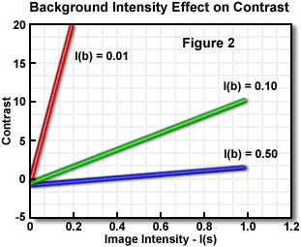
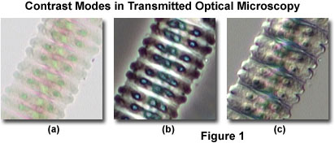
Contrast versus Resolution
Higher contrast easier to achieve with darker background
Bright-field
  Low contrast & high resolution
Phase,
  High contrast & loss in resolution
DIC,
  High contrast & resolution
Bright-field
Phase
DIC
Notes:
http://www.microscopyu.com/articles/formulas/specimencontrast.html

Slide 4
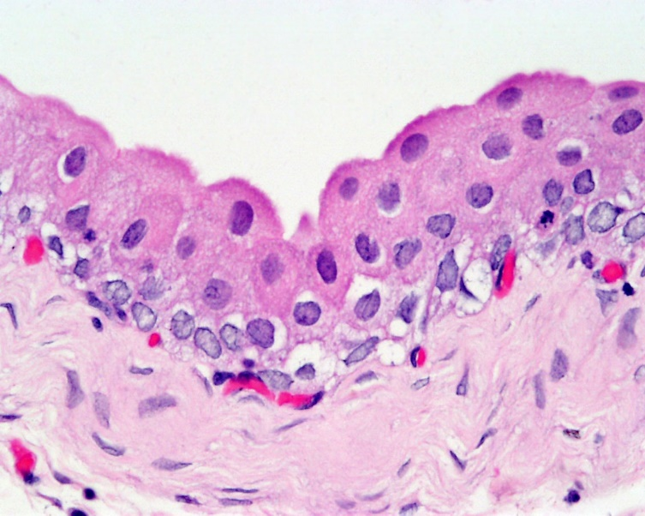
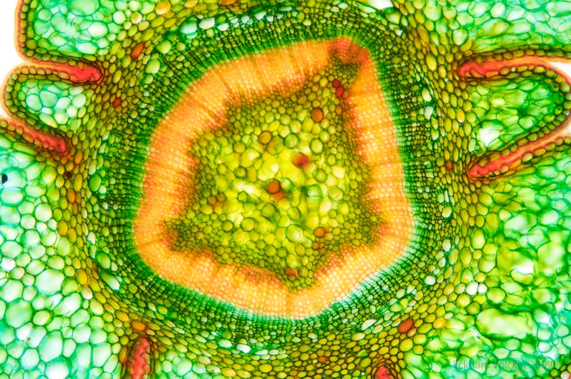
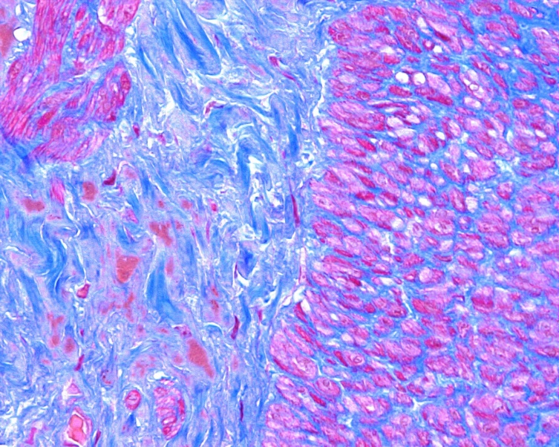
The First Contrast
Histological stains
Still important today
Notes:
Trichrome-uterusTrichrome-uterus.jpg
https://mit-ki.ilabsolutions.com/service_center/show_external/3170/histology-core-facility
Stained section of Taxus baccata, Sprout, 10x
https://www.flickr.com/photos/wunderkanone/4244591261/
File Bladder histology 004jpg Embryology
http://kuentir.biz/histology/histology-epithelial-hd.html

Slide 5
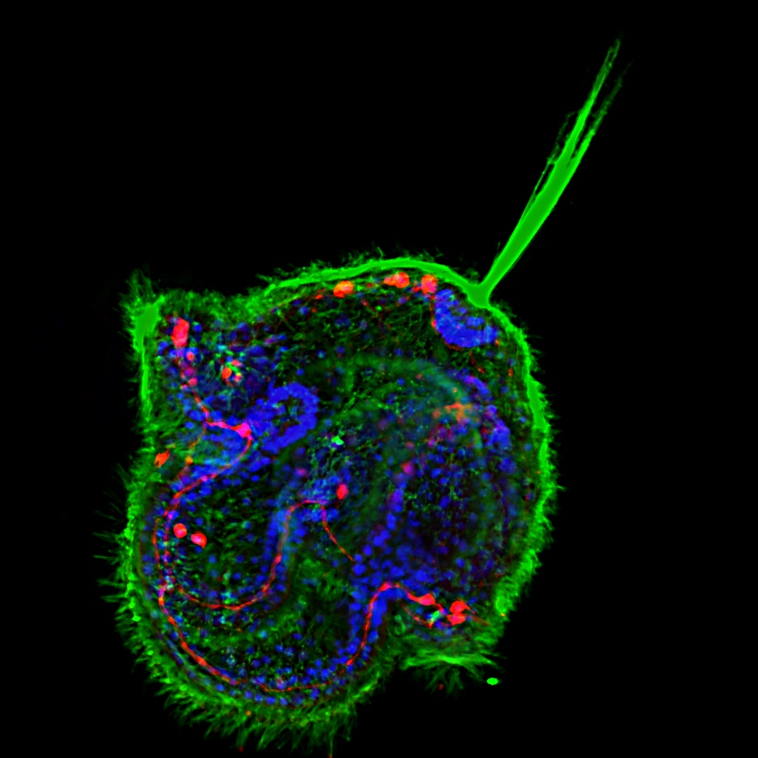
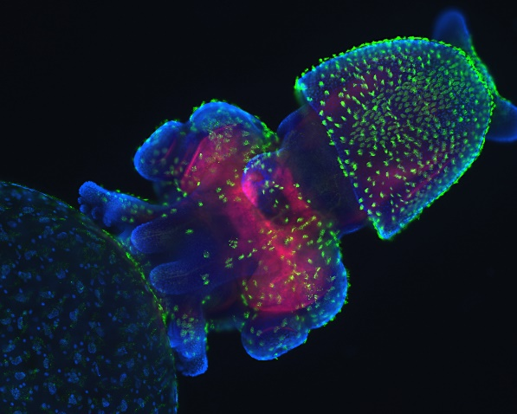
The Ultimate Contrast
Transparent specimen contrast
  Bright field 2-5%
  Phase & DIC 15-20%
  Stained specimen 25%
  Dark field 60%
  Fluorescence 75%
Notes:
Congratulations to Meii Chung of UT Austin, whose image of a Cerebratulus pilidium larva won first place in the latest voting round to choose a cover for Development from images taken by students of the 2010 Woods Hole Embryology course.
http://mblembryology.stowers.org/Development%20Covers.html
Confocal image of a squid embryo. All nuclei are stained with DAPI (blue). Phalloidin staining reveals neural structures (red), while cilia on the surface of the embryo are highlighted by acetylated tubulin staining (green). This image was taken by Davalyn Powell (University of Colorado Denver).

Slide 6
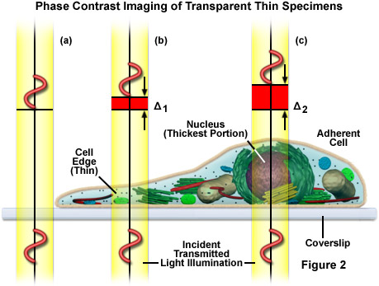
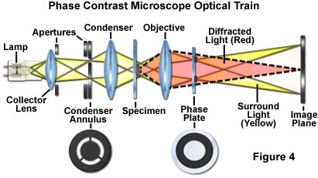
Phase contrast illumination
0 order Surround light is advanced
Diffracted light through specimen is retarded
Phase wave tutorial
S
D
D
Notes:
The most important parameter in the basic design of a phase contrast microscope is to isolate the surround and diffracted light waves emerging from the specimen so that they occupy different locations in the diffraction plane at the rear aperture of the objective. This interactive tutorial explores light pathways through a phase contrast microscope and dissects the incident electromagnetic wave into surround (S), diffracted (D), and resultant (particle; P) components. (from Nikon web site)
The image of a specimen in phase contrast can be influenced by appropriately selecting the retardation of the direct (non-diffracted) beam through careful selection of the phase ring in the objective. Depending on the retardation value selected, objects with a higher refractive index than their surroundings appear either brighter or darker than their surroundings. This is also called either positive or negative phase contrast. In modern microscopes, positive phase contrast is standard, where the darkness of object features increases with their refractive index. The effect simulates absorption to the observer's eye in areas where a higher refractive index produces high contrast features. This impression is considered the optimum, particularly with cells and tissue in aqueous media because cell nuclei and organelles, for example, appear darker than the cytoplasm. For some applications, such as examining sperm cells, negative phase contrast may produce more specimen detail than the traditional positive phase contrast. (from: http://zeiss-campus.magnet.fsu.edu/articles/basics/contrast.html)

Slide 7
Questions about last lecture?

Slide 8
Illumination Techniques - Overview
Transmitted Light
Bright-field
Oblique
Darkfield
Phase Contrast
Polarized Light
DIC (Differential Interference Contrast)
Fluorescence - not any more > Epi !
Reflected (Incident) Light
Bright-field
Oblique
Darkfield
Not any more (DIC !)
Polarized Light
DIC (Differential Interference Contrast)
Fluorescence (Epi)

Slide 9
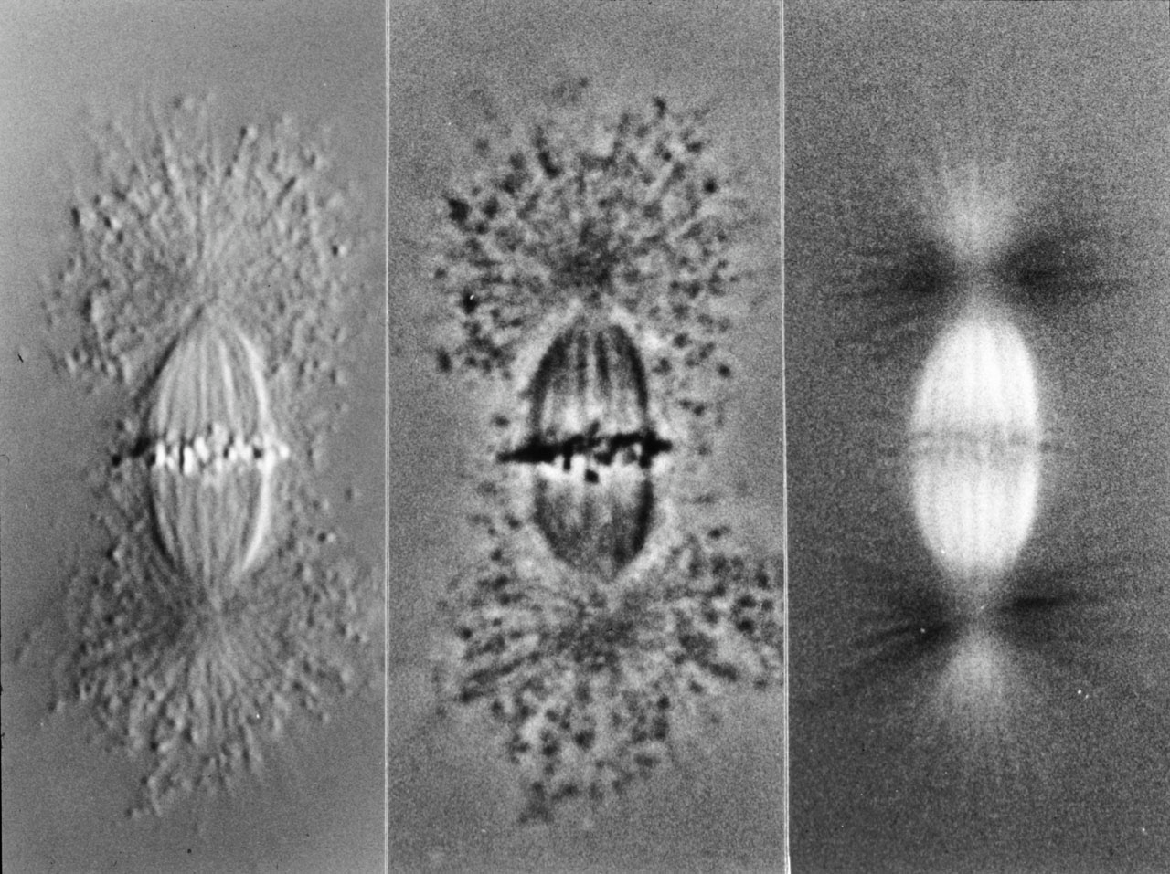
Different types of contrast
E. D. Salmon
Notes:
DIC, Phase, Polarized light
Sea urchin mitotic spindle
Ribosomal particles isotropic
https://www.ibiology.org/ibioeducation/taking-courses/polarization-microscopy.html
Edward D. Salmon from UNC

Slide 10
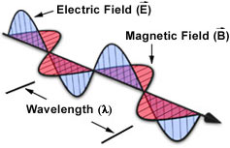
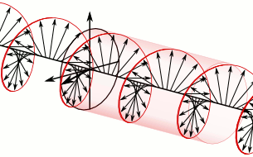
Polarized light
Unpolarized light waves oscillate in all directions (radial)
By convention, polarization refers to electric field
Linear polarization, confined to one plane
Circular polarization, electric field rotates
Notes:
https://en.wikipedia.org/wiki/Linear_polarization
In electrodynamics, elliptical polarization is the polarization of electromagnetic radiation such that the tip of the electric field vector describes an ellipse in any fixed plane intersecting, and normal to, the direction of propagation. An elliptically polarized wave may be resolved into two linearly polarized waves in phase quadrature, with their polarization planes at right angles to each other. Since the electric field can rotate clockwise or counterclockwise as it propagates, elliptically polarized waves exhibit chirality.

Slide 11
Polarized light
Circular polarization, rarely produced in nature
Notes:
In 1911, Albert Abraham Michelson discovered that light reflected from the golden scarab beetle Chrysina resplendens is preferentially left-polarized.
Chrysina resplendens
"Cetonia-aurata" by I, Chrumps. Licensed under CC BY-SA 3.0 via Wikimedia Commons - https://commons.wikimedia.org/wiki/File:Cetonia-aurata.jpg#mediaviewer/File:Cetonia-aurata.jpg
B

Slide 12
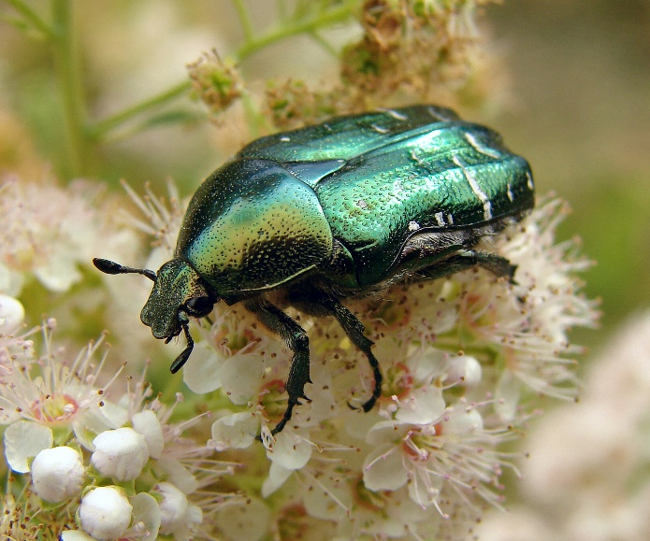
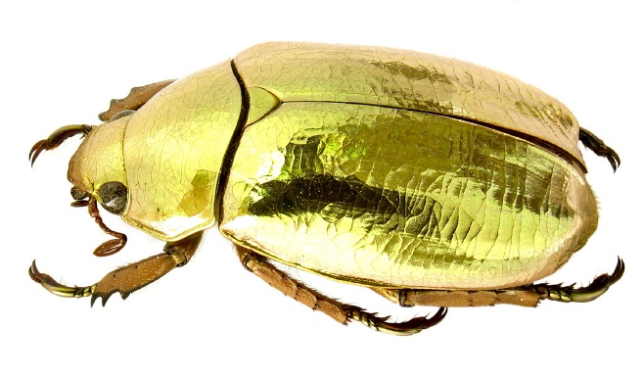
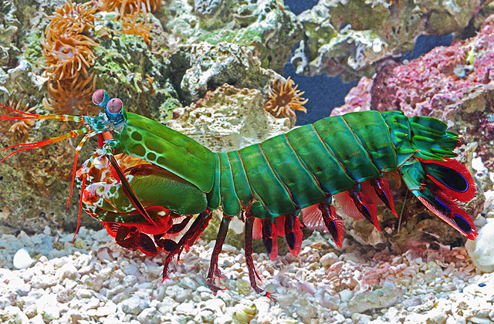
Polarized light
Circular polarization, rarely produced in nature
Can see on iridescent scarab beetles and Mantis shrimps
Mantis shrimps can see circularly polarized light
Notes:
In 1911, Albert Abraham Michelson discovered that light reflected from the golden scarab beetle Chrysina resplendens is preferentially left-polarized.
Chrysina resplendens
"Cetonia-aurata" by I, Chrumps. Licensed under CC BY-SA 3.0 via Wikimedia Commons - https://commons.wikimedia.org/wiki/File:Cetonia-aurata.jpg#mediaviewer/File:Cetonia-aurata.jpg
B

Slide 13
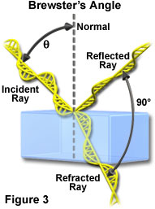
Polarized light
Radial light waves becomes polarized when reflected off surface at Brewster’s angle
Brewster’s angle ranges from 50° to 70° depending on surface material.
Used to polarize lasers
Notes:
For water (refractive index of 1.333), glass (refractive index of 1.515), and diamond (refractive index of 2.417), the critical (Brewster) angles are 53, 57, and 67.5 degrees, respectively. Light reflected from a highway surface at the Brewster angle often produces annoying and distracting glare, which can be demonstrated quite easily by viewing the distant part of a highway or the surface of a swimming pool on a hot, sunny day. Modern lasers commonly take advantage of Brewster's angle to produce linearly polarized light from reflections at the mirrored surfaces positioned near the ends of the laser cavity.

Slide 14
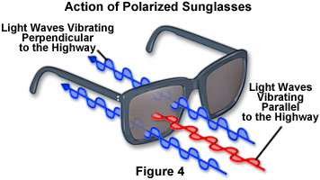
Polarized light
Radial light waves becomes polarized when reflected off surface at Brewster’s angle
Brewster’s angle ranges from 50° to 70° depending on surface material.
Used to polarize lasers
Why sunglasses horizontally polarized
Notes:
For water (refractive index of 1.333), glass (refractive index of 1.515), and diamond (refractive index of 2.417), the critical (Brewster) angles are 53, 57, and 67.5 degrees, respectively. Light reflected from a highway surface at the Brewster angle often produces annoying and distracting glare, which can be demonstrated quite easily by viewing the distant part of a highway or the surface of a swimming pool on a hot, sunny day. Modern lasers commonly take advantage of Brewster's angle to produce linearly polarized light from reflections at the mirrored surfaces positioned near the ends of the laser cavity.

Slide 15
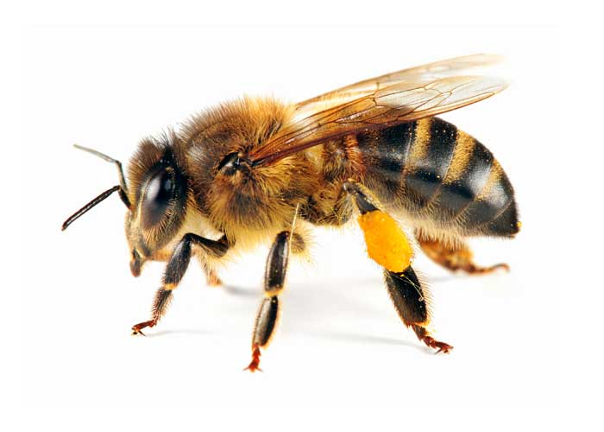
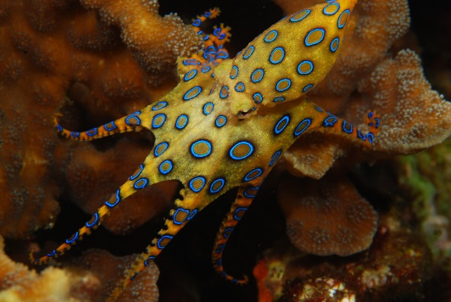
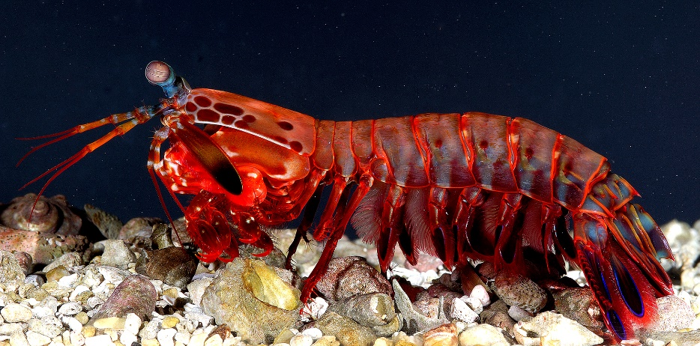
Polarized light
We cannot detect the polarization of light very well
But some animals can see polarized light
Many insects, octopi and mantis shrimps
Notes:
Bees use horizontally polarized light to orient relative to sun
Mantis shrimp can see 6 degrees of polarization

Slide 16
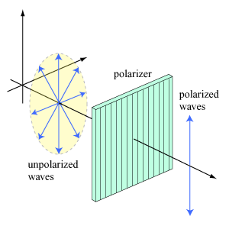
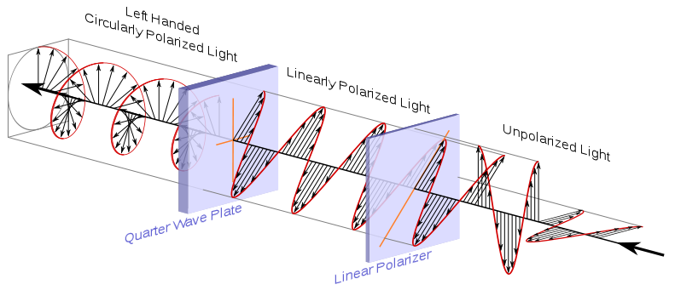
Polarized light
Polarizer is an optical filter passing light of a specific polarization while blocking waves of other polarizations
Notes:
https://en.wikipedia.org/wiki/Polarizer
"Circular.Polarization.Circularly.Polarized.Light Circular.Polarizer Creating.Left.Handed.Helix.View" by Dave3457 - Own work. Licensed under Public Domain via Wikimedia Commons - https://commons.wikimedia.org/wiki/File:Circular.Polarization.Circularly.Polarized.Light_Circular.Polarizer_Creating.Left.Handed.Helix.View.svg#mediaviewer/File:Circular.Polarization.Circularly.Polarized.Light_Circular.Polarizer_Creating.Left.Handed.Helix.View.svg

Slide 17
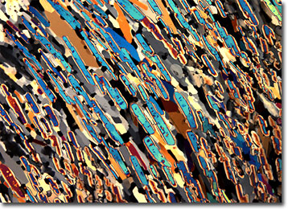
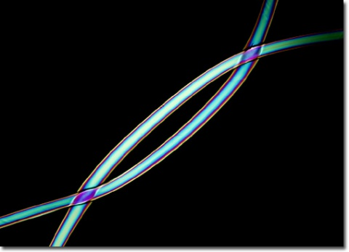
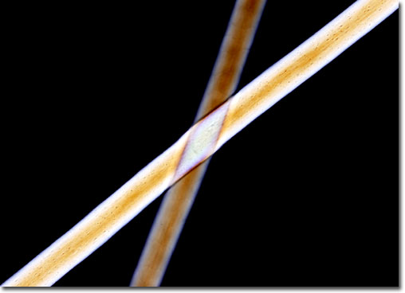
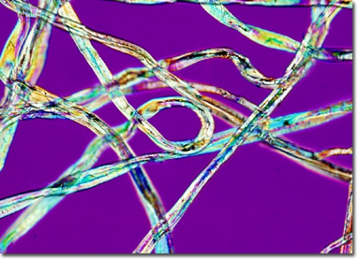
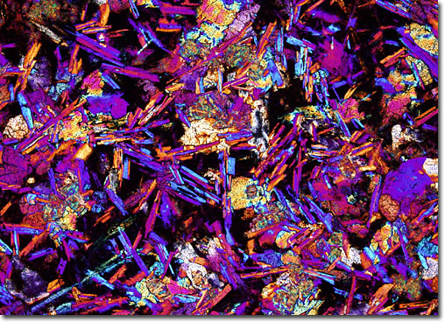
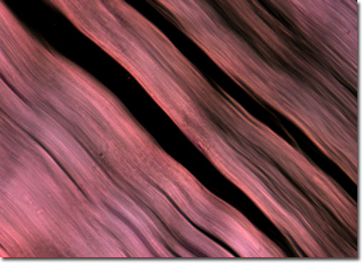
Polarized light microscopy
Highly specific detection of birefringent components
Orientation-specific
Less radiation than through other techniques such as fluorescence
Linear / circular Polarized Light
Differential Interference Contrast (DIC) uses polarized light
Notes:
http://micro.magnet.fsu.edu/primer/techniques/polarized/gallery/index.html
http://olympus.magnet.fsu.edu/galleries/polarizedlight/index.html
In 1831, beta-carotene was first isolated from the roots of carrots, but it was not until the Nobel prize-winning research of Paul Karrer in the early 1930s that the structure of the substance was determined. The earliest use of synthesized beta-carotene was as a food colorant, but during the 1980s the vitamin precursor’s growing reputation as an antioxidant and a possible cancer-fighter resulted in its frequent inclusion in vitamin supplements. Since that time, however, conflicting findings about the benefits of taking synthesized beta-carotene have surfaced.
Though highly desirable for many purposes, certain drawbacks to polypropylene use have limited its exploitation in some areas, such as the traditional textile industry. The fibers poor dyeability and texturizability, for instance, have played a significant role in the notable rarity of polypropylene in most clothing and apparel items. Other negative facets of the material are its low melting point, flammability, weak thermal stability, and poor adhesion to glues and latex. Though many of these problematic aspects may be significantly improved with the addition of other materials or by changing processing conditions, doing so is often a cost prohibitive action.
Typically smaller than other types of goats and sheep, the Angora goat is often said to have a gentle disposition. It breeds in autumn and has a gestation period of approximately 149 days. Through selective breeding, the ruminant’s outer coat of coarse guard hairs has been almost completely eliminated, leaving behind only a soft, fleecy underfur that grows in long locks. These locks are usually sheared twice annually, producing about 10 pounds of fleece per year per animal.
Cotton fiber is utilized to produce a seemingly boundless range of products and commodities. It has, however, historically been most popular as a material for clothing and other textiles due to its softness, absorbency, strength, and dyeability, as well as the ease with which it may be cared for. More recently, many of these same qualities have been responsible for cotton’s introduction into such products as paper, cardboard, medical supplies, plastics, and tire cord.
Basalts may vary greatly in composition and form. Some types, for instance, are compact and display a smooth, glassy surface, while others are porous or feature large, distinct crystals in a groundmass matrix. These conspicuous crystals most commonly consist of augite, feldspars, and olivine. Basalts also typically contain about 50 percent silica, as well as a relatively large amount of iron and magnesium. Large deposits of basalt are present in numerous locations around the world, including the mid-oceanic islands, Iceland, Germany, Turkey, Australia, India, Italy, and the United States.
There are more than 600 muscles in the human body, which collectively comprise about 40 percent of one’s bodyweight. The tissues that constitute these muscles are typically classified, however, as one of three basic types: striated, smooth, or cardiac. Named for its banded appearance under the microscope, striated muscle comprises the bulk of muscle tissue in the human body. Sometimes alternatively known as skeletal muscle, this tissue type is usually attached to the body’s skeleton via fibrous tendons and is under voluntary control.
Special orientation-independent technique (Oldenbourg Pol Scope)

Slide 18
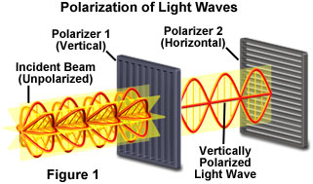
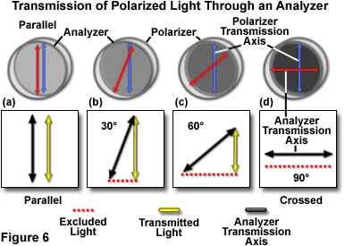
Polarized light microscopy
Two polarizers arranged at 90° angle block all light.
  Crossed polarizers
Microscope needs two polarizers
  One called Polarizer
  Second called Analyzer
Notes:
http://www.microscopyu.com/articles/polarized/polarizedlightintro.html

Slide 19
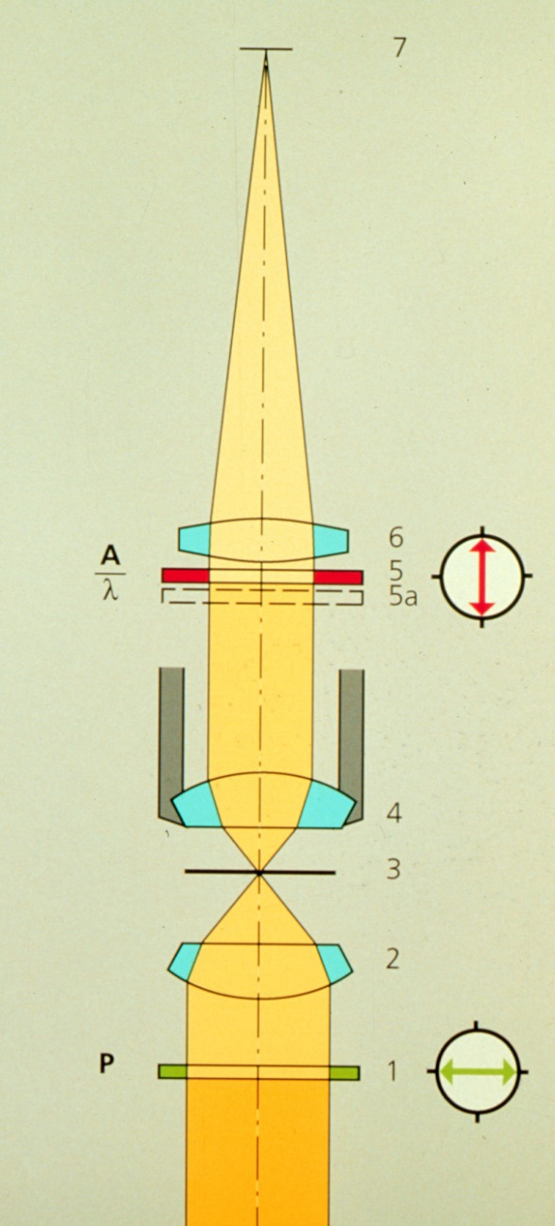
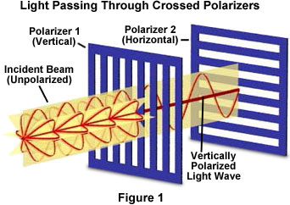
Polarized light microscopy
With crossed polarizers:
  Only items that rotate the plane of polarization reach the detector
Retardation plate optional
  Converts contrast to color

Slide 20
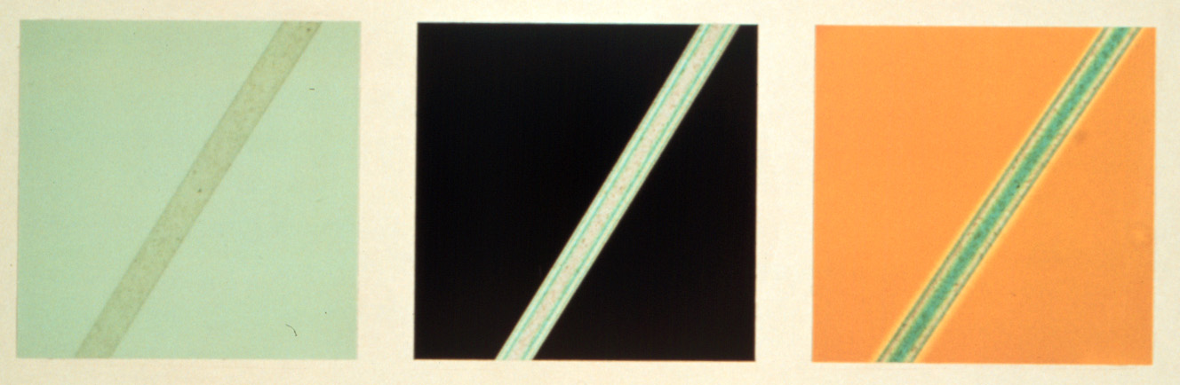
Polarized light microscopy images
Birefringent Material
Color of
sample and background modified by wave plate
Background
Brightfield
Polarized Light
Pol + Red I

Slide 21
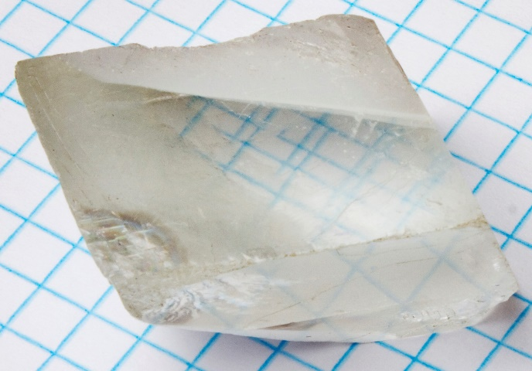
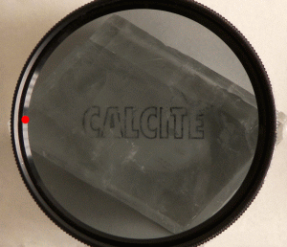
Birefringence
Material having a refractive index (η) dependent on polarization
Responsible for DOUBLE REFRACTION, splitting of a ray of light into two with differing polarization
Notes:
"Calcite and polarizing filter" by Aldoaldoz - Own work. Licensed under CC BY-SA 3.0 via Wikimedia Commons - https://commons.wikimedia.org/wiki/File:Calcite_and_polarizing_filter.gif#mediaviewer/File:Calcite_and_polarizing_filter.gif

Slide 22
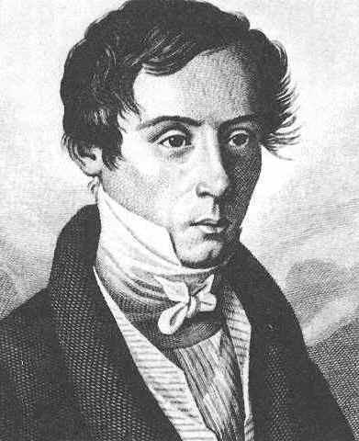
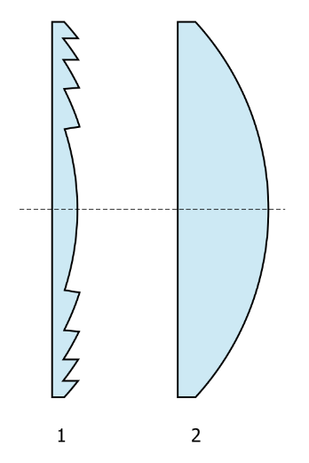
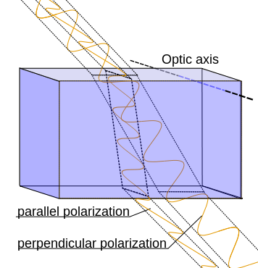
Birefringence
Augustin-Jean Fresnel first described in terms of polarized light
Isotropic solids are not birefringent (glass)
Anisotropic solids are birefringent (calcite, plastic dishes)
Splits light into two rays with perpendicular polarization
Augustin-Jean Fresnel
1788-1827
Notes:
http://www.microscopyu.com/articles/polarized/birefringenceintro.html
"Positively birefringent material" by Mikael Häggström - Own work. Licensed under Public Domain via Wikimedia Commons - https://commons.wikimedia.org/wiki/File:Positively_birefringent_material.svg#mediaviewer/File:Positively_birefringent_material.svg

Slide 23
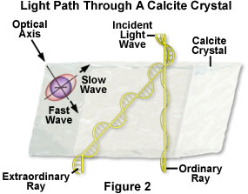
Birefringence
Light split into extraordinary and ordinary rays
Birefringence difference between refractive index of extraordinary ray (η_{e}) and ordinary ray (η_{o})
Notes:
http://www.microscopyu.com/articles/polarized/birefringenceintro.html

Slide 24
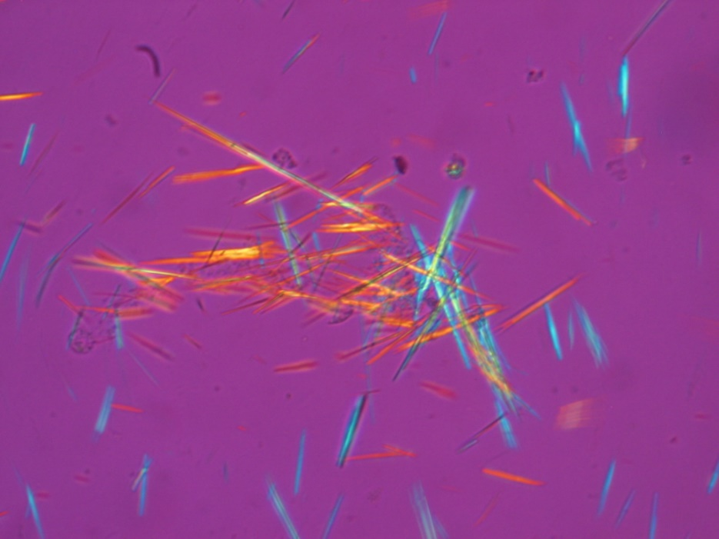
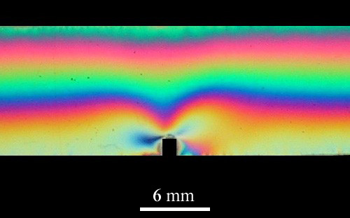
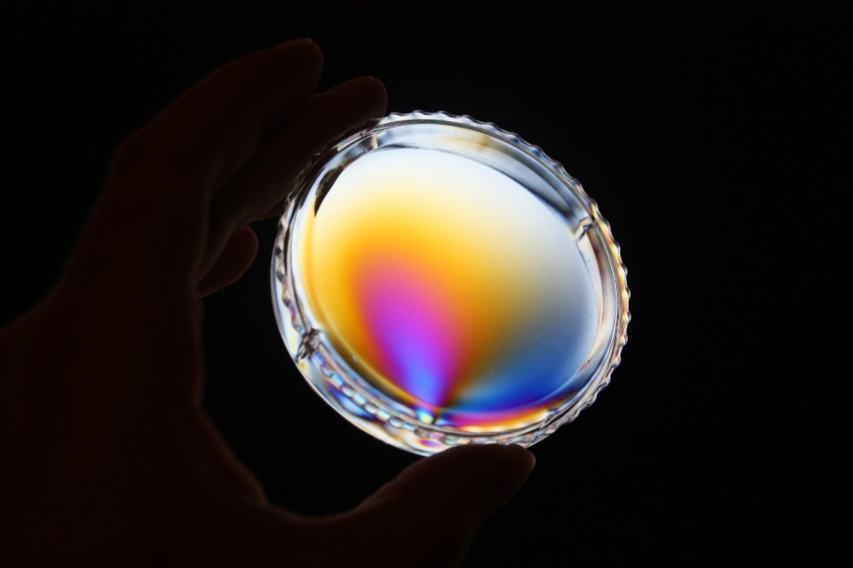
Birefringence
Structural
  Anisotropic
Stress or strain
  Isotropic
Notes:
"Fluorescent uric acid" by Bobjgalindo - Own work. Licensed under GFDL via Wikimedia Commons - https://commons.wikimedia.org/wiki/File:Fluorescent_uric_acid.JPG#mediaviewer/File:Fluorescent_uric_acid.JPG
"Birefringence Stress Plastic" by Zephyris - Own work. Licensed under CC BY-SA 3.0 via Wikimedia Commons - https://commons.wikimedia.org/wiki/File:Birefringence_Stress_Plastic.JPG#mediaviewer/File:Birefringence_Stress_Plastic.JPG
Strain-induced birefringence in a notched polycarbonate bar

Slide 25
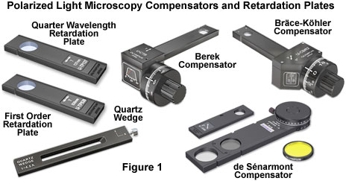
Compensators and retardation plates
Retardation Plates
  Quarter wavelength
  Full (First order) wavelength
Compensators
  Quartz wedge
  de Sénarmont
  Berek
  Bräce-Köhler
Read more about compensators and retardation plates here.
Notes:
Optical anisotropy is studied in the polarized light microscope with accessory plates that are divided into two primary categories: retardation plates that have a fixed optical path difference and compensators, which have variable optical path lengths. Addition of a retardation plate or compensator to the polarized light microscope produces a highly accurate analytical instrument that can be employed to determine the relative retardation (often symbolized by the Greek letter G) or optical path difference between the orthogonal wavefronts (termed ordinary and extraordinary) that are introduced into the optical system by specimen birefringence. The terms relative retardation, used extensively in polarized light microscopy, and optical path difference (D or OPD), are both formally defined as the relative phase shift between the orthogonal wavefronts, expressed in nanometers.
http://micro.magnet.fsu.edu/primer/techniques/polarized/compensatorshome.html

Slide 26

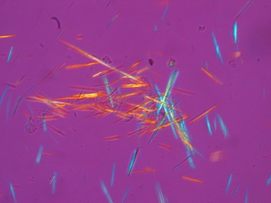
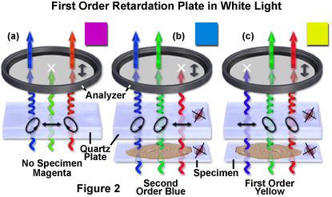
Full Wave (First Order) Retardation Plate
Also known as:
  Lambda plate
  Red plate
  Red-I plate
  Gypsum plate
  Selenite plate
Retard one wavelength in the green (550 nm) between extraordinary ray and ordinary ray
Cotton
Uric Acid
Notes:
The first order retardation plate is designed to introduce a relative retardation of exactly one wavelength (in the green or 550 nanometer region) between the ordinary and extraordinary wavefronts passing through the plate when the birefringent retardation material is illuminated by linearly polarized light at a 45-degree incident angle to the index ellipsoid. As a result, green wavelengths emerge from the retardation plate crystal still linearly polarized and having the same orientation as when they entered the retardation material (parallel to the polarizer). These wavelengths are perpendicular to the analyzer, thus are absorbed and do not pass through. The orthogonal wavefronts of all other wavelengths will experience some degree of retardation (less than a full wavelength) and will emerge from the retardation plate having varying degrees of elliptical polarization. These wavefronts are therefore able to pass a component vector through the analyzer. Subtracting the green wavelengths (blocked by the analyzer) from white light yields bright magenta-red, which results from a combination of all visible light spectral colors when the green wavelength band is missing. The magenta color observed in the microscope when a first order retardation plate is inserted into the optical train is a direct result of the events described above and is the origin for much of the common nomenclature describing this important qualitative tool.
The behavior of a quartz first order retardation plate in polarized white light, symbolized by a combination of red, green, and blue wavefronts, is reviewed in Figure 2. Without a specimen in the optical pathway (Figure 2(a)), the retardation plate induces an elliptical polarization vector to the red and blue waves as they pass through, but the green light travels through the quartz crystal as a linearly polarized wavefront that is absorbed by the analyzer. As a result, only a component of the red and blue waves is able to pass through the analyzer to produce a spectrum of white light minus the green wavelengths, which is seen in the microscope as a bright magenta background.
When a birefringent specimen with a wavefront ellipsoid parallel to the retardation plate is inserted into the optical pathway (Figure 2(b)), the relative retardation of orthogonal wavefronts is increased across the viewfield so that the color (red) now exhibiting linear polarized behavior is shifted to longer wavelengths. The blue and green wavelengths are elliptically polarized and interfere at the intermediate image plane to form a hue similar to second order blue (an addition color). Rotating the specimen by 90 degrees alters the relationship between the wavefront ellipsoids (Figure 2(c)) so that they are now perpendicular. In this case, the relative retardation of the orthogonal wavefronts is decreased across the viewfield and the shorter (blue) wavelengths emerge as linearly polarized light (only to be absorbed by the analyzer). Elliptically polarized green and red wavelengths ultimately recombine to form a first order yellow (subtraction) interference color.
http://micro.magnet.fsu.edu/primer/techniques/polarized/firstorderplate.html
Optical path differences ranging from a fraction of a wavelength up to several wavelengths can be readily estimated using a first order (or full wave) retardation plate. This versatile tool is known by several names, including a red plate, red-I (red-one) plate, lambda (l) plate, gypsum plate, selenite plate, sensitive violet, or simply a color tint plate, and adds a fixed optical path difference between 530 and 560 nanometers (depending upon the manufacturer) to every wavefront in the field. The first order retardation plate is a standard accessory that is frequently utilized to determine the optical sign (positive or negative) of a birefringent specimen in polarized light microscopy. In addition, the retardation plate is also useful for enhancing contrast in weakly birefringent specimens.
http://micro.magnet.fsu.edu/primer/techniques/polarized/compensatorshome.html

Slide 27
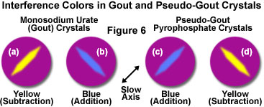
Polarized light microscopy
One of the most common usages in medicine is for diagnosing gout
Gout caused by elevated levels of uric acid which crystalize in joints
Antonie van Leeuwenhoek described the microscopic appearance of uric acid crystals in 1679
Urate crystals, long axis seen as horizontal and parallel to that of a red compensator filter. These appear as yellow, and are thereby of negative birefringence.
Notes:
Monosodium urate crystals grow in elongated prisms that have a negative optical sign of birefringence, which generates a yellow (subtraction) interference color when the long axis of the crystal is oriented parallel to the slow axis of the first order retardation plate (Figure 6(a)). Rotating the crystals through 90 degrees changes the interference color to blue (addition color; Figure 6(b)). In contrast, pseudo-gout pyrophosphate crystals, which have similar elongated growth characteristics, exhibit a blue interference color (Figure 6(c)) when oriented parallel to the slow axis of the retardation plate and a yellow color (Figure 6(d)) when perpendicular. The sign of birefringence can be employed to differentiate between gout crystals and those consisting of pyrophosphate. Gout can also be identified with polarized light microscopy in thin sections of human tissue prepared from the extremities. Polarized light is also useful in the medical field to identify amyloid, a protein created by metabolic deficiencies and subsequently deposited in several organs (spleen, liver, kidneys, brain), but not observed in normal tissues.
http://www.microscopyu.com/articles/polarized/polarizedintro.html

Slide 28
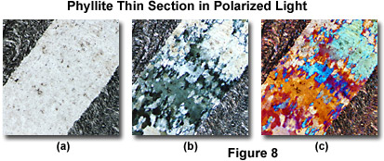
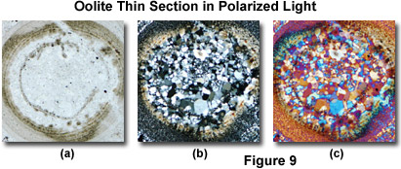
Polarized light microscopy
Using full wave retardation plate
Phyllite
  Metamorphic rock aligned under heat and stress
Oolite
  Sedimentary rock of cemented sand grains
Plane-
Polarized
Cross-
Polarized
Full wave
retardation plate
Notes:
In geological applications, the standard thickness for rock thin sections is 25-30 micrometers. Specimens can be ground down with diamond impregnated wheels and then hand finished to the correct thickness using abrasive powders of successively decreasing grit size. The final specimen should have a cover glass cemented with an optically transparent adhesive. Softer materials can be prepared in a manner similar to biological samples using a microtome. Slices between one and 40 micrometers thick are used for transmitted light observations.

Slide 29
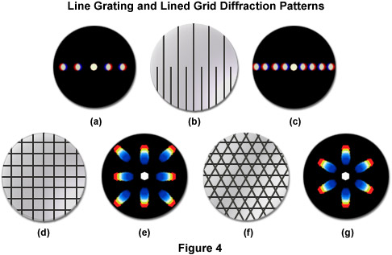
Diffraction and Image Formation
Conoscopic images of diffraction patterns
Notes:
The closer the spacing of a line grating, the fewer the spectra that will be captured by a given objective, as illustrated in Figure 4(a-c). The diffraction pattern illustrated in Figure 4(a) was captured by a 40x objective imaging the lower portion the line grating in Figure 4(b), where the slits are closer together. In Figure 4(c), the objective is focused on the upper portion of the line grating (Figure 4(b)) where the slits are farther apart, and more spectra are captured by the objective. The direct light and the light from the higher order diffraction maxima are focused by the objective to form an image in the intermediate image plane at the fixed diaphragm of the eyepiece. Here the direct and diffracted light rays interfere and are thus reconstituted into the real, inverted image that is seen by the eye lens of the eyepiece and further magnified. This is illustrated in Figure 4(d) through Figure 4(g) with two types of diffraction gratings. The square grid illustrated in Figure 4(d) represents the orthoscopic image of the grid (in effect, the usual specimen image observed through the eyepieces) as seen through the full aperture of the objective. The diffraction pattern derived from this grid is shown as a conoscopic image that would be seen at the rear focal plane of the objective (Figure 4(e)). Likewise, the orthoscopic image of a hexagonally arranged grid (Figure 4(f)) produces a corresponding hexagonally arranged conoscopic image (Figure 4(g)) of first order diffraction patterns.

Slide 30
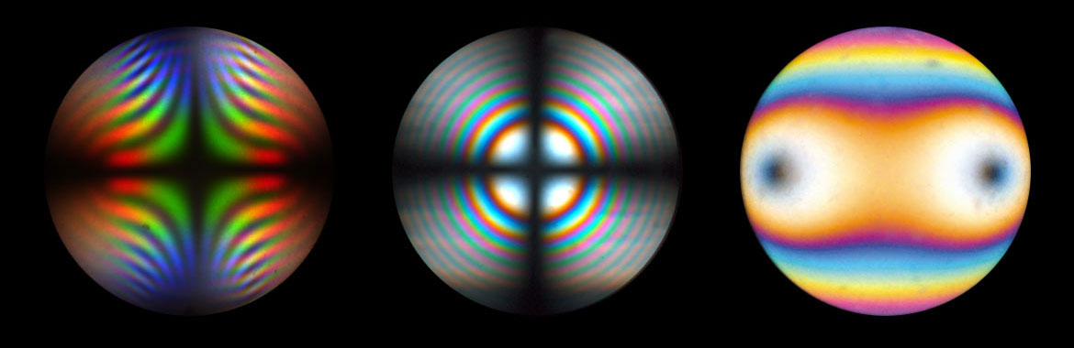


Diffraction and Image Formation
Diffraction patterns for even more complex structures
Plus adding polarized illumination
Notes:
Brookite, TiO2, with strong dispersion colors
Uni-axial interference figure of thick calcite plate, perpendicular to optical axis (quarter wavelength plate)
Bi-axial interference figure of thin biotite crystal in diagonal position at circular polarized light (is typical of a uniaxial crystal with a first order retardation plate inserted into the optical pathway)
Brookite from wikipedia
Biotite from http://www4.uwm.edu/course/geosci-100/Mineral_Rocks/biotite_data.html
http://www.leica-microsystems.com/products/light-microscopes/details/product/leica-dm4-p/

Slide 31

Required / Recommended Components for Polarization Microscopy:
Polarizer (fixed or rotatable)
Strain-free Condenser and Objective
Rotating, centerable Stage
Compensator and/or retardation plate
Analyzer (fixed or rotatable)
Crossline Eyepiece

Slide 32

Many of these techniques can be done with reflected light as well
Reflected Light
Transmitted Light

Slide 33

Reflected polarized light microscopy
Requires special objective
Not corrected for viewing through cover glass
Strain free
Integrated circuit
Ceramic crystal
Copper imperfections
Notes:
Illustrated in Figure 3 is a series of reflected polarized light photomicrographs of typical specimens imaged utilizing this technique. On the left (Figure 3(a)) is a digital image revealing surface features of a microprocessor integrated circuit. Birefringent elements employed in the fabrication of the circuit are clearly visible in the image, which displays a portion of the chip's arithmetic logic unit. The blemished surface of a ceramic superconducting crystal (bismuth base) is presented in Figure 3(b), which shows birefringent crystalline areas with interference colors interspersed with grain boundaries. Metallic thin films are also visible with reflected polarized light. Figure 3(c) illustrates blisters that form imperfections in an otherwise confluent thin film of copper (about 0.1 micron thick) sandwiched over a nickel/sodium chloride substrate to form a metallic superlattice assembly.
Reflected light techniques require a dedicated set of objectives that have not been corrected for viewing through the cover glass, and those for polarizing work should also be strain free.
http://www.microscopyu.com/articles/polarized/polarizedintro.html

Slide 34
Different types of contrast
E. D. Salmon
Notes:
DIC, Phase, Polarized light
Sea urchin mitotic spindle
Ribosomal particles isotropic
https://www.ibiology.org/ibioeducation/taking-courses/polarization-microscopy.html
Edward D. Salmon from UNC

Slide 35


Slide 36


Differential Interference Contrast (DIC)
Also called Nomarski Interference Contrast
Named after discoverer, Polish Physicist Georges Nomarski
Modified Wollaston Prism for DIC in 1950’s
Remember, Wollaston was English chemist who first noted Fraunhofer lines
Notes:
He invented the camera lucida (1807), the reflecting goniometer (1809), and the Wollaston prism

Slide 37




Differential Interference Contrast (DIC)
High Contrast and high resolution
Full Control of condenser aperture
Visualization of any type of gradient
3-D Image appearance
Color DIC by adding a wave plate
Selectable contrast / resolution via different DIC sliders
Orientation-specific > orient fine details perpendicular to DIC prism
Notes:
Chicken Embryo Lens - Although initially all cells within a chicken embryo look alike, they quickly begin to develop into specialized structures. Within the first 24 hours of embryonic development, the head becomes distinguishable, the foregut forms, blood begins to accumulate in areas that will become parts of the vascular system, and the eye starts to take shape. Developmental progression moves swiftly, and on the second day the lenses of the eyes materialize, the vascular system takes a definite form, and the heart begins beating. The lightning-fast pace of growth and change continues, each feature developing within a set period of time, until a few short weeks later a full-formed and functional baby chicken, complete with claws and feathers, taps it way out of its shell to first see the light of day.
Chinese Liver Fluke (Clonorchis sinensis) - Similar to many other parasites, Chinese liver flukes have a three-host lifecycle and must, therefore, reside in two intermediate hosts before infecting a definitive host. The first hosts of the species are snails, which ingest the eggs of the flukes from contaminated water. The eggs complete their gestation in the snails before hatching and exiting the organisms. The trematodes then burrow into fish, their second intermediate hosts, where they become encysted inside muscle tissue. Humans, or other animals, become the final hosts of the flukes when they eat the raw flesh of an infected fish.
Down Feathers - There are three basic types of feathers, each with its own set of specific functions. Contour feathers line the wings, tails, and backs of birds, giving them a defined shape and acting as aerodynamic structures. Beneath them, lie the soft, fluffy feathers commonly referred to as down. As anyone who has ever used a down comforter or sleeping bag should know, down feathers are excellent insulators. Thus, their primary function is to maintain the proper body temperature of birds, a task that they are aided in by hair feathers. Sometimes alternatively known as filoplumes, hair feathers are also believed to function as pressure and vibration receptors that sense the location of other feathers so that they can be appropriately adjusted.
Jellyfish Sensory Organs (Aurelia Tentaculocysts) - One of the jellyfish most familiar to humans is the moon jelly, scientifically known as Aurelia aurita. The species is easy to recognize because of the four round, or horseshoe-shaped, reproductive organs that can be clearly seen through their transparent pink or bluish hued bodies. The tentacles of moon jellies are short and fringelike, and their sting is much less toxic than many other types of jellyfish. Also, the stinging action of their nematocysts is not powerful enough to pierce the thick skin of humans, though they can occasionally catch small aquatic animals. Most of their food is instead gained by trapping plankton in the layer of mucus that coats their bells.

Slide 38


DIC vs Phase
Aperture bigger in DIC than phase so better resolution
Notes:
http://www.olympusmicro.com/primer/techniques/dic/dicphasecomparison.html

Slide 39

DIC thought experiment:
Need two different light rays
Pass through specimen independently
Afterwards, let them interfere with one another
How to label them? How to offset them (shear)?
Shear

Slide 40
DIC thought experiment:
Color code two paths that are offset
Problem: red and green light don’t interfere with each other
Objective lens
Condenser lens

Slide 41
DIC thought experiment:
Need two different light rays
Pass through specimen independently
Afterwards, let them interfere with one another
How to label them? How to offset them (shear)?
Polarization as the label
Notes:
Polarization (light must be in same plane to interact)

Slide 42
Wollaston Prism
Birefringent material
Different η for different polarizations
lower
higher
higher
lower

Slide 43
Wollaston Prism
Birefringent material
Different η for different polarizations
Problem: Light in different planes of polarization don’t interfere with each other (need an analyzer)

Slide 44

DIC- two beams labeled by plane of polarization
Analyzer - forces two beams into same plane
Wollaston prism - recombines two beams
Domain of independent paths
Wollaston prism - splits into two beams; adds shear
Polarizer - prepares for Wollaston prism 50-50 split

Slide 45
Differential Interference Contrast (DIC)
Unpolarized light enters the microscope and is polarized at 45°
The polarized light enters the first Wollaston prism and is separated into two rays polarized at 90° to each other
The two rays are focused by the condenser for passage through the sample. These two rays are focused so they will pass through two adjacent points in the sample, around 0.2 μm apart.
The rays travel through adjacent areas of the sample, separated by the shear. The separation is normally similar to the resolution of the microscope. They will experience different optical path lengths where the areas differ in refractive index or thickness. This causes a change in phase.
The rays travel through the objective lens and are focused for the second Wollaston prism.
The second prism recombines the two rays into one polarized at 135°. The combination of the rays leads to interference, brightening or darkening the image at that point according to the optical path difference.
Notes:
https://en.wikipedia.org/wiki/Differential_interference_contrast_microscopy

Slide 46
Differential Interference Contrast (DIC)
DIC Optics
Good -
  Contrast at full aperture
  Optical sectioning (to ~0.3um)
  (two beams mostly overlap)
Bad -
  Expense
  Very sensitive to polarization
  Plastic
  Glass with stress

Slide 47

Required components for DIC
Nosepiece with DIC receptacles
Polarizer (or Sénarmont Polarizer)
Low Strain Condenser and Objective
DIC Prisms for Condenser (#I orII orIII)
Specific DIC Slider for each objective
Analyzer (or de Sénarmont Analyzer)

Slide 48


Reflected light DIC
Notes:
http://www.microscopyu.com/articles/dic/reflecteddic.html

Slide 49



Reflected light DIC
Imaging opaque materials
DIC good for optical sectioning
Notes:
Azimuth contrast effects in reflected light differential interference contrast can be utilized to advantage by equipping the microscope with a 360-degree rotating circular stage. An essential element in polarized light microscopy, circular stages enable the operator to rotate the specimen with respect to the shear axis in order to maximize or minimize contrast effects for selected specimen features. Contrast in reflected light DIC microscopy achieves a minimum level for linear phase specimens that extend along the direction of shear, but can be varied significantly by rotating the stage by 90 degrees. Non-linear metallurgical specimens, such as mosaic grain boundaries, wires, amorphous alloys, and crystalline spherulites, do not display significant azimuthal effects in reflected light DIC, and can usually be imaged satisfactorily in a variety of orientations.
Presented in Figure 7 are two semiconductor integrated circuit specimens, each having a significant amount of periodicity, but displaying a high degree of asymmetry when imaged in reflected light DIC. Figures 7(a) and 7(b) illustrate the same region of a microprocessor arithmetic logic unit located near the pad ring, which contains numerous bus lines, bonding wire pads and registers. When the circuit is positioned with the long axis of the bonding pad oriented perpendicular to the shear axis (northwest to southeast for all images in Figure 7), the central trapezoid-shaped region of bus lines becomes very dark and almost extinct (Figure 7(a)), losing virtually all recognizable detail. Rotating the integrated circuit by 90 degrees (Figure 7(b)), highlights the central trapezoid bus structure, but causes adjacent areas to lose contrast. In order to capture all the detail present on the surface of this integrated circuit, the optimum orientation is to position the elongated bus structure at a 45-degree angle to the shear axis of the microscope.
The series of high-magnification DIC images presented in Figure 9 illustrate three separate focal planes in the same viewfield of overlapping surface structures present on a typical integrated circuit. In brightfield or darkfield illumination, these structures are often observed merged together and can become quite confusing when attempting to image specific surface details. Figure 9(a) reveals several metal oxide terminals on the upper surface of the integrated circuit, including vias (miniature connections between vertical layers) and part of a bus line. Refocusing the microscope a few tenths of a micrometer deeper exposes numerous connections in the central region of the circuit (Figure 9(b)). Still farther into the circuitry, near the first layers applied above the pure silicon, are a series of metal oxide lines dotted with an ordered array of via connections (Figure 9(c)). The optical sectioning capability of reflected light DIC microscopy is clearly revealed by the ability to image specific focal planes on the surface of this complex integrated circuit.

Slide 50

DIC High resolution and contrast
E. D. Salmon
Notes:
High Resolution VE-DIC Image of Microtubules
https://www.ibiology.org/ibioeducation/taking-courses/polarization-microscopy.html
Edward D. Salmon from UNC

Slide 51

Numerical Aperture and Resolution
Resolution: smallest distance between two points on a specimen that can still be distinguished as two separate entities.
R = 0.61λ/NA
R = 1.22λ/(NA(obj) + NA(cond))
Notes:
http://micro.magnet.fsu.edu/primer/anatomy/numaperture.html

Slide 52


Resolution
zero order (maximum) surrounded by concentric 1st, 2nd, 3rd, etc., order maxima of sequentially decreasing brightness that make up the intensity distribution.
Light from points of specimen passes through the objective, forms image,
Points of the specimen appear in the image as small patterns: Airy patterns.
  -caused by diffraction or scattering of the light passing through specimen
Central maximum of the Airy patterns: Airy disk, region enclosed by the first minimum
  -contains 84 percent of the luminous energy.
Notes:
Figure 3(a) illustrates a hypothetical Airy disk that essentially consists of a diffraction pattern containing a central maximum (typically termed a zeroth order maximum) surrounded by concentric 1st, 2nd, 3rd, etc., order maxima of sequentially decreasing brightness that make up the intensity distribution. Two Airy disks and their intensity distributions at the limit of optical resolution are illustrated in Figure 3(b). In this part of the figure, the separation between the two disks exceeds their radii, and they are resolvable. The limit at which two Airy disks can be resolved into separate entities is often called the Rayleigh criterion. Figure 3(c) shows two Airy disks and their intensity distributions in a situation where the center-to-center distance between the zeroth order maxima is less than the width of these maxima, and the two disks are not individually resolvable by the Rayleigh criterion.
https://en.wikipedia.org/wiki/Sparrow%27s_resolution_limit
http://www.olympusmicro.com/primer/digitalimaging/deconvolution/deconresolution.html
Remember Rayleigh criterion at FWHM
http://micro.magnet.fsu.edu/primer/anatomy/numaperture.html

Slide 53

Resolution
Airy disc size decreases with numerical aperture
An image sensor can resolve if pixels separated
Notes:
Figure 4 illustrates the effect of numerical aperture on the size of Airy disks imaged with a series of hypothetical objectives of the same focal length, but differing numerical apertures. With small numerical apertures, the Airy disk size is large, as shown in Figure 4(a). As the numerical aperture and light cone angle of an objective increases however, the size of the Airy disk decreases as illustrated in Figure 4(b) and Figure 4(c). The resulting image at the eyepiece diaphragm level is actually a mosaic of Airy disks which we perceive as light and dark.
A practical way of understanding line-pairs is to think of them as pixels on a camera sensor, where a single line-pair corresponds to two pixels (Figure 2). Two camera sensor pixels are needed for each line-pair of resolution: one pixel is dedicated to the red line and the other to the blank space between pixels. Using the aforementioned metaphor, image resolution of the camera can now be specified as equal to twice its pixel size.
http://micro.magnet.fsu.edu/primer/anatomy/numaperture.html

Slide 54
Modulation transfer function
Resolution and performance of optical microscope can be characterized by the modulation transfer function (MTF)
MTF is measurement of microscope's ability to transfer contrast from the specimen to the image plane at specific resolution.
Incorporates resolution and contrast into one specification
Notes:
http://www.edmundoptics.com/technical-resources-center/optics/modulation-transfer-function
http://www.microscopyu.com/articles/optics/mtfintro.html
http://en.wikipedia.org/wiki/Optical_transfer_function

Slide 55

Modulation transfer function
The effect of increasing spatial frequency on image contrast
See it in action.
Modulation (M) = (I(max) - I(min))/(I(max) + I(min))
MTF = Image Modulation/Object Modulation
Notes:
where I(max) is the maximum intensity displayed by a repeating structure and I(min) is the minimum intensity found in the same specimen. By convention, the modulation transfer function is normalized to unity at zero spatial frequency. Modulation is typically less in the image than in the specimen and there is often a slight phase displacement of the image relative to the specimen. By comparing several specimens having differing spatial frequencies, it can be determined that both image modulation and phase shifts will vary as a function of spatial frequency. By definition, the modulation transfer function (MTF) is described by the equation:
This quantity, as discussed above, is an expression of the contrast alteration observed in the image of a sinusoidal object as a function of spatial frequency. In addition, there is a position or phase shift of the sinusoid that is dependent upon spatial frequency in both the horizontal and vertical coordinates. A good example occurs in video microscopy where the raster scanning process produces slightly different responses resulting in a variation between the horizontal and vertical modulation transfer functions.
http://www.microscopyu.com/articles/optics/mtfintro.html

Slide 56
Modulation transfer function
The effect of increasing spatial frequency on image contrast
See it in action.
Modulation (M) = (I(max) - I(min))/(I(max) + I(min))
MTF = Image Modulation/Object Modulation
MTF = 2(φ - cosφsinφ)/π
φ = cos-1(λν/2NA)
Notes:
where I(max) is the maximum intensity displayed by a repeating structure and I(min) is the minimum intensity found in the same specimen. By convention, the modulation transfer function is normalized to unity at zero spatial frequency. Modulation is typically less in the image than in the specimen and there is often a slight phase displacement of the image relative to the specimen. By comparing several specimens having differing spatial frequencies, it can be determined that both image modulation and phase shifts will vary as a function of spatial frequency. By definition, the modulation transfer function (MTF) is described by the equation:
This quantity, as discussed above, is an expression of the contrast alteration observed in the image of a sinusoidal object as a function of spatial frequency. In addition, there is a position or phase shift of the sinusoid that is dependent upon spatial frequency in both the horizontal and vertical coordinates. A good example occurs in video microscopy where the raster scanning process produces slightly different responses resulting in a variation between the horizontal and vertical modulation transfer functions.
http://www.microscopyu.com/articles/optics/mtfintro.html

Slide 57

Modulation transfer function
The effect of increasing spatial frequency on image contrast
Note how middling objective can outperform a higher quality objective at lower frequencies
Notes:
A perfect aberration-free optical system is termed diffraction limited, because the effects of light diffraction at the pupils limit the spatial frequency response and establish the limits of resolution. Presented in Figure 2 is a graph relating the modulation transfer function of a repeating specimen imaged with incoherent illumination by visible light with several different diffraction-limited microscope objectives having a circular pupil. In this case, objective quality affects the modulation response as a function of spatial frequency. Higher quality objectives (red line in Figure 2) exhibit greater performance than those of a lower quality (yellow line), and are able to transfer contrast more effectively at higher spatial frequencies. The objective represented by the yellow curve has the highest performance at low spatial frequencies, but falls short of the high numerical aperture objective at larger frequencies. Beneath the graph is a representation of relative feature size versus spatial frequency with respect to the Rayleigh criteria and Sparrow limit. Also presented is a series of sine waves representing a specimen (object) and the resulting image produced in a typical microscope as the frequency of the sinusoid increases.

Slide 58

Modulation transfer function
The effect of increasing spatial frequency on image contrast
Note how middling objective can outperform a higher quality objective at lower frequencies
One important performance factor is NA
Notes:
Individual objectives in a microscope display a specific modulation transfer function (or optical transfer function) that depends on numerical aperture, objective design, illumination wavelength, and the mode of contrast generation. When the numerical aperture of the condenser is equal to or greater than that of the objective, the spatial frequency cutoff value decreases with decreasing objective numerical aperture (Figure 4(a)). Holding the objective numerical aperture value constant and varying the condenser numerical aperture results in progressively lower cutoff values with decreasing condenser numerical aperture (Figure 4(b)).
A perfect aberration-free optical system is termed diffraction limited, because the effects of light diffraction at the pupils limit the spatial frequency response and establish the limits of resolution. Presented in Figure 2 is a graph relating the modulation transfer function of a repeating specimen imaged with incoherent illumination by visible light with several different diffraction-limited microscope objectives having a circular pupil. In this case, objective quality affects the modulation response as a function of spatial frequency. Higher quality objectives (red line in Figure 2) exhibit greater performance than those of a lower quality (yellow line), and are able to transfer contrast more effectively at higher spatial frequencies. The objective represented by the yellow curve has the highest performance at low spatial frequencies, but falls short of the high numerical aperture objective at larger frequencies. Beneath the graph is a representation of relative feature size versus spatial frequency with respect to the Rayleigh criteria and Sparrow limit. Also presented is a series of sine waves representing a specimen (object) and the resulting image produced in a typical microscope as the frequency of the sinusoid increases.

Slide 59

Modulation transfer function
Can see how different contrast techniques compare
Notes:
http://en.wikipedia.org/wiki/Single-sideband_modulation
Utilization of contrast enhancing techniques such as phase contrast and differential interference contrast (DIC) results in unique modulation transfer functions that display curves markedly different from those observed in brightfield illumination using the objective's full numerical aperture (Figure 5). For example, the narrow illumination produced by phase rings in phase contrast microscopy produces a modulation transfer function curve that oscillates above and below the brightfield curve, while the curves generated by DIC objectives vary with the angle between the specimen period and the shear direction of the Wollaston or Nomarski prisms. Also illustrated in Figure 5 is the curve produced by a single-sideband edge enhancement microscope (developed by Dr. Gordon W. Ellis), which yields images of superior contrast at high spatial frequencies.

Slide 60
Homework 3
Since confocal microscopy is very photon starved, it is important to get objectives that are bright.
For this assignment let’s assume you have a 10x objective with an N.A. of 0.3. Calculate the N.A. a 20x, 40x and 60x would need to have to be as bright as this 10x.
Do the same for a 10x with an N.A. of 0.5. Also note if the 20x, 40x or 60x would be a dry, water or oil objective.
Hint – Assume Brightness for fluorescence equals NA⁴ / Mag²

Slide 61
Refractive index η
Medium Refractive Index
Air 1.0003
Water 1.33
Glycerin 1.47
Immersion Oil 1.518
Glass 1.56 – 1.46
Diamond 2.42

Slide 62
Homework 3 solution
10x at 0.3 NA
10x at 0.5 NA
Obj Mag | NA
20x | 0.424264
40x | 0.6
60x | 0.734847
Obj Mag | NA
20x | 0.707107
40x | 1
60x | 1.224745

Slide 63
Biology 177: Principles of Modern Microscopy
Course Work:
  Reading
  Simple problem sets
  Projects
  No exams
Projects (two):
  Read and summarize a publication
  Describe technology
  How could it have been done better?
  Must say one good thing about paper.
Note: Auditors welcome

