Slide 1
Biology 177: Principles of Modern Microscopy
Lecture 06:
Fluorescence Microscopy
Andres Collazo, Director Biological Imaging Facility
Wan-Rong (Sandy) Wong, Graduate Student, TA

Slide 2
Lecture 6: Fluorescence Microscopy
Detectors for Microscopy, Part 2
  CMOS, PMT and APD
Phenomenon of Fluorescence
  Energy Diagram
  Rates of excitation, emission, ISC
  Practical Issues
    Lighting, Filters

Slide 3
Detectors for microscopy
Film
CMOS (Complementary metal–oxide–semiconductor)
CCD (Charge coupled device)
PMT (Photomultiplier tube)
GaAsP (Gallium arsenide phosphide)
APD (Avalanche photodiode)
Array of detectors, like your retina
Single point source detectors

Slide 4
Questions about last lecture?

Slide 5
Let’s look at an actual example
Visualizing hearing in vivo

Slide 6
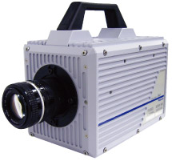
High speed cameras
Used by the military so expensive
10,000 frames/sec.
Fastcam 1024 PCI
  Photron, up to 100,000 fps
  47,000 with LED illumination and DIC
ProAnalyst software
  Xcetex, Cambridge, Mass
Actually Fastcam SA5

Slide 7
Nyquist criterion
Sampling frequency needs to be greater than twice the frequency trying to image
Undersampling can result in aliasing
Such differences can result in distortions or artifacts
  Avoid the “wagon wheel” effect
Notes:
In terms of a function's own bandwidth (B), as depicted above, the Nyquist criterion is often stated as f_{s} > 2B. And 2B is called the Nyquist rate for functions with bandwidth B. When the Nyquist criterion is not met (B > ½ f_{s}), a condition called aliasing occurs, which results in some inevitable differences between x(t) and a reconstructed function that has less bandwidth. In most cases, the differences are viewed as distortion.

Slide 8
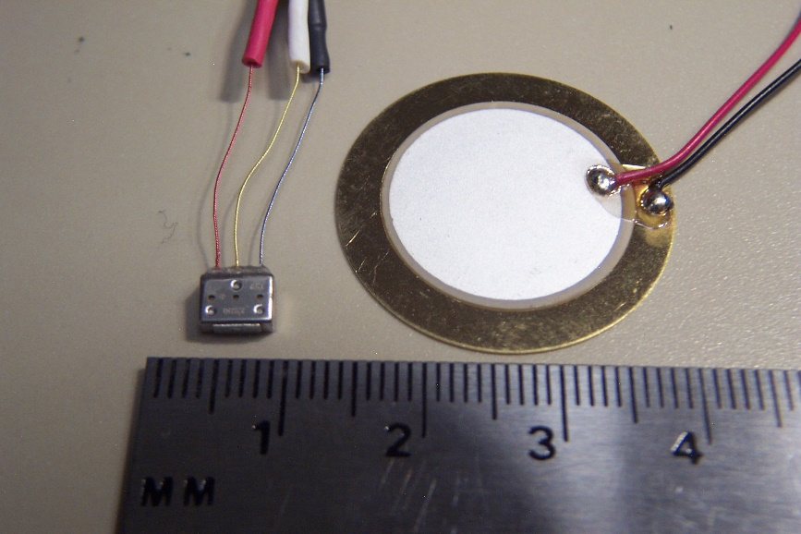
Visualizing Hearing In Vivo
Spontaneous otoacoustic emissions
  In vivo SOAE 600 Hz to 60 kHz
  In vitro hair bundle motions < 100 Hz
Playing sounds 100 to 2000 Hz
Experimental Setup
  High magnification DIC microscopy
  High speed camera 6000 fps +
  Specialized data analysis software
Speaker
Specimen
Water-filled tube
Glass bottom dish

Slide 9
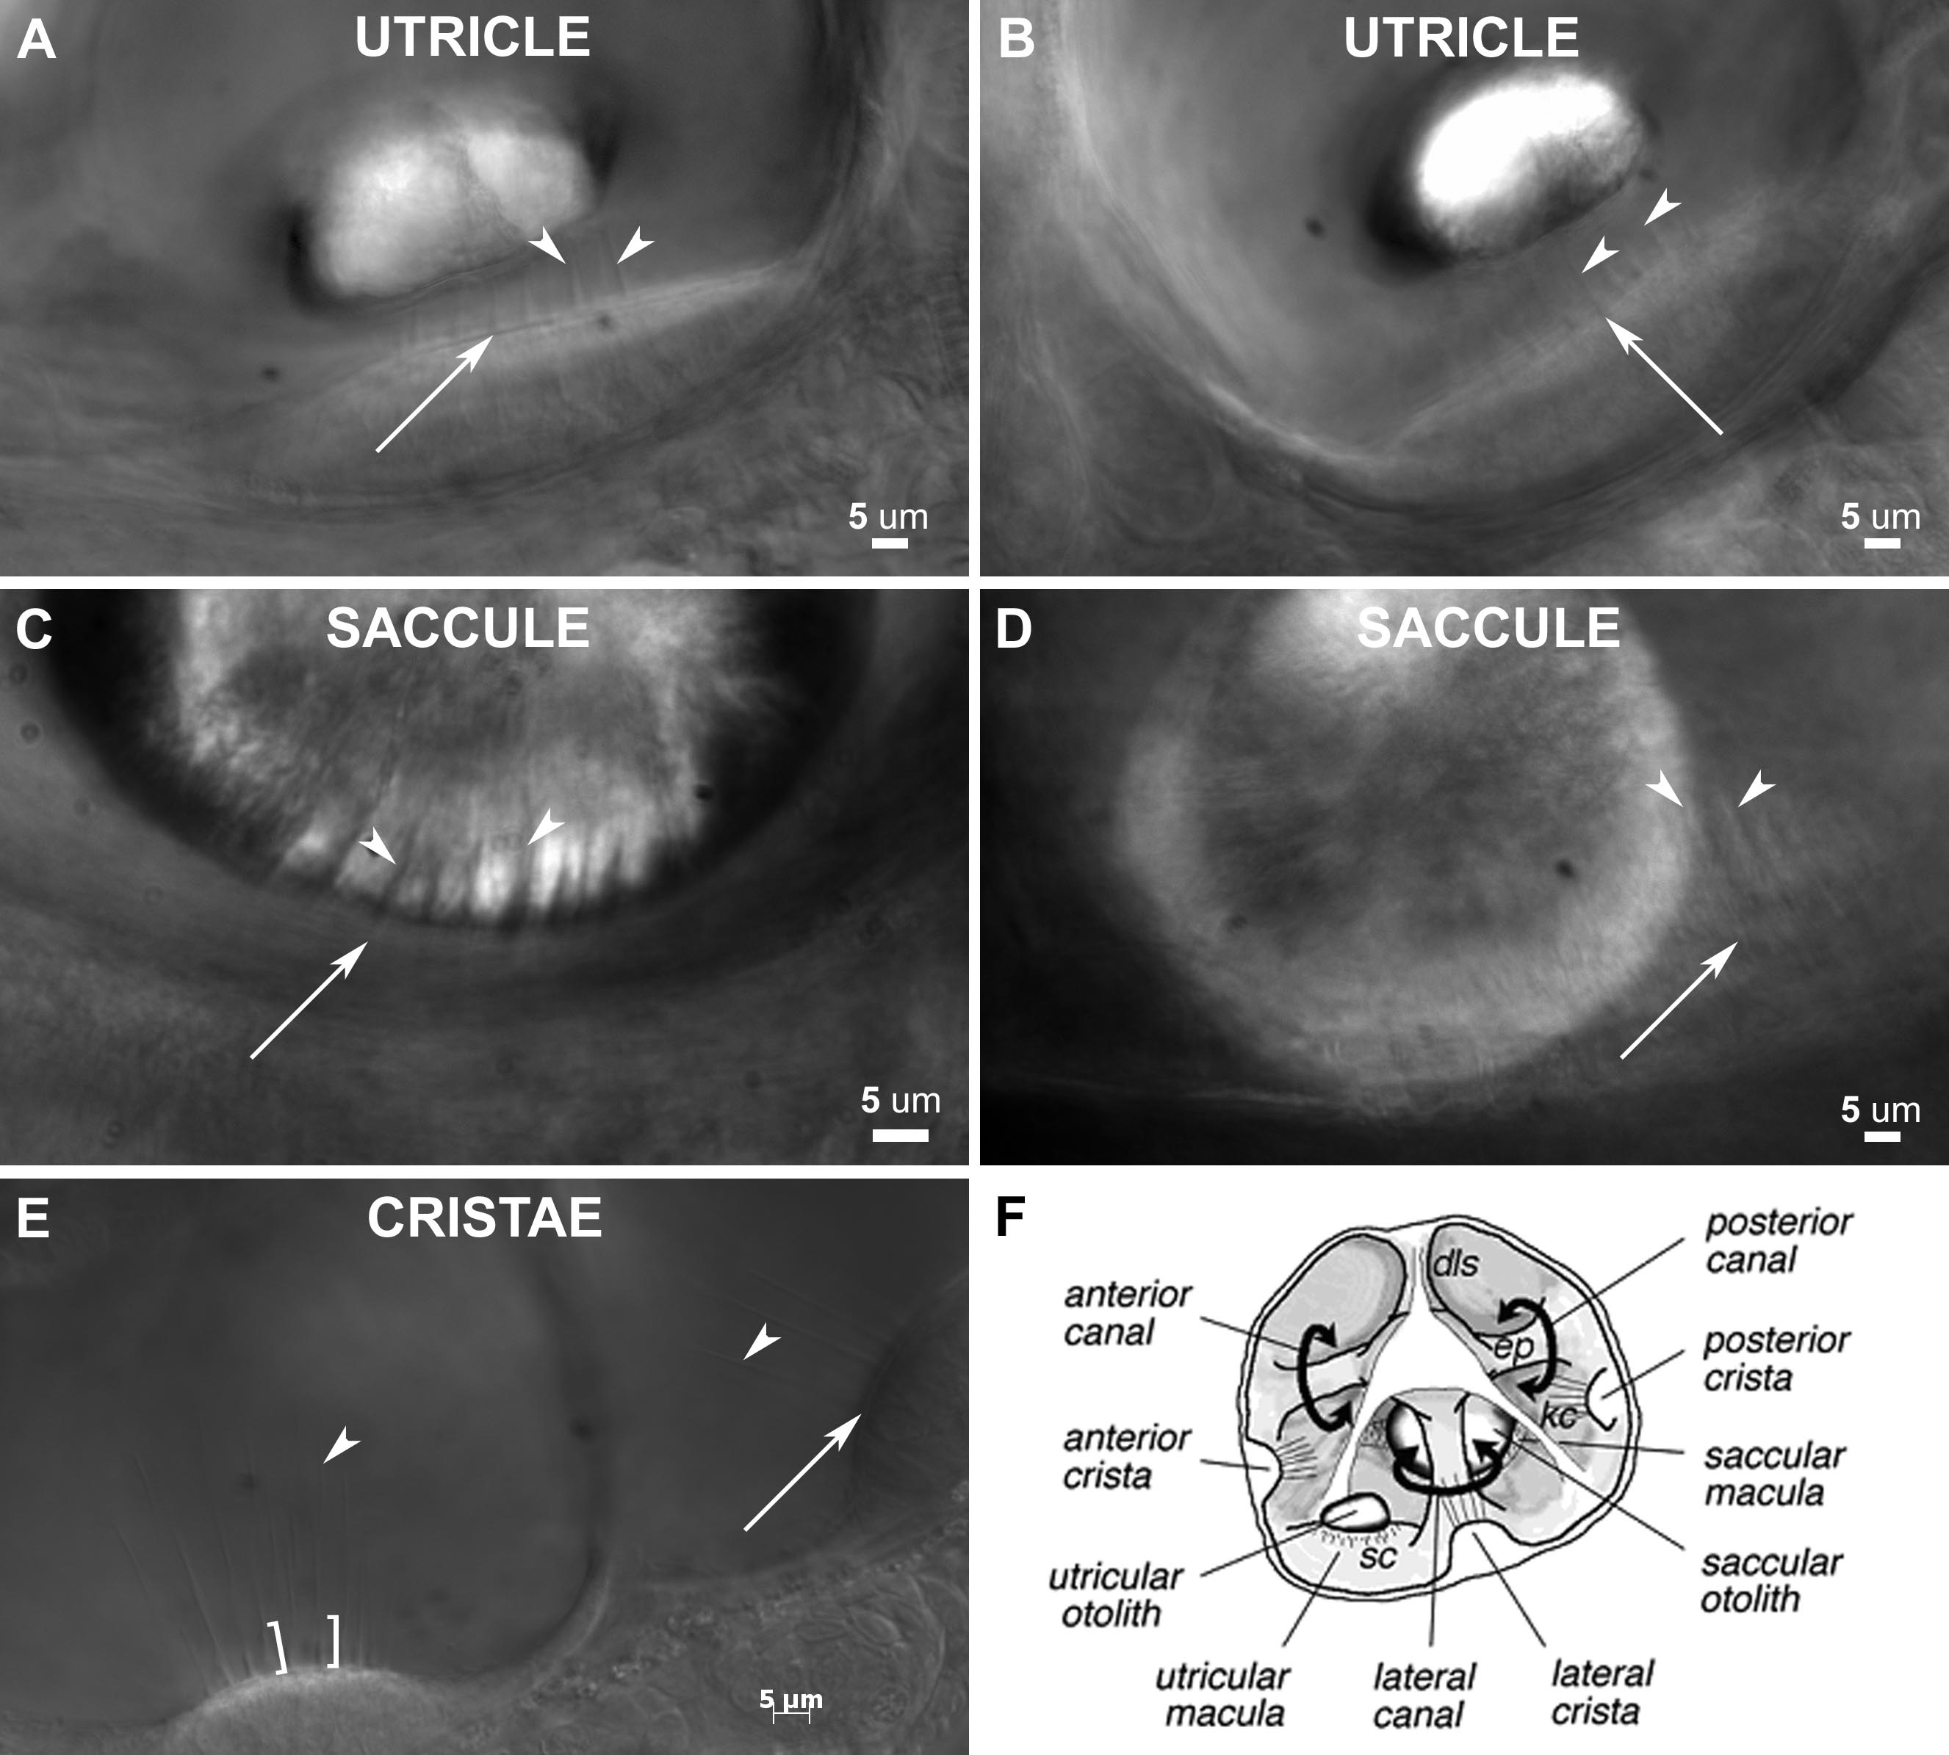

Slide 10
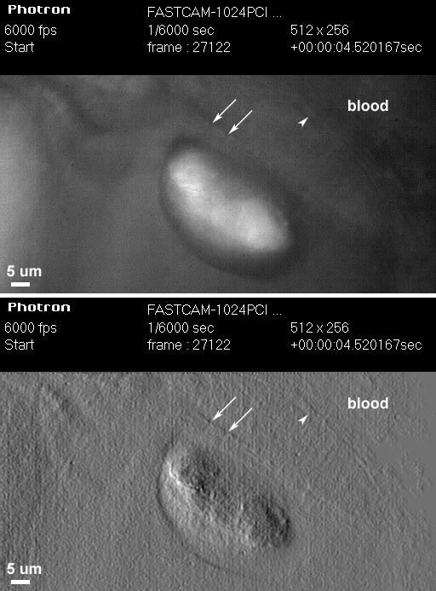
Temporal Resolution: Ultra High-Speed Video
1000 fps is 1024x1024
6000 fps reduced to 512x256, 1024x128, etc.
High Power LED System-36AD3500, Lightspeed Technologies, Campbell, CA
  20/80 to 90/10 on/off
Fastcam SA1 (Photron, San Diego, CA), 5400 fps at 1024x1024

Slide 11
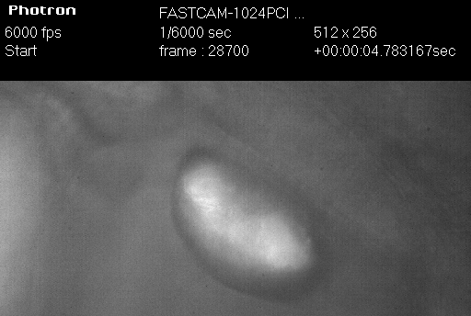
6000 fps movie played at 30 fps

Slide 12
Photomultiplier Tube (PMT)
PMTs use electric potential to amplify electrons
Photons impact a phosphor screen creating electrons
Electrons are multiplied by impacting other surfaces (Dynode chain)
Increasing the gain increases the number of electrons produced in a non-linear fashion
So increasing Gain increases signal

Slide 13
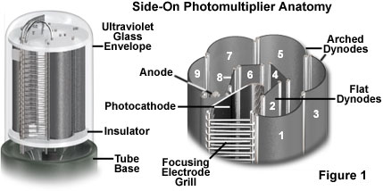
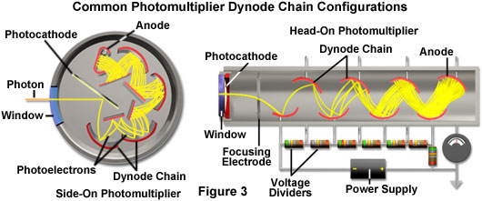
Photomultiplier Tube (PMT)
Two types of Photomultipliers
  Side-on, most popular due to high performance rating and low cost
  Head-on
Notes:
Point source detector
The two most popular photomultiplier designs have configurations that place the sensitive photocathode element either at the end (head-on) or on the side (side-on) of the vacuum tube (see Figure 3). Incident light is detected through a window at the top of the glass envelope in head-on designs, and through the curved side in side-on photomultipliers. Due to their high performance ratings and low cost, side-on photomultipliers are the most widely used tubes for general photometric applications, such as spectrophotometry, fluorimetry, and confocal microscopy. Side-on photomultipliers contain an opaque and relatively thick reflection-mode photocathode surrounded by a circular cage-like dynode element chain. Incident photoelectrons do not pass through the photocathode in a side-on photomultiplier, but instead are ejected from the front face and angled toward the first dynode element.
In contrast, the photocathode in an end-on photomultiplier must be of precise thickness as well as composition, and is semi-transparent. The photoemissive material is deposited on the surface of an optical window so that electrons are emitted from the side of the photocathode opposite that of the incident radiation. If the photocathode is too thick, more photons will be absorbed but fewer photoelectrons will be emitted from the rear surface. Alternatively, if the photocathode is too thin, photons may pass straight through without being absorbed. Because of these differences in design, side-on photomultipliers having photocathodes of similar composition to head-on tubes often exhibit higher quantum efficiencies.
http://www.olympusmicro.com/primer/techniques/confocal/pmtintro.html

Slide 14
As with CCDs, PMTs have same Noise problems
Shot noise
  Random fluctuations in the photon population
Dark current
  Noise caused by spontaneous electron formation/accumulation in the wells (usually due to heat)
Readout noise
  Grainy noise you see when you expose the chip with no light

Slide 15
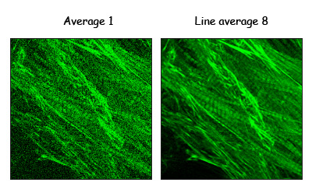
The cost of increasing gain
More electrons means more noise
This is what causes the noise in scanning confocal images
  Averaging can decrease the noise
Notes:
http://microscopy.duke.edu/learn/introtomicroscopy/confocals.html

Slide 16
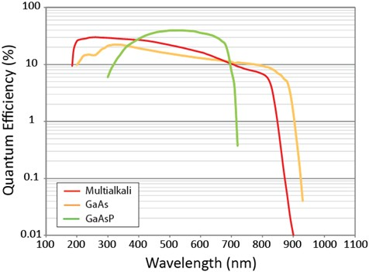
Photomultiplier Tube (PMT)
PMTs less sensitive in the red
Most PMTs multialkali photocathode material
GaAsP detectors more sensitive
Can buy PMTs that are more “green” sensitive or more “red”sensitive
  But not much difference
Notes:
As is evident in Figure 2, most photocathode materials have good response in the shorter wavelength regions of the visible and ultraviolet spectrum, between approximately 200 and 400 nanometers. Photomultipliers that have photocathodes composed of bialkali materials have a higher quantum efficiency and lower noise level in the green region of the spectrum (550-nanometers), while those with multialkali photocathodes respond better in the red and near-infrared. Bialkali photocathodes are composed of an alloy containing antimony and several alkali metals, such as rubidium, potassium, and cesium. The spectral response of bialkali photocathodes is excellent in the ultraviolet and blue regions, but drops quickly as visible wavelengths stretch into the green and red regions. Multialkali photocathodes (often referred to as S20) are composed of similar materials, but with the addition of at least three alkali metals, and have a wider spectral response region that extends into the red and near-infrared portions.
Even with their superior gain characteristics, photomultipliers have some disadvantages when compared to other types of detectors. The gain and dark current performance of individual photomultipliers from the same production run can vary widely, often by a factor of 2 to 5 for a particular design. In addition, the devices can be damaged by exposure to high illumination levels, often requiring very long recovery times (some never recover from high intensity illumination). Modern photocathodes yield very good visible and ultraviolet performance, but sensitivity drops dramatically in the longer visible wavelengths and infrared. Photomultipliers require a stabilized high voltage power supply, which increases the cost of using these detectors. Finally, even in the most sensitive wavelength region, about two-thirds of the incident light is not detected by the photocathode and does not contribute to photomultiplier gain.
http://www.olympusmicro.com/primer/techniques/confocal/pmtintro.html
Picture from
https://www.semrock.com/multimodal-nonlinear-optical-nlo-imaging.aspx

Slide 17
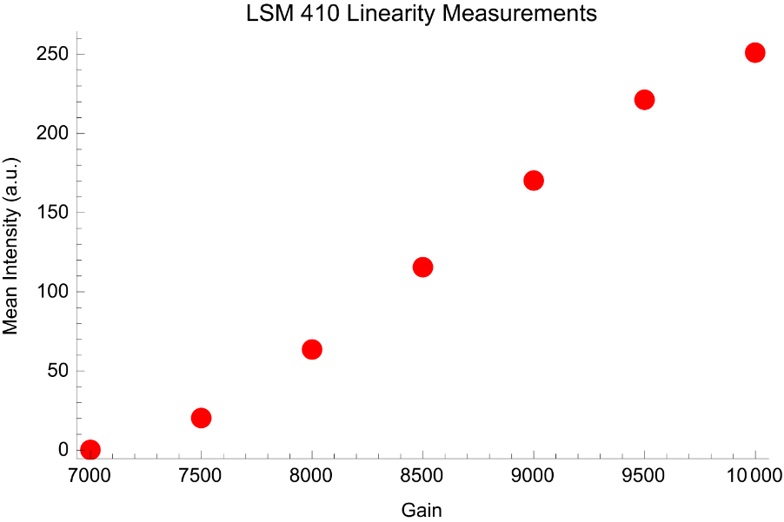
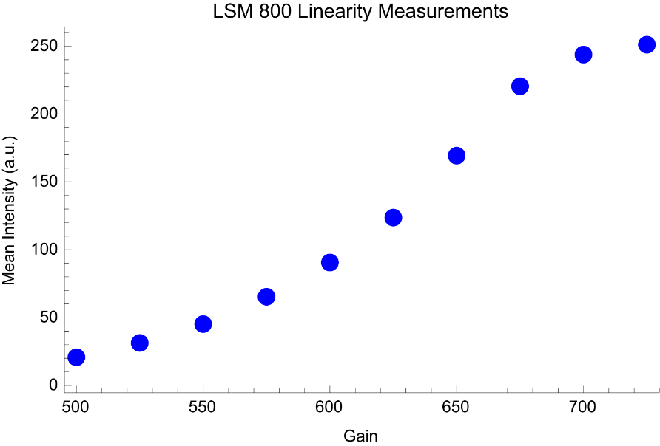
Photomultiplier Tube (PMT)
GaAsP detectors more sensitive but less linear than multialkali PMTs (Josh Brake & Emily Wyatt Bi227)
PMT
GaAsP

Slide 18
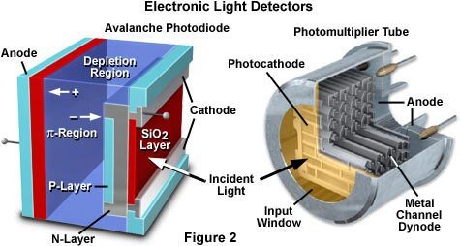
Avalanche Photodiodes vs PMT
Notes:
Two examples of commonly used light detectors lacking spatial discrimination are the photomultiplier tube and the photodiode (illustrated in Figure 2). Both devices employ a photosensitive surface that captures incident photons and generates electronic charges that are sensed and amplified. Photomultiplier tubes (PMTs) are widely used in confocal microscopes and high-end automatic exposure bodies for film cameras as well as in spectrometers. These devices respond when photons impinge on a photocathode and liberate electrons that are accelerated toward an electron multiplier composed of a series of curved plates, known as dynodes.
Silicon photodiodes also respond rapidly to light by the generation of a current, but they do so without the huge gain that accompanies electron multiplication by the PMT. Photodiodes have a relatively flat response over the entire visible spectrum (Figure 3) with high quantum efficiency that ranges from 80 to 90 percent. Uniformity of the photosensitive surface is excellent and the dynamic range and response speed of these devices are among the highest of any light detector. However, silicon diodes produce a considerable amount of noise, (much of it thermal) resulting in relatively poor signal-to-noise under photon-limited conditions, such as are common in fluorescence microscopy. Photodiodes that incorporate limited gain have been developed (avalanche photodiodes, illustrated in Figure 2) and been utilized in some confocal and wide-field fluorescence microscopes. Although they have up to 300-fold gain, they exhibit significant dark noise even when cooled to 0° C.
http://hamamatsu.magnet.fsu.edu/articles/digitalimagingdetectors.html

Slide 19
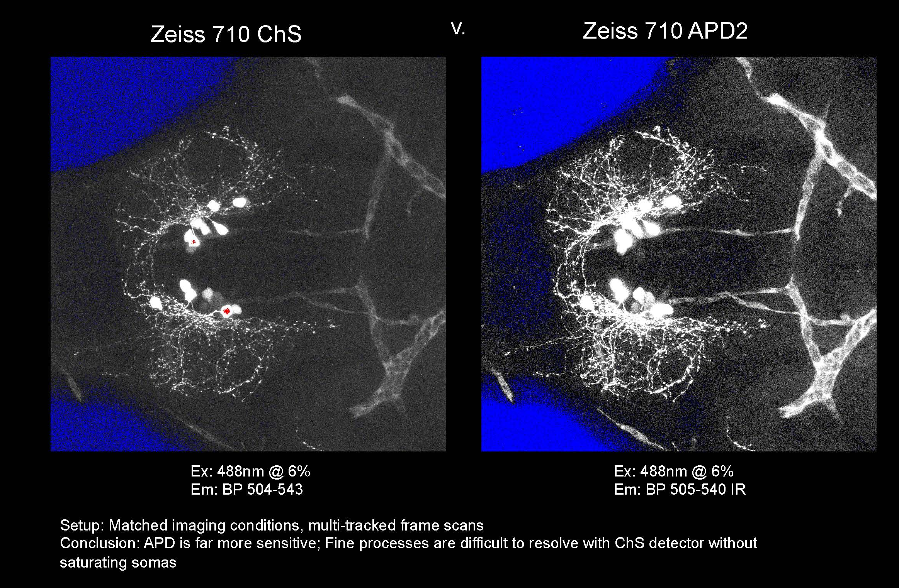
Confocal Imaging: Avalanche Photodiodes
Cindy Chiu from David Prober’s Lab, Caltech
Notes:
APD not linear. This can be good.

Slide 20
Fluorescence Microscopy
The Ultimate in Contrast

Slide 21
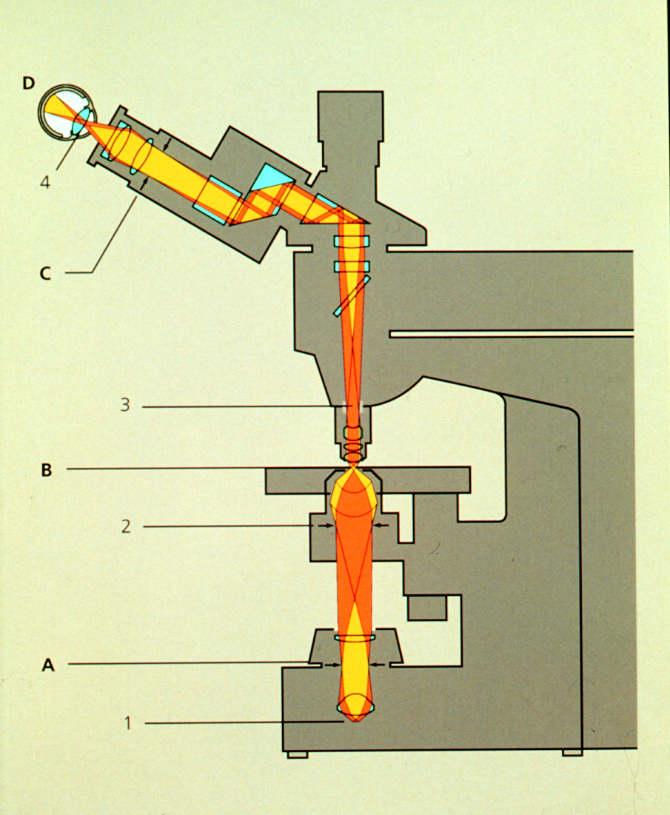
Thus Far, have considered compound microscope, and the microscope optics as a projection system (into eye)
Deliver light to the specimen
Image light from the specimen
Contrast from light absorbed, diffracted

Slide 22
Illumination Techniques - Overview
Transmitted Light
Bright-field
Oblique
Darkfield
Phase Contrast
Polarized Light
DIC (Differential Interference Contrast)
Fluorescence - not any more > Epi !
Reflected (Incident) Light
Bright-field
Oblique
Darkfield
Not any more (DIC !)
Polarized Light
DIC (Differential Interference Contrast)
Fluorescence (Epi)

Slide 23
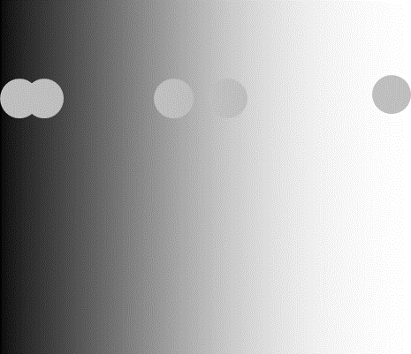
What we want in a microscope
Resolution
Contrast

Slide 24
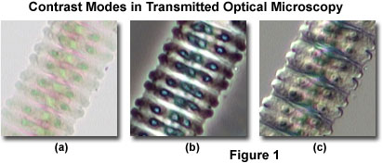
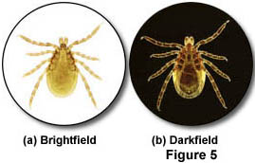
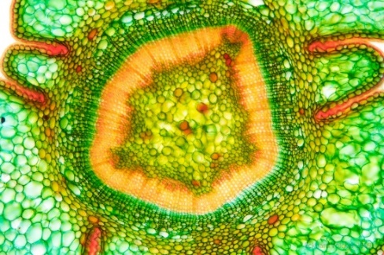
Comparing Contrast Methods
Transparent specimen contrast
  Bright field 2-5%
  Phase & DIC 15-20%
  Stained specimen 25%
  Dark field 60%
https://www.flickr.com/photos/wunderkanone/4244591261
Notes:
Stained section of Taxus baccata, Sprout, 10x
https://www.flickr.com/photos/wunderkanone/4244591261/

Slide 25
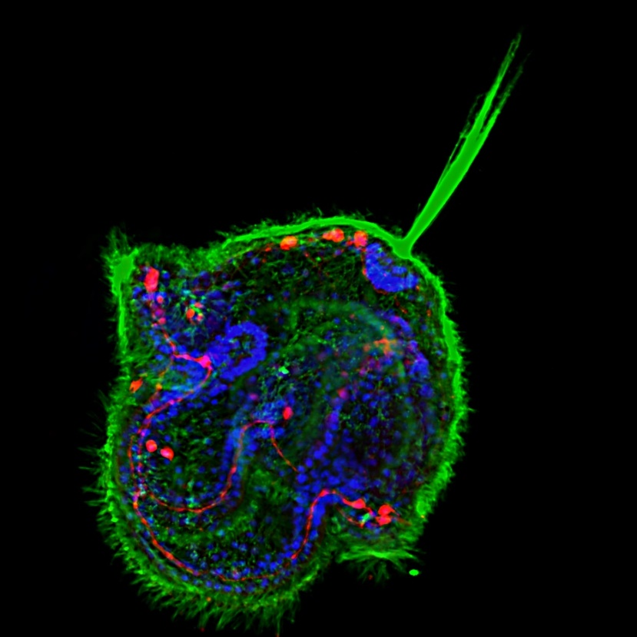
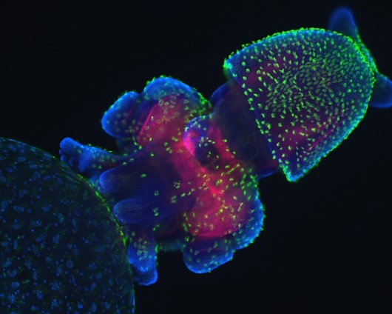
The Ultimate Contrast
Transparent specimen contrast
  Bright field 2-5%
  Phase & DIC 15-20%
  Stained specimen 25%
  Dark field 60%
  Fluorescence 75%
Notes:
Congratulations to Meii Chung of UT Austin, whose image of a Cerebratulus pilidium larva won first place in the latest voting round to choose a cover for Development from images taken by students of the 2010 Woods Hole Embryology course.
http://mblembryology.stowers.org/Development%20Covers.html
Confocal image of a squid embryo. All nuclei are stained with DAPI (blue). Phalloidin staining reveals neural structures (red), while cilia on the surface of the embryo are highlighted by acetylated tubulin staining (green). This image was taken by Davalyn Powell (University of Colorado Denver).

Slide 26
Transmitted light microscopy: photons out of the microscope are some fraction of the photons in
Now, turn our attention to fluorescence, based on the absorption and re-emission of photons
Fluorescent Dye
Dipole antenna
Delocalized electrons
Longer dipole, longer λ
Notes:
transition dipole moment (TDM)
http://www.nh.cas.cz/people/lazar/celler/emission.php

Slide 27
Fluorescence
Easy to set up: Objective = Condenser
Highly specific technique, wide selection of markers
Detection and Identification of Proteins, Bacteria, Viruses
Basics for
  Special Techniques e.g. TIRF, FRET, FRAP etc.
  3-D imaging
  Deconvolution
  Structured Illumination
  Confocal Techniques

Slide 28
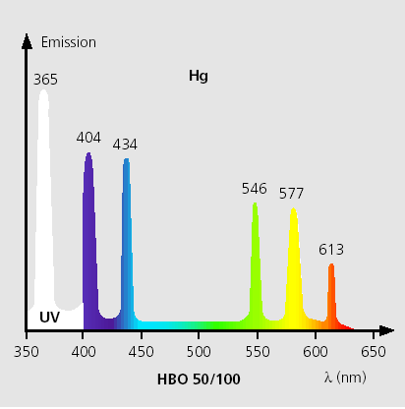
Light sources
Mercury (Hg)
Xenon, Hg/Xe Combination
Laser
LED’s
Tungsten Halogen

Slide 29
A good dye must absorb light well (high extinction coef.)
Dye in cuvette
Blue light absorbed
Beer’s Law
I_{out} = I_{in} e^{-ax}
I_{absorbed} = I_{out} - I_{in}
= I_{in}(1-e^{-εcx})
ε = extinction coefficient
For Fluorescein
ε ~ 70,000 (liter /cm M)
490nm
Light absorbed
Wavelength
Notes:
Beer Lambert Law
x = distance light travels through the material
α = attenuation coefficient
The attenuation coefficient is a quantity that characterizes how easily a material or medium can be penetrated by a beam of light. A large attenuation coefficient means that the beam is quickly "attenuated" (weakened) as it passes through the medium, and a small attenuation coefficient means that the medium is relatively transparent to the beam.
α = ε c
c = concentration of attenuating species in material
ε =extinction coefficient also called molar absorption coefficient, absorptivity of attenuator

Slide 30
Where does energy go?
Green light emitted
Blue light absorbed
Quantum Yield = light emitted/light absorbed
Q ~ 0.8 fluorescein
~ 0.3 rhodamine
Stokes Shift
490nm
520nm

Slide 31
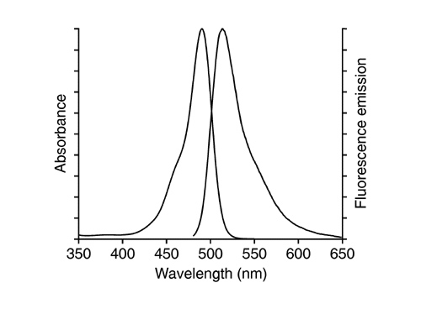
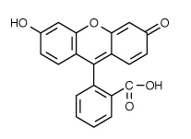
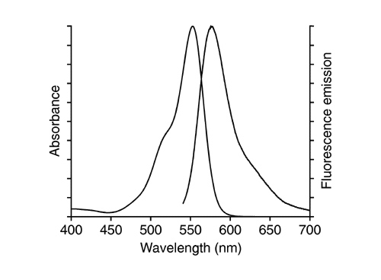
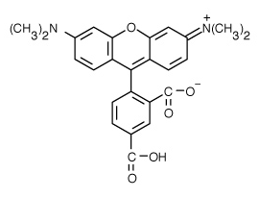
fluorescein
Co-TM rhodamine
Notes:
Carboxy tetramethyl-rhodamine (TAMRA): important for olignucleotide labeling and automated nucleic acid sequencing
Fluorescein has an absorption maximum at 494 nm and emission maximum of 512 nm (in water).
https://en.wikipedia.org/wiki/Fluorescein
http://www.sigmaaldrich.com/life-science/biochemicals/biochemical-products.html?TablePage=17902163

Slide 32
Which dye is better?
1 - absorb well (high ε )
2 - emit well (high Q)
Brightness ~ εQ
(fluorescein 0.8 * 70,000 = 57,000)
(rhodamine 0.3 * 90,000 = 27,000)
Notes:
Extinction coefficient (70,000) & Quantum yield (0.8)

Slide 33
Go deeper to explain bleaching and background
(Jablonski diagram)
4nsec
Other losses
Heat
Energy transfer
0.8 emitted

Slide 34
Add in Interstate Crossing (ISC)
ISC
~0.03
Excited triplet
state
0.8 emitted
fluorescence
4nsec
Phosphorescence
(usec - msec)
Triplet state is long lived.
therefore even low probability can deplete active dye
(steady state reached in ~200msec
~80-90% in triplet --> 5-10 fold dimmer)
CLSM: can have a major impact (~5 fold less throughput)

Slide 35
Interstate Crossing (ISC) Problem 2: Reactive oxygen
ISC
~0.03
Excited triplet
state
0.8 emitted
fluorescence
4nsec
Phosphorescence
(usec - msec)
Triplet state lifetime shortened by oxygen
(20 msec if none; 0.1 usec if oxygen present)
Good news: Returns dye to ground state
Bad news: Creates reactive oxygen

Slide 36
Issues in fluorescence
No dye is perfect < 100,000 photons total
  (ISC, bleaching)
Every emitted photon is sacred
  (NA 1.25 collects ~20%)
  (clsm w/ PMT collects 0.02% - 0.3%)
Signal/noise limited by number of photons
  Counting error N ± sqrt(N)
  Image requires >200 photons/pixel
Notes:
Since the standard deviation of shot noise is equal to the square root of the average number of events N, the signal-to-noise ratio (SNR) is given by:
S N R = ( N / sqrt N ) 2 = N .
http://www.nature.com/nmeth/journal/v7/n5/full/nmeth0510-357.html
https://en.wikipedia.org/wiki/Shot_noise

Slide 37
Not enough fluorescence photons?
If >200 photons/ pixel needed
Microscope records 0.02%
Need about 100,000 photons/pixel
~ lifetime of a dye
Given dwell-time of laser beam, ISC, collection efficiency
Lucky to record 1 photon/dye/scan
Every emitted photon is sacred!
Maximize throughput (filters, lenses, mirrors)
Minimize Bleaching

Slide 38
To reduce bleaching:
Shorten Triplet lifetime
Antibleach Agents:
Retinoids, carotinoids, glutathione
Vitamin E, N-propyl gallate
Eliminate Oxygen (scavenger, bubble N₂)
No reactive oxygen produced
(but lengthens triplet lifetime)

Slide 39
Can’t get more light by turning up the laser:
Dye saturates as I is increased
Intense laser beam depletes dye in ground state
Pumps more dye into the triplet state
(reactive oxygen and silent)
Noise doesn’t saturate
Autofluorescence in cell
flavins, NADH, NADPH
Raman spectrum of water
(488nm in; 584nm out)

Slide 40
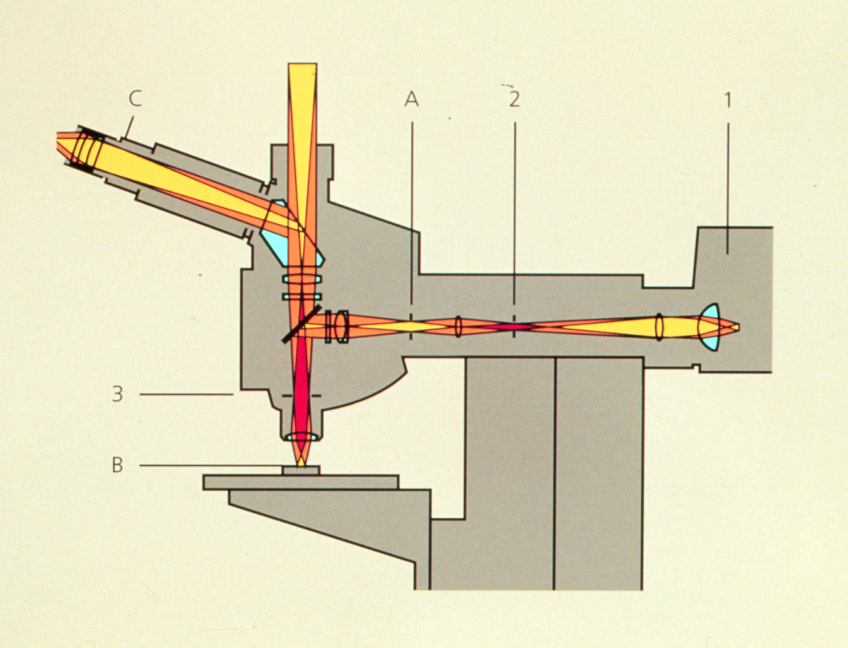
Optimize light collection, uniformity of illumination
High NA, Kohler illumination

Slide 41
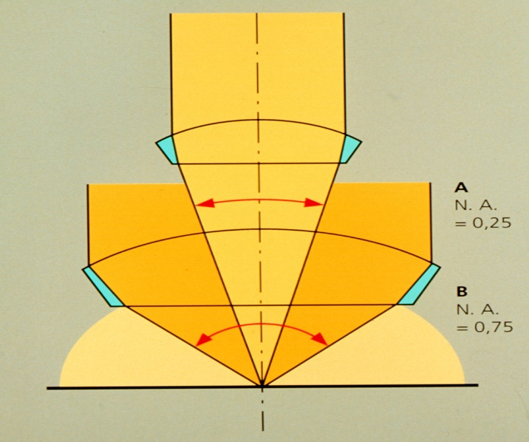
N.A. and image brightness
Transmitted light
Brightness = fn (NA² / magnification²)
θ
N.A. = η sin θ
10x 0.5 NA is 3 times brighter than 10x 0.3NA
Epifluorescence
Brightness = fn (NA⁴ / magnification²)
10x 0.5 NA is 8 times brighter than 10x 0.3NA

Slide 42
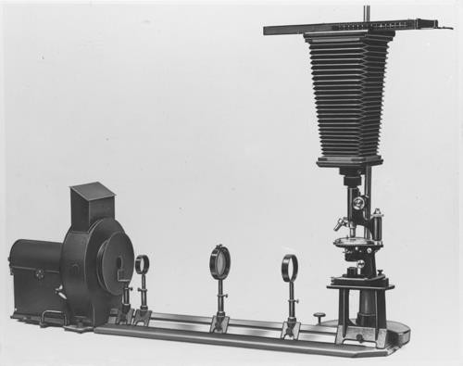

First Fluorescence microscope
Built by Henry Seidentopf & August Köhler (1908)
Used transmitted light path
So dangerous that couldn’t look through it, needed camera
Image credit: corporate.zeiss.com “Technical Milestones of Microscopy”
Notes:
Inspired by Ernst Abbe's finding that shorter wavelength light leads to higher resolution, August Köhler constructed the first ultraviolet (UV) microscope at Zeiss Optical Works in Jena, Germany, in 1904. The instrument used UV illumination from a cadmium arc lamp and allowed photographic reproduction of objects at twice the resolution of visible light microscopes. Köhler also noted that some objects emitted light of longer wavelength on illumination with UV, but it was the physicist Oskar Heimstädt who, in 1911, used this observation as the basis for the construction of the first successful fluorescence microscope.

Slide 43
First epi-fluorescence microscope
Designed in 1929 by German pharmacologist Philipp Ellinger & anatomist August Hirt
Used yellow barrier filter between objective and ocular to block reflected excitation light
Would be custom made, specialized instrument for almost 40 years
Notes:
In what they called an 'intravital microscope' the excitation light passed through a series of filters before the right wavelength hit the objective lens and triggered emission of fluorescent light in the observed tissue. A yellow barrier filter between the objective and ocular prevented most reflected excitation light from interfering with observation. Ellinger and Hirt imaged kidney and liver tissue in rodents injected with the fluorochromes fluorescein and trypaflavin.
http://www.nature.com/milestones/milelight/full/milelight04.html

Slide 44
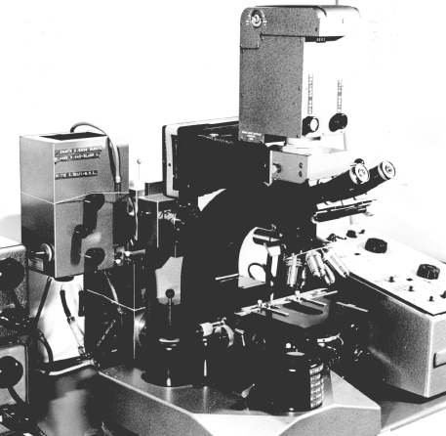
Key advance dichroic mirrors!
Dutch scientist Bas Ploem developed these in 1967
Dichromatic mirrors converted epi-fluorescence microscope from a tool that could be used only by trained specialists to a universal and indispensable instrument for modern biology
Prototype of first epi-illumination fluorescence microscope that he developed in Amsterdam in the sixties
Notes:
http://www.cyto.purdue.edu/cdroms/cyto10a/cytometryhistory/individualhistories/tanke.html
http://www.cyto.purdue.edu/cdroms/cyto10a/cytometryhistory/individualhistories/ploem.html
http://www.nature.com/milestones/milelight/full/milelight04.html

Slide 45
Choose filters well
Excitation
Dichroic
Emission
Optimize the light path for collection

Slide 46
Emission filter:
Selectively detect dye
Dichroic Reflector:
Bounce exciting λ
Pass emitted λ
Excitation filter:
Selectively excite dye

Slide 47
Epi - Fluorescence
(Specimen containing green fluorescing Fluorochrome)
Observation port
Excitation Filter
Emission Filter
FL
Light Source
Dichromatic Mirror
Specimen containing green fluorescing Fluorochrome

Slide 48
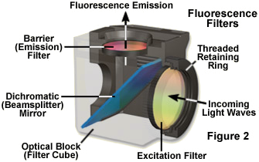
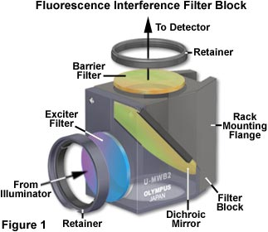
Here is what they look like
Nikon
Olympus

Slide 49
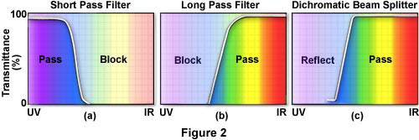
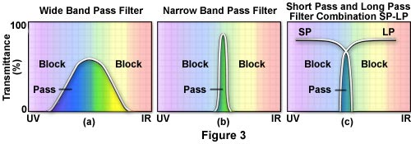
Different kinds of Emission and Excitation Filters

Slide 50
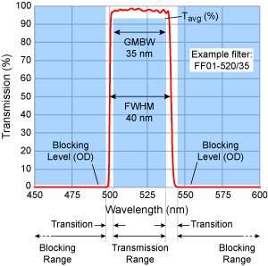
Reading bandpass filter spectrum
All have a center wavelength
Guaranteed Minimum Bandwidth (GMBW)
This is less than the FWHM
Example 520/35 filter (502.5-537.5)
Notes:
http://www.semrock.com/bandwidth.aspx
Full Width at Half Maximum (FWHM)

Slide 51
Dichroic reflector
Issues:
How steep,
How efficient to excite
How efficient to collect
Dichroic reflectors tend to be characterized by the color(s) of light that they reflect, rather than the color(s) they pass
Notes:
Also called Dichroic mirror

Slide 52
How to separate wavelengths: Interference Filters
Basic principle based on reflection from mirror
mirror
Reflection from higher index --> 180 degree shift
(separated for clarity below)
Notes:
A dichroic filter, thin-film filter, or interference filter is a very accurate color filter used to selectively pass light of a small range of colors while reflecting other colors. By comparison, dichroic mirrors and dichroic reflectors tend to be characterized by the color(s) of light that they reflect, rather than the color(s) they pass. (See dichroism for the etymology of the term.)

Slide 53
Interference Filters
Add a layer of intermediate index
3% reflection from glass
(higher index --> 180 degree shift
(separated for clarity below)
Less light passed
Constructive interference
λ/2
Note: thickness of layer in terms of wavelength
Notes:
A dichroic filter, thin-film filter, or interference filter is a very accurate color filter used to selectively pass light of a small range of colors while reflecting other colors. By comparison, dichroic mirrors and dichroic reflectors tend to be characterized by the color(s) of light that they reflect, rather than the color(s) they pass. (See dichroism for the etymology of the term.)

Slide 54
Interference Filters are wavelength dependent
λ ₂ = 2 x λ ₁
λ ₁
Less light passed
Constructive interference
λ/2
λ ₂
most light passed
Destructive interference
(antireflection coating)
λ/4
Same thickness is smaller in terms of wavelength for λ ₂
Notes:
A dichroic filter, thin-film filter, or interference filter is a very accurate color filter used to selectively pass light of a small range of colors while reflecting other colors. By comparison, dichroic mirrors and dichroic reflectors tend to be characterized by the color(s) of light that they reflect, rather than the color(s) they pass. (See dichroism for the etymology of the term.)

Slide 55
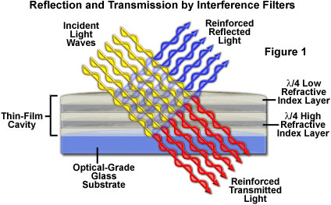
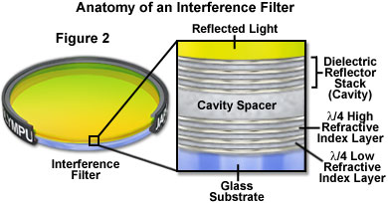
Interference filters: the movie
Reflect one wavelength while passing another
Innovation that relatively inexpensive to make
Link to Java Tutorial
http://olympus.magnet.fsu.edu/primer/java/filters/interference/index.html
Notes:
Recent technological achievements in bandpass filter design have led to the relatively inexpensive construction of thin-film interference filters featuring major improvements in wavelength selection and transmission performance. These filters operate by transmitting a selected wavelength region with high efficiency while rejecting, through reflection and destructive interference, all other wavelengths.

Slide 56
Another Note:
Resonance Energy Transfer (non-radiative)
The Bad: Self-quenching
If dye at high concentration
“hot-potato” the energy until lost

Slide 57
Another Note:
Resonance Energy Transfer (non-radiative)
The Good: FRET as a molecular yardstick
Transfer of energy from one dye to another
Depends on:
Spectral overlap
Distance
Alignment

Slide 58
donor
acceptor
FRET:
Optimize spectral overlap
Optimize κ² -- alignment of dipoles
Minimize direct excitement of the acceptor
(extra challenge for filter design)

