Slide 1
Biology 177: Principles of Modern Microscopy
Lecture 05:
Illumination and Detectors
Andres Collazo, Director Biological Imaging Facility
Wan-Rong (Sandy) Wong, Graduate Student, TA

Slide 2
Lecture 5: Illumination and Detectors
Review diffraction
Illumination sources
  Tungsten-Halogen
  Mercury arc lamp
  Metal Halide Arc lamps
  Xenon Arc lamps
  LED (Light-Emitting Diode)
  Laser
Detectors
  CCD
  CMOS
Review Homework 2

Slide 3
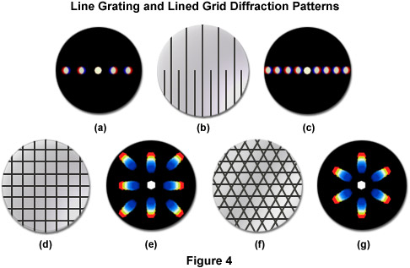
Diffraction review
-1
0
+1
-2
+2
+3
+4
+5
Blue “light”
Notes:
Interference of Coherent Waves

Slide 4
Questions about last lecture?

Slide 5
Two types of illumination
Critical
  Focus the light source directly on the specimen
  Only illuminates a part of the field of view
  High intensity applications only (VE-DIC)
Köhler
  Light source out of focus at specimen
  Most prevalent
  The technique you must learn and use
Notes:
Video enhanced DIC

Slide 6


Conjugate Planes (Koehler)
Retina
Eye
Eyepoint
Eyepiece
Intermediate Image
TubeLens
Imaging Path
Objective Back Focal Plane
Objective
Specimen
Condenser
Condenser Aperture Diaphragm
Field Diaphragm
Illumination Path
Collector
Light Source

Slide 7
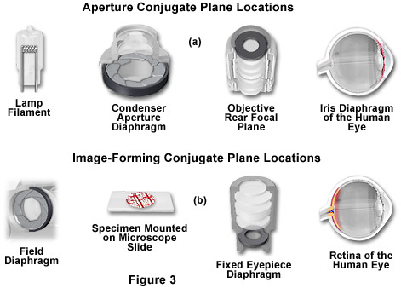
Illumination and optical train
Helpful for finding contamination
Notes:
The microscope contains two different groups of interlaced optical planes that are responsible for controlling illumination and image formation. Collectively, these optical planes are known as conjugate planes. The first group of planes (termed the aperture planes) controls the beam path for illuminating light and produces a focused image of the lamp filament at the plane of the substage condenser aperture diaphragm, the rear focal plane of the objective, and the eye point (also called the Ramsden disk) of the eyepiece. Conjugate planes are in common focus and are critical in achieving proper Köhler illumination. A second set of planes, known as the image-forming conjugate planes include the field diaphragm, the specimen, the fixed diaphragm of the eyepiece and the retina of the eye or the surface of a camera detector. By definition, an object that is in focus at one plane is also in focus at the other conjugate planes of that light path. In each light pathway (both image-forming and illumination), there are four separate planes that together make up the conjugate plane set.
In review, conjugate planes in the path of the illuminating light rays in Köhler illumination (Figure 3(a)) include:
The lamp filament.
The condenser aperture diaphragm (at the front focal plane of the condenser).
The back focal plane of the objective.
The eye point (also called the Ramsden disk) of the eyepiece, which is located approximately one-half inch (one centimeter) above the top lens of the eyepiece, at the point where the observer places the front of the eye during observation.
Likewise, the conjugate planes in the image-forming light path in Köhler illumination (Figure 3(b)) include:
The field diaphragm.
The focused specimen.
The intermediate image plane (i.e., the plane of the fixed diaphragm of the eyepiece).
The retina of the eye, film plane, or image sensor surface of the camera.
http://zeiss-campus.magnet.fsu.edu/articles/basics/images/opticaltrainfigure3.jpg

Slide 8
Illumination sources

Slide 9
Illumination sources
What was the first source of illumination?

Slide 10
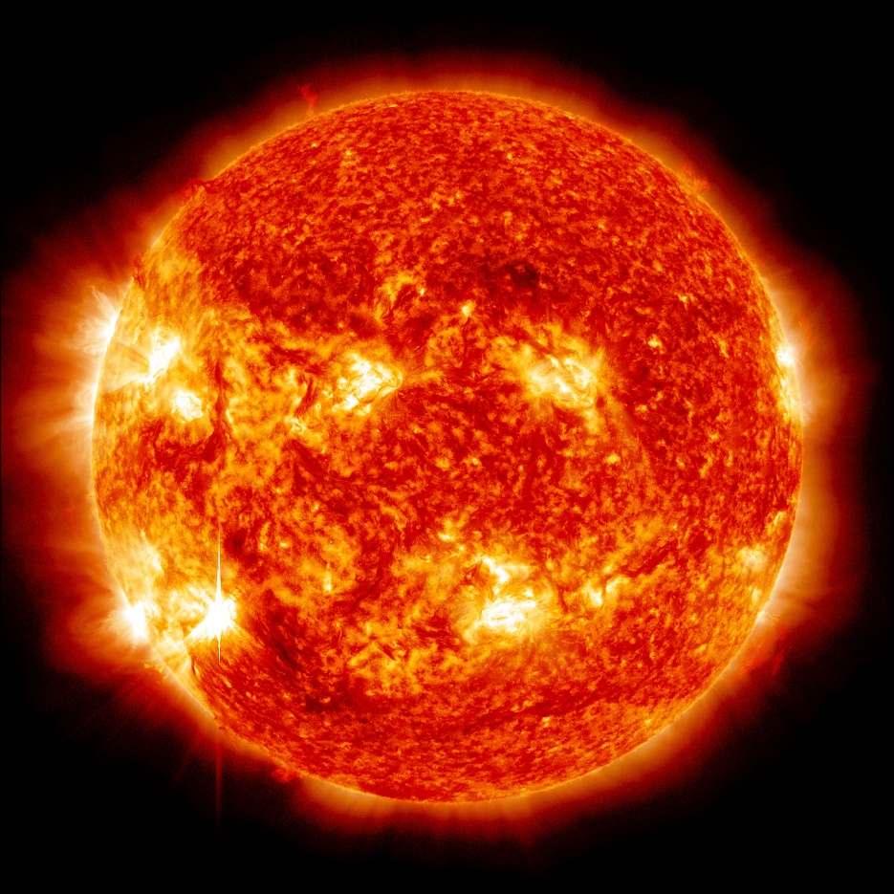
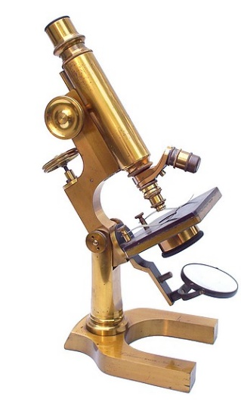
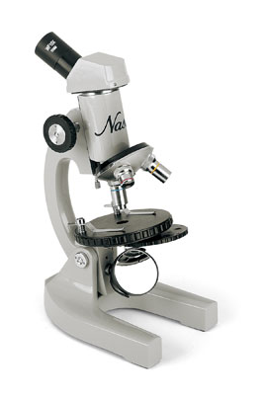
Illumination sources
What was the first source of illumination?
The Sun!
Notes:
Visible in the lower left corner, the sun emitted an M6 solar flare on Nov. 12, 2012, which peaked at 9:04 p.m. EST. This image is a blend of two images captured by NASA's Solar Dynamics Observatory (SDO), one showing the sun in the 304 Angstrom wavelength and one in the 193 Angstrom wavelength.
Image Credit:
NASA/SDO
http://www.antique-microscopes.com/mics/Schrauer_b.html
L. Schrauer, Maker, New York
Continental style monocular microscope, c.1892
http://imgarcade.com/1/microscope-mirror/

Slide 11
Illumination sources
Tungsten-Halogen lamps
Mercury Arc lamps
Metal Halide Arc lamps
Xenon Arc lamps
LED (Light-Emitting Diode)
Laser (Light Amplification by Stimulated Emission of Radiation)
Notes:
http://micro.magnet.fsu.edu/primer/anatomy/lightsourceshome.html

Slide 12
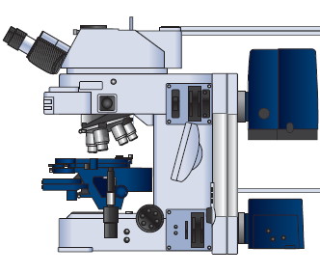
Illumination sources
Incident Light
Tungsten-Halogen lamps
Mercury Arc lamps
Metal Halide Arc lamps
Xenon Arc lamps
LED
Laser
Transmitted Light
Notes:
http://micro.magnet.fsu.edu/primer/anatomy/lightsourceshome.html

Slide 13
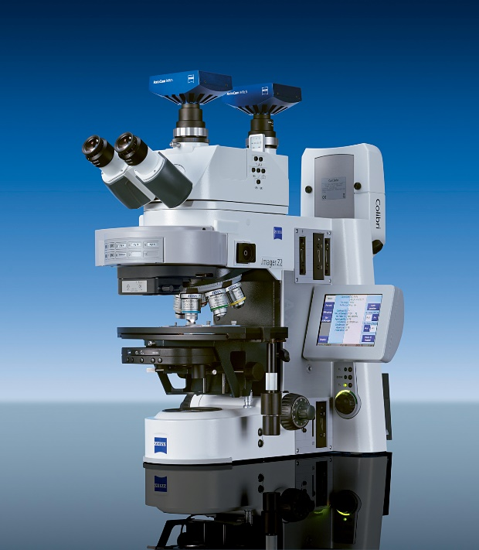
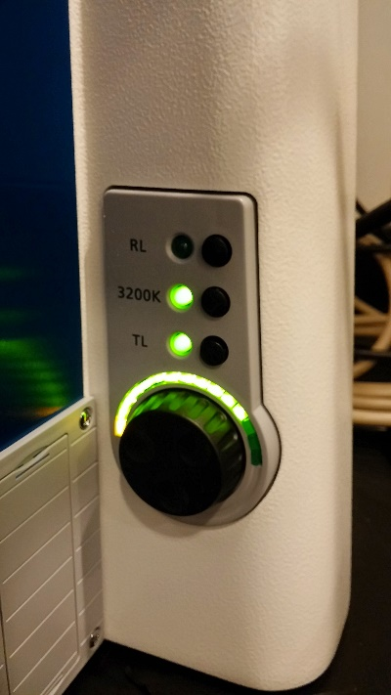
Tungsten-Halogen lamps
Why would we want higher filament temperatures?
What does the 3200K button on a microscope mean?
Notes:
n contrast, the tubular envelope in tungsten-halogen lamps is filled with an inert gas (either nitrogen, argon, krypton, or xenon) that is mixed during assembly with a minute amount of a halogen compound (usually hydrogen bromide; HBr) and trace levels of molecular oxygen. The halogen compound serves to initiate a reversible chemical reaction with tungsten evaporated from the filament to yield gaseous tungsten oxyhalide molecules in the vapor phase.
The benefits of the halogen regenerative cycle include the ability to use smaller envelopes that are maintained in a clean, deposit-free condition during the life span of the lamp. Because the envelope is smaller than those used in conventional tungsten lamps, expensive quartz and related glass alloys can be more economically employed during fabrication. The stronger quartz envelopes enable higher internal gas pressure to be used to assist in suppression of filament vaporization, thus allowing increased filament temperatures that produce more luminous output and shift emission profiles to feature a greater proportion of the more desirable visible wavelengths. As a result, tungsten-halogen lamps retain their original brightness throughout their life span and also convert electric current to light more efficiently than their predecessors. On the downside, the tungsten vaporized and re-deposited by the halogen regenerative cycle is not returned to its original location, but rather winds up on the coolest regions of the filament, resulting in uneven thickness. Eventually the lamps fail due to decreased filament thickness in the hottest regions. Otherwise, tungsten-halogen lamps might feature almost infinite life spans.
Early investigations revealed that the addition of fluoride salts to the vapor sealed inside tungsten-halogen lamps produced output with the highest level of visible wavelengths, and also deposited recycled tungsten on regions of the filament with higher temperatures. This discovery instilled hope that tungsten filaments could be maintained at a more uniform thickness throughout a dramatically increased life span for these lamps. Furthermore, the shifting of lamp emission profile output to include more visible wavelengths was highly desirable compared to the lower color temperatures afforded by similar lamps having alternative halogen compounds (iodide, chloride, and bromide). Unfortunately, fluoride compounds were discovered to aggressively attack glass (note that hydrofluoric acid is commonly used to etch glass) leading to premature failure of the envelope. Thus, fluoride compounds are not useful for commercial lamps. As a consequence, the bromide compounds discussed above are still the reagent of choice for production of tungsten-halogen lamps, but the lamp manufacturers continue to research the application of new fill gas and halogen mixtures for these highly useful light sources.

Slide 14
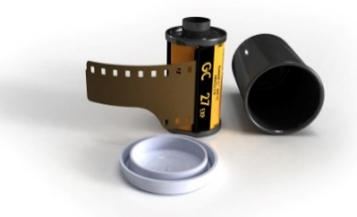
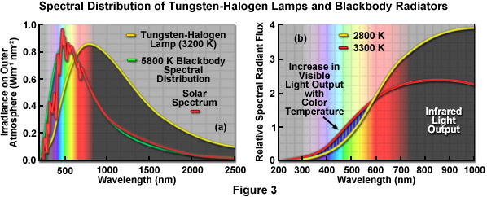
Tungsten-Halogen lamps
Why would we want higher filament temperatures?
What does the 3200K button on a microscope mean?
A relic of the days of film
Notes:
n contrast, the tubular envelope in tungsten-halogen lamps is filled with an inert gas (either nitrogen, argon, krypton, or xenon) that is mixed during assembly with a minute amount of a halogen compound (usually hydrogen bromide; HBr) and trace levels of molecular oxygen. The halogen compound serves to initiate a reversible chemical reaction with tungsten evaporated from the filament to yield gaseous tungsten oxyhalide molecules in the vapor phase.
The benefits of the halogen regenerative cycle include the ability to use smaller envelopes that are maintained in a clean, deposit-free condition during the life span of the lamp. Because the envelope is smaller than those used in conventional tungsten lamps, expensive quartz and related glass alloys can be more economically employed during fabrication. The stronger quartz envelopes enable higher internal gas pressure to be used to assist in suppression of filament vaporization, thus allowing increased filament temperatures that produce more luminous output and shift emission profiles to feature a greater proportion of the more desirable visible wavelengths. As a result, tungsten-halogen lamps retain their original brightness throughout their life span and also convert electric current to light more efficiently than their predecessors. On the downside, the tungsten vaporized and re-deposited by the halogen regenerative cycle is not returned to its original location, but rather winds up on the coolest regions of the filament, resulting in uneven thickness. Eventually the lamps fail due to decreased filament thickness in the hottest regions. Otherwise, tungsten-halogen lamps might feature almost infinite life spans.
Early investigations revealed that the addition of fluoride salts to the vapor sealed inside tungsten-halogen lamps produced output with the highest level of visible wavelengths, and also deposited recycled tungsten on regions of the filament with higher temperatures. This discovery instilled hope that tungsten filaments could be maintained at a more uniform thickness throughout a dramatically increased life span for these lamps. Furthermore, the shifting of lamp emission profile output to include more visible wavelengths was highly desirable compared to the lower color temperatures afforded by similar lamps having alternative halogen compounds (iodide, chloride, and bromide). Unfortunately, fluoride compounds were discovered to aggressively attack glass (note that hydrofluoric acid is commonly used to etch glass) leading to premature failure of the envelope. Thus, fluoride compounds are not useful for commercial lamps. As a consequence, the bromide compounds discussed above are still the reagent of choice for production of tungsten-halogen lamps, but the lamp manufacturers continue to research the application of new fill gas and halogen mixtures for these highly useful light sources.

Slide 15
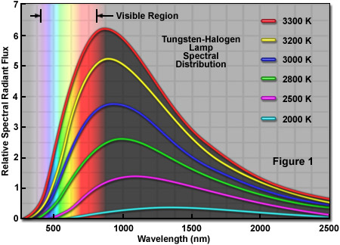
Tungsten-Halogen lamps
Still most popular illumination for transmitted light path, but not for long
Can you see one problem with this light source?
Notes:
Tungsten-halogen lamps were first developed in the early 1960s by replacing the traditional glass bulb with a higher performance quartz envelope that was no longer spherical, but tubular in shape. In addition, minute amounts of iodine vapor were sealed inside the envelope. Replacement of the lower-melting glass by quartz was necessary because the halogen regenerative cycle of the lamp (discussed in detail below) requires the envelope to be maintained at a high temperature (in excess of those tolerated by ordinary glass) to prevent tungsten halogen compounds from solidifying on the inside surface. Because of the new components, these advanced lamps were originally referred to using the term: quartz-iodide. Although lamps containing halogens represented a significant improvement over the plain tungsten bulbs they replaced, the new lamps featured a slight pinkish tinge that is characteristic of iodine vapor. In addition, quartz is readily attacked by the mild alkalis formed during operation, leading to premature failure of the envelope itself. In following years, bromine compounds replaced iodine and the envelope was fabricated with newer borosilicate glass alloys to produce tungsten-halogen lamps having even longer life spans and higher radiant output.

Slide 16
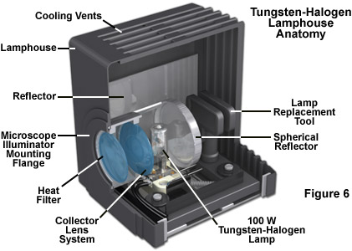
Tungsten-Halogen lamps
Still most popular illumination for transmitted light path, but not for long
Can you see one problem with this light source?
Solving IR problem
Notes:
Tungsten-halogen lamps were first developed in the early 1960s by replacing the traditional glass bulb with a higher performance quartz envelope that was no longer spherical, but tubular in shape. In addition, minute amounts of iodine vapor were sealed inside the envelope. Replacement of the lower-melting glass by quartz was necessary because the halogen regenerative cycle of the lamp (discussed in detail below) requires the envelope to be maintained at a high temperature (in excess of those tolerated by ordinary glass) to prevent tungsten halogen compounds from solidifying on the inside surface. Because of the new components, these advanced lamps were originally referred to using the term: quartz-iodide. Although lamps containing halogens represented a significant improvement over the plain tungsten bulbs they replaced, the new lamps featured a slight pinkish tinge that is characteristic of iodine vapor. In addition, quartz is readily attacked by the mild alkalis formed during operation, leading to premature failure of the envelope itself. In following years, bromine compounds replaced iodine and the envelope was fabricated with newer borosilicate glass alloys to produce tungsten-halogen lamps having even longer life spans and higher radiant output.

Slide 17
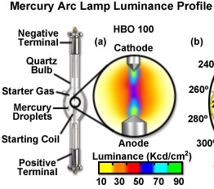
Mercury Arc lamps
10-100 x brighter than incandescent lamps
Started using in 1930s
Also called HBO ™ lamps (H = mercury Hg, B = symbol for luminance, O = unforced cooling).

Slide 18
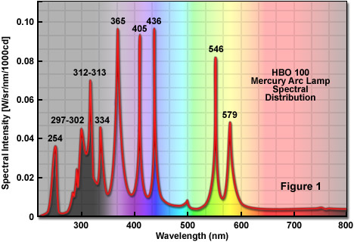
Mercury Arc lamps
33% output in visible, 50% in UV and rest in IR
Quite different from T-Halogen lamp output
Spectral output is peaky
Many fluorophores have been designed and chosen based on Hg lamp spectral lines
Remember Fraunhofer lines?
Notes:
For Halogen lamp the majority of the emitted energy (up to 85 percent) lies in the infrared and near-infrared regions of the spectrum, with 15-20 percent falling into the visible (400 to 700 nanometers), and less and 1 percent in the ultraviolet wavelengths (below 400 nanometers).
Newer synthetic fluorophores, including the MitoTrackers, Cyanine (Cy) series, and Alexa Fluor dyes have been specially tailored to match mercury spectral lines. For example, the MitoTracker Red absorption maximum of 579 nanometers almost exactly matches the corresponding mercury line, whereas Cy3 (maximum at 548 nanometers) efficiently absorbs the 546 mercury line. Several of the Alexa Fluor dyes are named in reference to their equivalent mercury absorption profiles: Alexa Fluor 350 (mercury-365), Alexa Fluor 405 (mercury-405), Alexa Fluor 430 (mercury-436), and Alexa Fluor 546 (mercury-546). In general, when exciting fluorophores with a mercury arc illumination source, it is wise to choose among the widely available fluorophores that closely match the spectral lines.

Slide 19
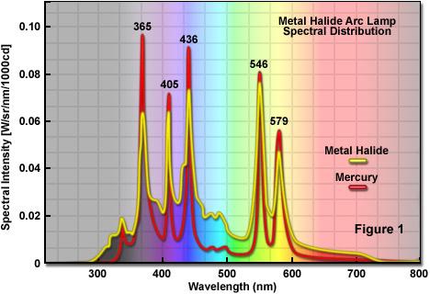
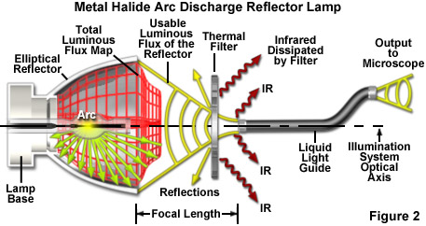
Metal Halide Arc lamps
Use arc lamp and reflector to focus into liquid light guide
Light determined by fill components (up to 10!)
Most popular uses Hg spectra but better in between peaks (GFP!)
Notes:
The quality of light emitted by a metal halide lamp is primarily determined by the fill components. Depending upon the application, metal halide lamps can be filled with any number of up to 10 different components that perform critical functions, dictated by their chemical and physical properties, in the light generation process. One of the components present in all metal halide lamps is an inert starter gas, usually argon or xenon, which does not react with other fill components and exhibits desirable ignition properties. The lamps used in microscopy also contain liquid mercury vapor and halogens. Mercury concentration primarily affects the lamp operating pressure and governs the voltage requirements, as discussed above. The halogens most widely used in metal halide lamps are iodine and bromine, which react with the trace levels of rare earth metals to form halide salts. These salts exhibit a higher vapor pressure than the metals alone, enabling engineers to fine-tune the particle density of rare earths in the arc for adjustments of color temperature and other emission properties.
The lamps used in microscopy also contain liquid mercury vapor and halogens. Mercury concentration primarily affects the lamp operating pressure and governs the voltage requirements, as discussed above. The halogens most widely used in metal halide lamps are iodine and bromine, which react with the trace levels of rare earth metals to form halide salts.
The rare earth metals used in metal halide lamps belong to the lanthanide series and are usually dysprosium (Dy), thulium (Tm), and/or holmium (Ho). Varying the combination and concentration of these metallic elements can be used to modulate the emission spectral distribution in order to match the target application for the lamp. In general, the rare earths are chosen to provide a continuous daylight spectral output with high luminous efficacy. At room temperature, metal halide lamps exist at or below ambient pressure, but during operation the internal pressure can range between 10 and 40 atmospheres, depending upon the fill components.
http://zeiss-campus.magnet.fsu.edu/print/lightsources/metalhalide-print.html

Slide 20
Metal Halide Arc lamps
Optical Power of Metal Halide Lamps
Filter Set | Excitation Filter Bandwidth (nm) | Dichromatic Mirror Cutoff (nm) | Power mW/Cm²
DAPI (49)¹ | 365/10 | 395 LP | 14.5
CFP (47)¹ | 436/25 | 455 LP | 76.0
GFP/FITC (38)¹ | 470/40 | 495 LP | 57.5
YFP (S-2427A)² | 500/24 | 520 LP | 26.5
TRITC (20)¹ | 546/12 | 560 LP | 33.5
TRITC (S-A-OMF)² | 543/22 | 562 LP | 67.5
Texas Red (4040B)² | 562/40 | 595 LP | 119.5
mCherry (64HE)¹ | 587/25 | 605 LP | 54.5
Cy5 (50)¹ | 640/30 | 660 LP | 13.5
Notes:
¹ZEISS Filters ²Semrock Filters
A considerable effort has been expended on developing specialized fluorophores that have absorption maxima located near the prominent mercury spectral lines (see Table 2). The classical fluorescent probes DAPI (4',6-diamidino-2-phenylindole) and rhodamine efficiently absorb the 365 and 546 nanometer mercury lines, respectively, however the absorption maximum of fluorescein (perhaps one of the universally most widely used fluorophores) lies in the region between 450 and 500 nanometers, which is devoid of a prominent mercury line (Figure 1). Newer synthetic fluorophores, including the MitoTrackers, Cyanine (Cy) series, and Alexa Fluor dyes have been specially tailored to match mercury spectral lines. For example, the MitoTracker Red absorption maximum of 579 nanometers almost exactly matches the corresponding mercury line, whereas Cy3 (maximum at 548 nanometers) efficiently absorbs the 546 mercury line. Several of the Alexa Fluor dyes are named in reference to their equivalent mercury absorption profiles: Alexa Fluor 350 (mercury-365), Alexa Fluor 405 (mercury-405), Alexa Fluor 430 (mercury-436), and Alexa Fluor 546 (mercury-546). In general, when exciting fluorophores with a mercury arc illumination source, it is wise to choose among the widely available fluorophores that closely match the spectral lines. It should be noted that mercury arc lamps are not a suitable light source for several ratiometric dyes, such as Fura-2 and Indo-1, where comparison of the signals at two excitation wavelengths is compromised by the fact that one of the wavelengths overlaps with a mercury peak to a much greater degree than does the other. Also, the relatively weak emission by mercury lamps in the 450 to 540 nanometer region renders these illumination sources less useful for many of the popular dyes that absorb strongly in the blue-green region, including fluorescein, Alexa Fluor 488, Cy2, and the many varieties of green fluorescent protein.

Slide 21
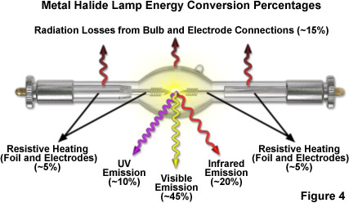
Metal Halide Arc lamps
Better light for fluorescence microscopy
Similar artifacts as mercury arc lamps
Remember Mercury arc lamp: 33% output in visible, 50% in UV and rest in IR
Notes:
Electronics allow them to be turned on and off without problems. No alignment!
The metal halide lamps used in microscopy are grouped in the HTI family by Osram, where H is an abbreviation of the symbol for mercury (Hg or Hydragyrum), T refers to the German term for daylight (Tageslicht), and I indicates the presence of halogen compounds (iodides and bromides). Other designations in use by Osram are M or R for rare earth metals, S for safe lamps that have an external bulb surrounding the envelope, P for projection lamps, and C for cable-equipped. Ushio metal halide lamps are marketed under the tradename of EmArc® with a code prefix of SMH, the acronym for short-arc metal halide. Other manufacturers have similarly confusing nomenclature, so their product catalogs should be carefully reviewed in order to ensure the correct lamp choice for a particular application.

Slide 22
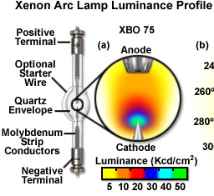
Xenon Arc lamps
Bright like Mercury
Better than Hg in blue-green (440 to 540 nm) and red (685 to 700 nm)
Also called XBO ™ lamps (X = xenon Xe, B = symbol for luminance, O = unforced cooling).

Slide 23
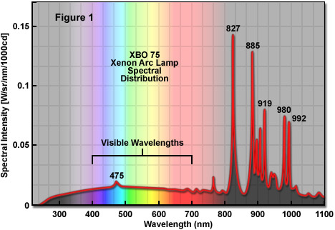
Xenon Arc lamps
25% output in visible, 5% in UV and 70% in IR
Continuous and uniform spectrum across visible
Color temp like sunlight, 6000K
Unlike Hg arc lamps, good for quantitative fluorescence microscopy
Great for ratiometric fluorophores
Notes:
One of the primary requirements of using a xenon arc lamp for quantitative fluorescence microscopy applications is that the emission output must be stable. The output radiant intensity of a xenon lamp is approximately proportional to the current flow through the lamp. Thus, to ensure maximum stability, the power supply must be carefully designed. Arc lamp power supplies must also incorporate a triggering device for lamp ignition. Illustrated in Figure 5 is the schematic diagram of a typical stabilized power supply for a xenon arc lamp. In addition to supplying the lamp with a stable direct current (DC) source, the power supply is also charged with maintaining the cathode at the optimal operating temperature using a specific current level. The stabilizing circuitry of a xenon arc lamp power supply, depending upon design, can stabilize the voltage, current, or the total power (voltage x current). If the voltage is stabilized, the current (and lamp brightness) will slowly decrease as the electrodes decay. In contrast, if the current is stabilized, the lamp will continue to emit at a constant level until the electrodes reach the critical point of deterioration that the lamp fails to ignite. On the downside, as increasing voltages are required to maintain a fixed current, the power sent to the arc slowly increases as the electrodes wear, which can result in overheating and the potential for an explosion. In power supplies that stabilize the total power level, the light output will slowly drop with current as the voltage needed to maintain the arc increases.

Slide 24
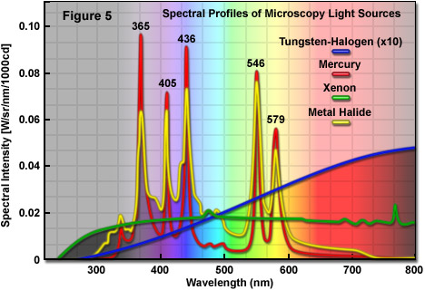
Illumination sources compared
Tungsten-Halogen lamps
Mercury Arc lamps
Metal Halide Arc lamps
Xenon Arc lamps
Notes:
http://micro.magnet.fsu.edu/primer/anatomy/lightsourceshome.html

Slide 25
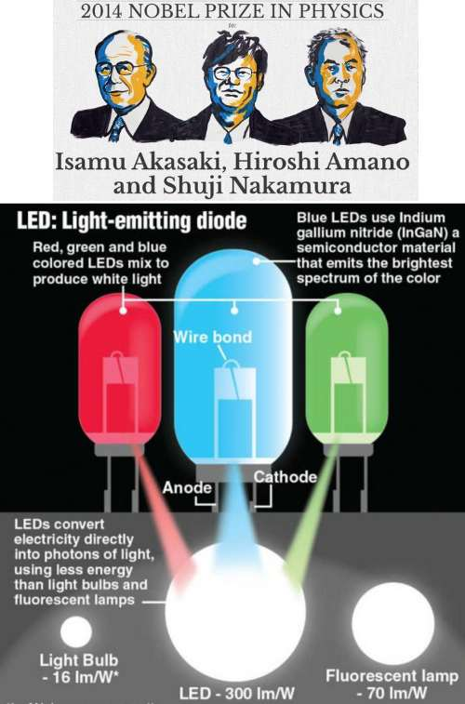
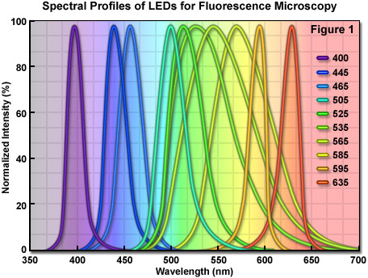
Light-Emitting Diodes (LEDs)
Semiconductor based light source
FWHM of typical quasi-monochromatic LED varies between 20 and 70 nm, similar in size to excitation bandwidth of many synthetic fluorophores and fluorescent proteins

Slide 26
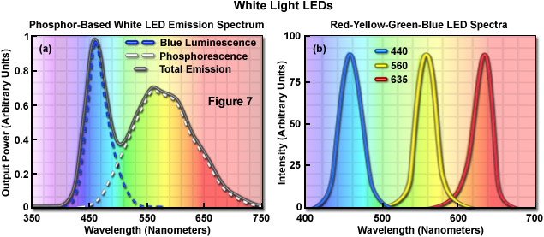
Light-Emitting Diodes (LEDs)
Can be used for white light as well
Necessary for transmitted illumination
2 ways to implement

Slide 27
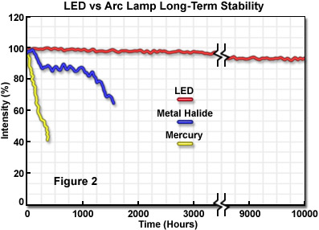
LED Advantages compared to T-Halogen, Mercury, Metal Halide & Xenon lamps
100% of output to desired wavelength
Produces little heat
Uses relatively little power
Not under pressure, so no explosion risk
Very stable illumination, more on this later
Getting brighter
Notes:
Advantages over Tungsten-Halogen as well as mercury, xenon and metal halide arc lamps

Slide 28
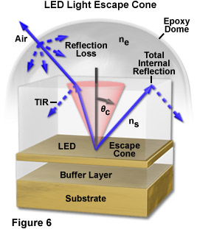
Light-Emitting Diodes (LEDs)
Only down-side so far is brightness but improving quickly
Losses to Total internal reflectance and refractive index mismatch
Microlens array most promising solution

Slide 29
Environmental implications of microscope illumination source
Toxic waste
  Mercury
  Other heavy metals
Energy efficiency
  Arc lamps use a lot of power
  Halogen, xenon and mercury lamps produce a lot of heat

Slide 30
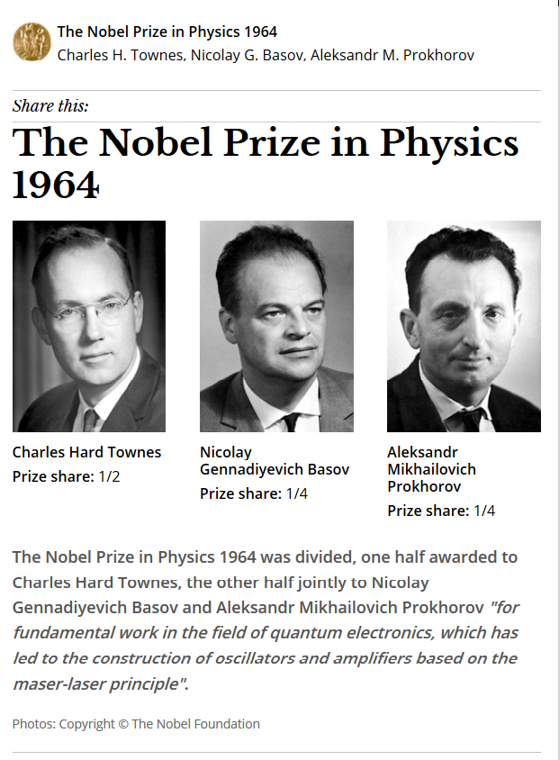
Laser (Light Amplification by Stimulated Emission of Radiation)
High intensity monochromatic light source
Masers (microwave) first made in 1953
Lasers (IR) in 1957
Laser handout on course website
Notes:
Laser (Light Amplification by Stimulated Emission of Radiation)

Slide 31
Most common Laser types for microscopy
Gas lasers
  Electric current is discharged through a gas to produce coherent light
  First laser
Solid-state lasers
  Use a crystalline or glass rod which is "doped" with ions to provide required energy states
Dye lasers
  use an organic dye as the gain medium.
Semiconductor (diode) lasers
  Electrically pumped diodes

Slide 32
Illumination sources of the future
LED (Light-Emitting Diode)
Laser (Light Amplification by Stimulated Emission of Radiation)
Notes:
http://micro.magnet.fsu.edu/primer/anatomy/lightsourceshome.html

Slide 33
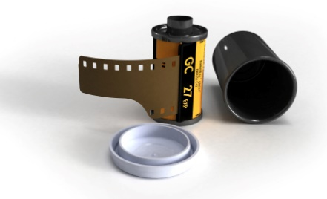
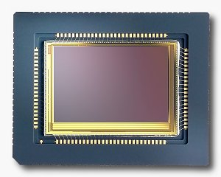
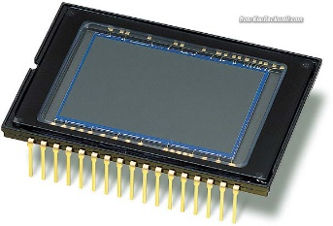
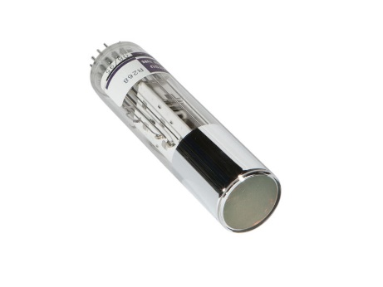
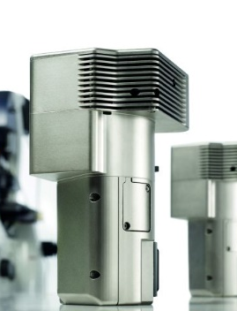
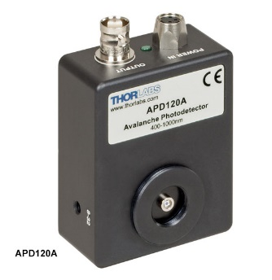
Detectors for microscopy
Film
CMOS (Complementary metal–oxide–semiconductor)
CCD (Charge coupled device)
PMT (Photomultiplier tube)
GaAsP (Gallium arsenide phosphide)
APD (Avalanche photodiode)

Slide 34
Detectors for microscopy
Film
CMOS (Complementary metal–oxide–semiconductor)
CCD (Charge coupled device)
PMT (Photomultiplier tube)
GaAsP (Gallium arsenide phosphide)
APD (Avalanche photodiode)
Array of detectors, like your retina
Single point source detectors

Slide 35
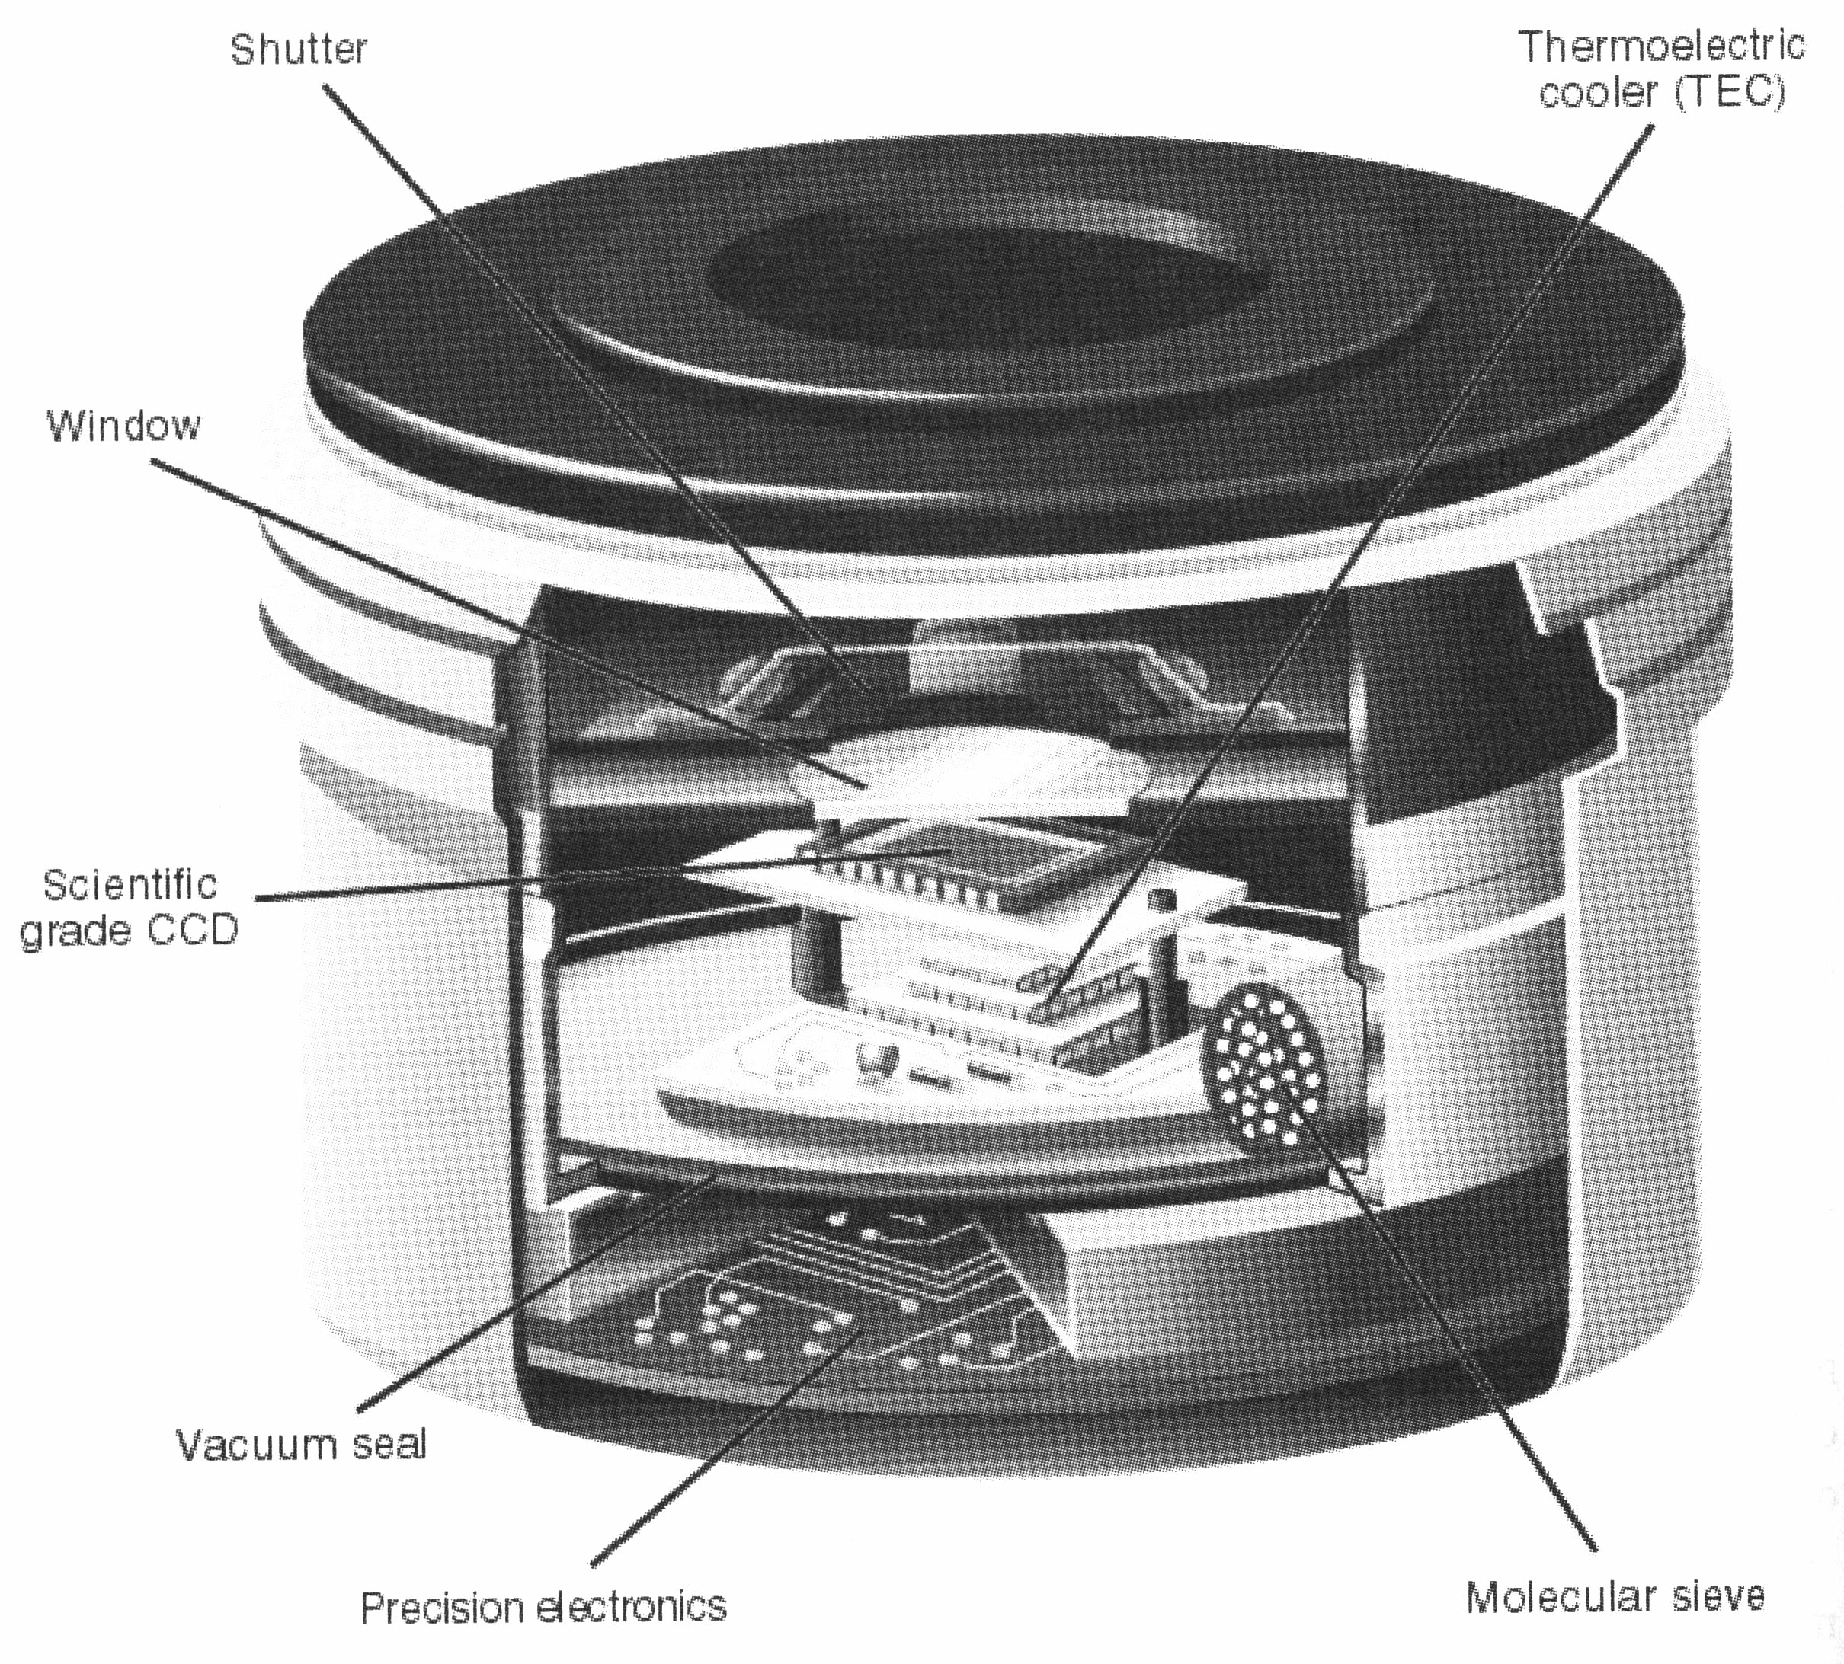
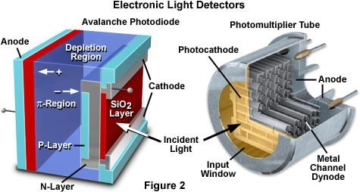
Will concentrate on the following
CCD
PMT

Slide 36
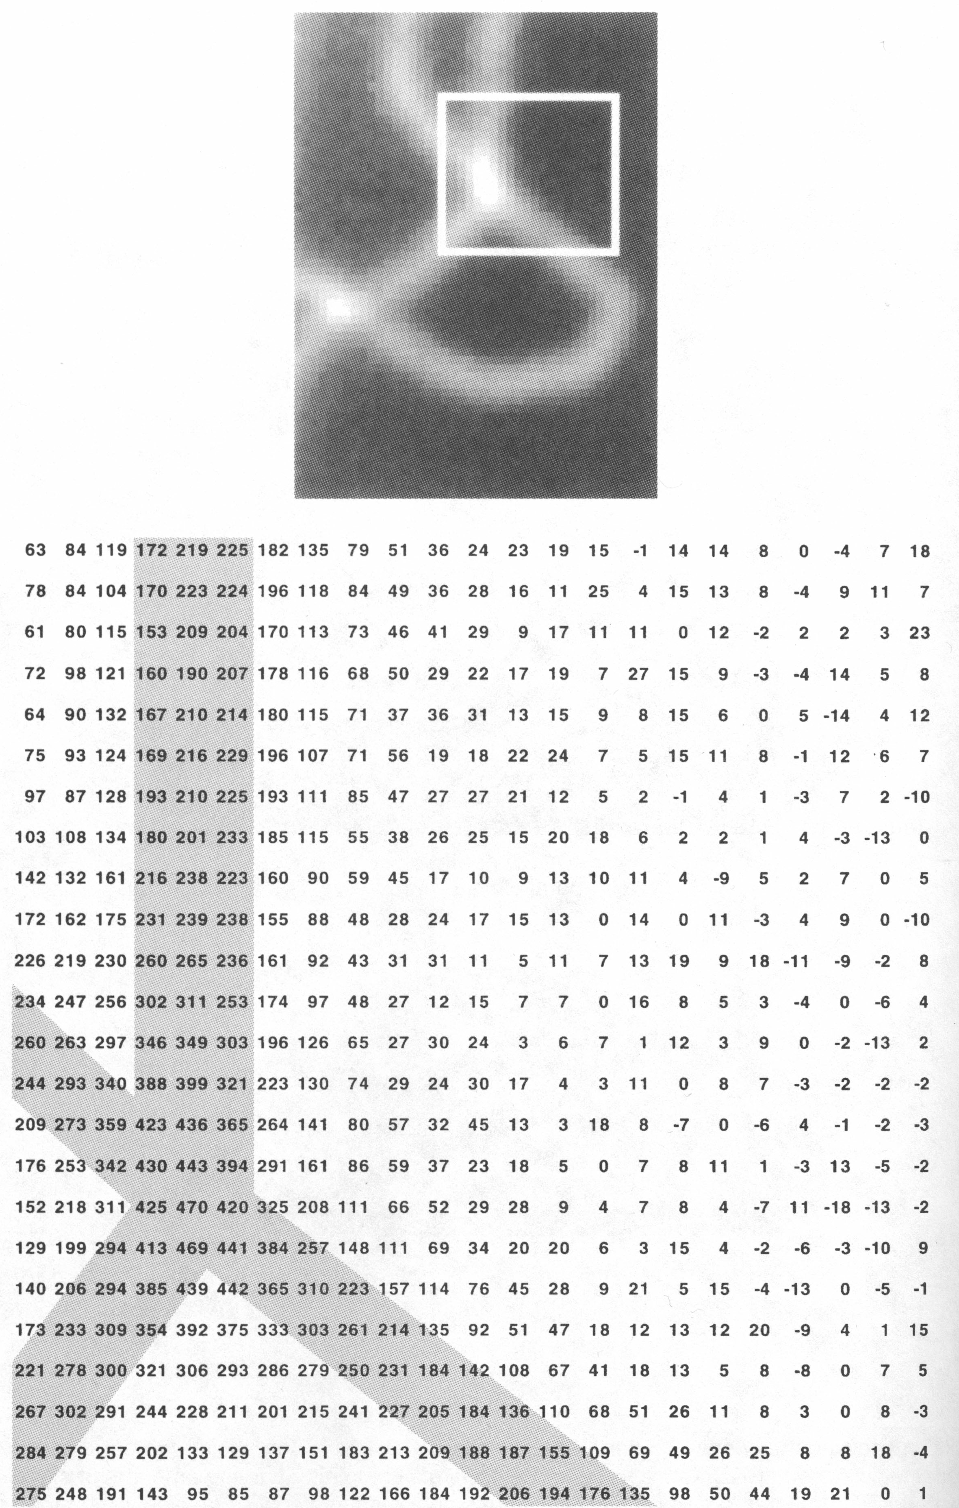
Digital Images are made up of numbers

Slide 37
General Info on CCDs
Charge Coupled Device (CCD)
Silicon chip divided into a grid of pixels
Pixels are electric “wells”
Photons are converted to electrons when they impact wells
Wells can hold “X” number of electrons
Each well is read into the computer separately
The Dynamic Range is the number of electrons per well / read noise

Slide 38
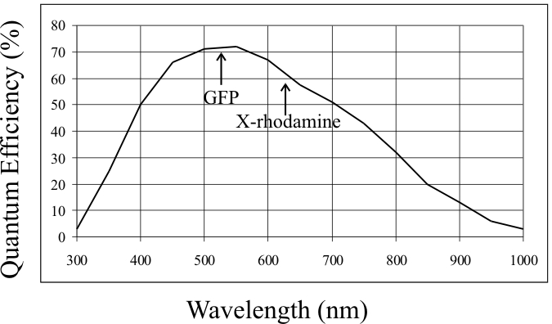
General Info on CCDs
Different CCDs have different Quantum Efficiency (QE)
  Think of QE as a probability factor
  QE of 50% means 5 out of 10 photons that hit the chip will create an electron
  QE changes at different wavelength

Slide 39
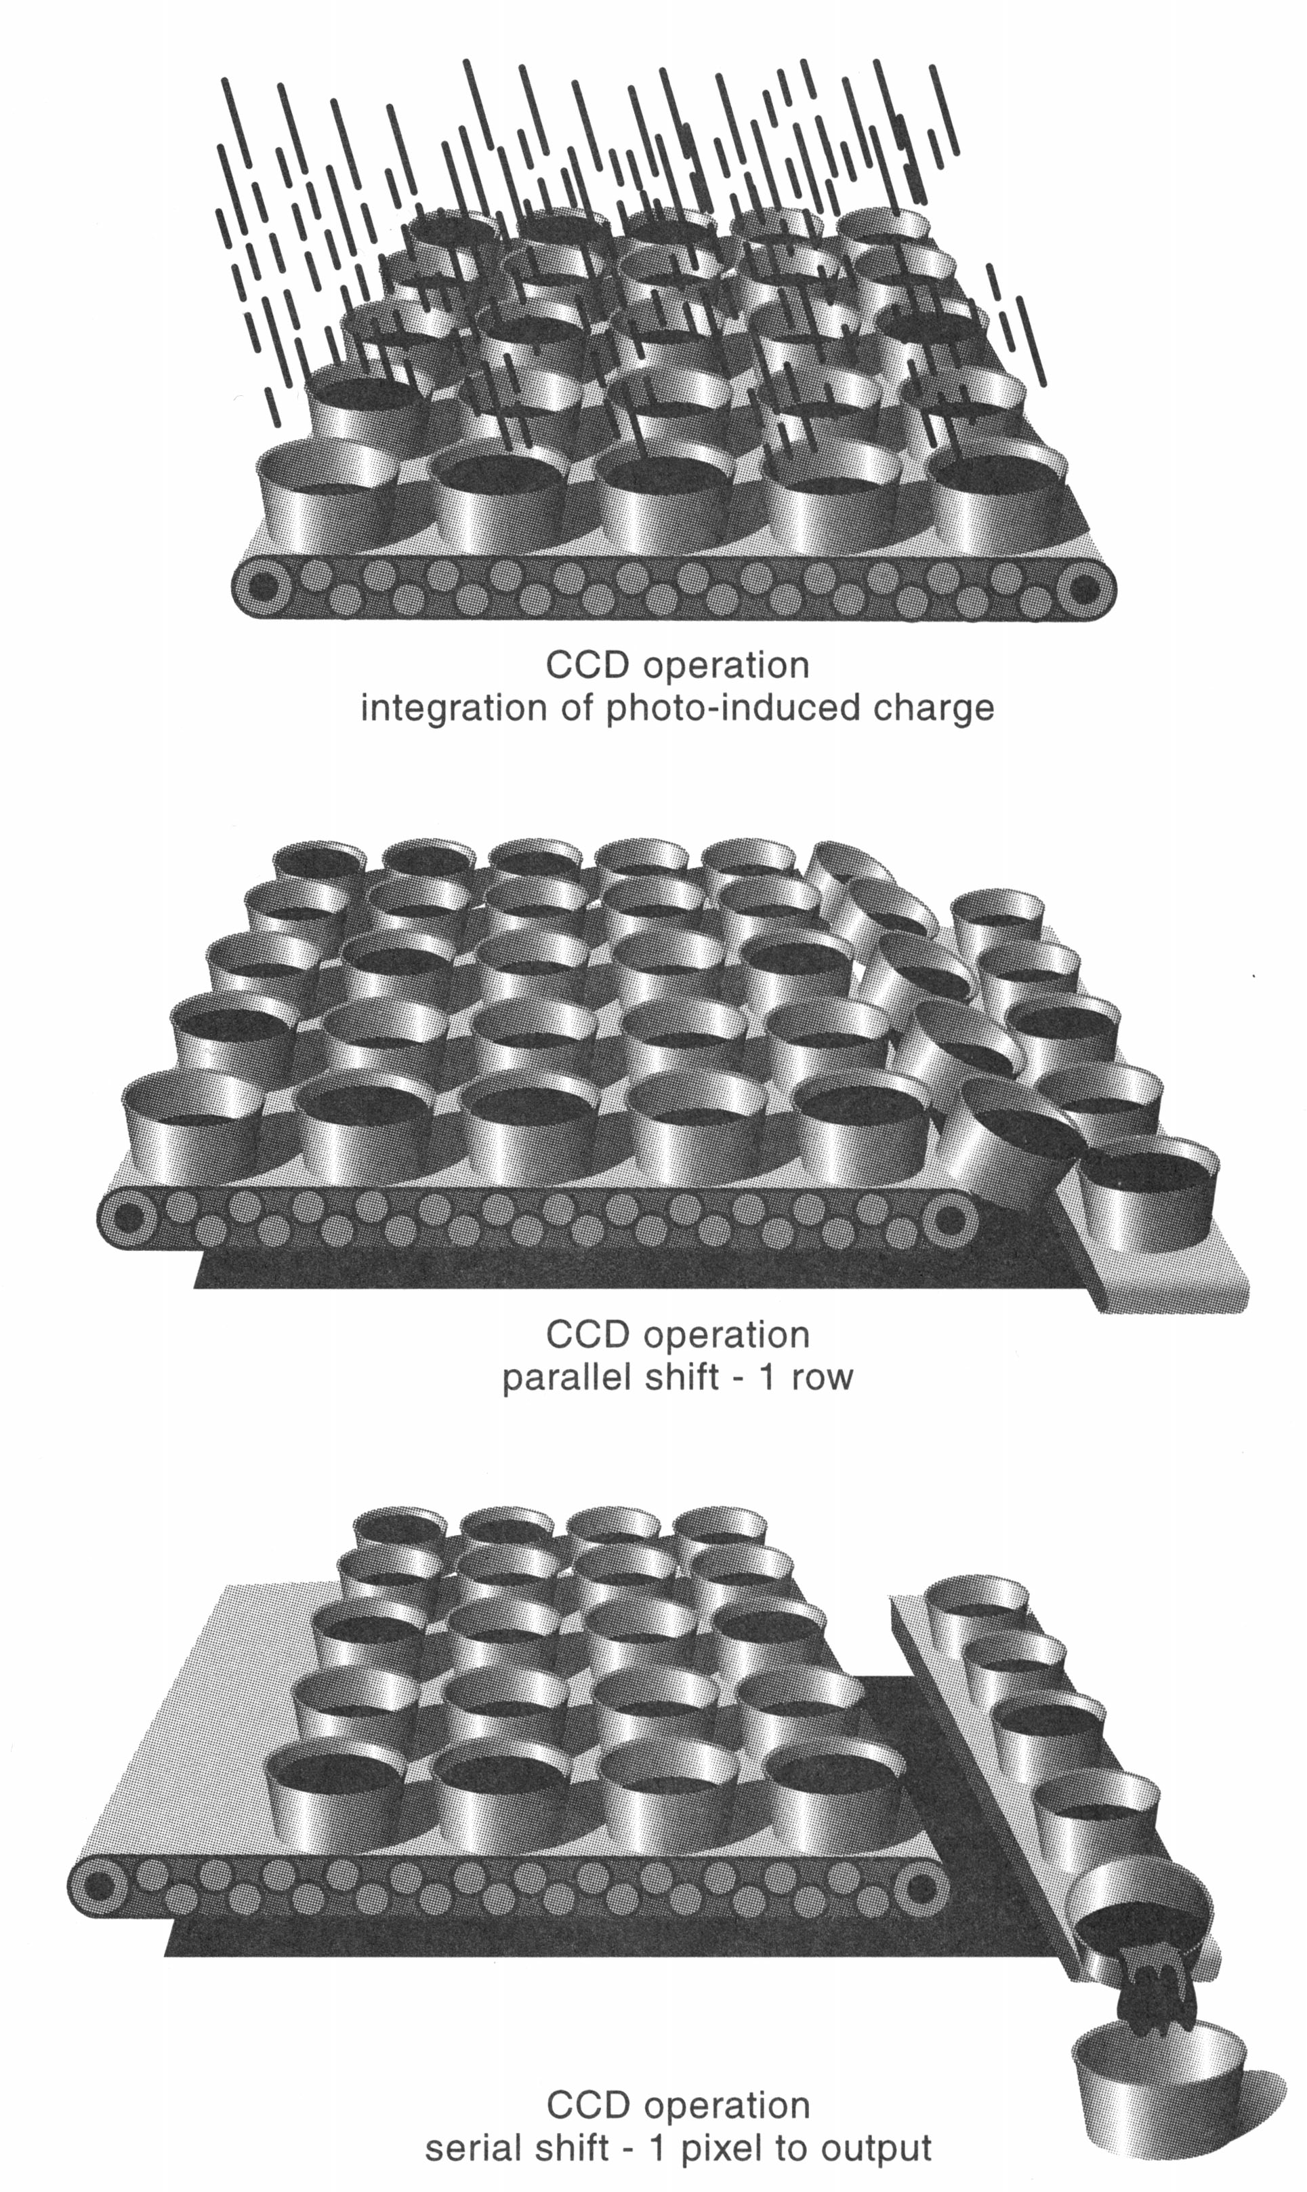
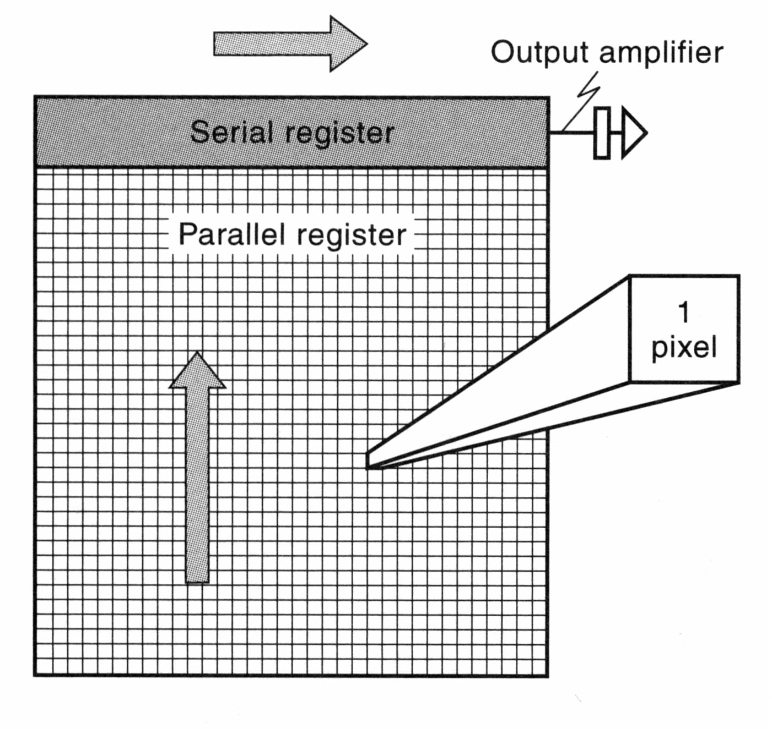
How do CCDs work?
Notes:
Analogue to digital converter

Slide 40
Full Well Capacity
Pixel wells hold a limited number of electrons
Full Well Capacity is this limit
Exposure to light past the limit will not result in more signal

Slide 41
Readout
Each pixel is read out one at a time
The Rate of readout determines the “speed” of the camera
1MHz camera reads out 1,000,000 pixels/ second (Typical CCD size)
Increased readout speeds lead to more noise

Slide 42
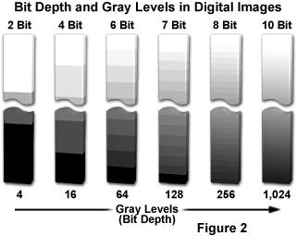
CCD Bit depth
Bit depth is determined by:
  Full well Capacity/readout noise
  eg: 21000e/10e = 2100 gray values (this would be a 12 bit camera (4096))
  21000e/100e = 210 gray values (8bit camera)
Sample Camera bit depths
  8 bit = 2⁸ = 256
  12 bit = 2¹² = 4,096
  16 bit = 2¹⁶ = 65,536
Notes:
http://www.olympusmicro.com/primer/digitalimaging/concepts/dynamicrange.html

Slide 43

CCDs are good for quantitative measurements
Linear
  If 10 photons = 5 electrons
  1000 photons = 500 electrons
Large bit-depth
  12 bits = 4096 gray values
  14 bits = ~16,000 gray values
  16 bits = ~65,000 gray values
1000
72
7
0

Slide 44
Sensitivity and CCDs
High QE = more signal
High noise means you have to get more signal to detect something
Sensitivity = signal/noise

Slide 45
Noise
Shot noise
  Random fluctuations in the photon population
Dark current
  Noise caused by spontaneous electron formation/accumulation in the wells (usually due to heat)
Readout noise
  Grainy noise you see when you expose the chip with no light

Slide 46
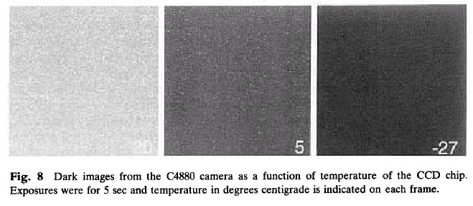
Dark Current noise and Cooling
20

Slide 47
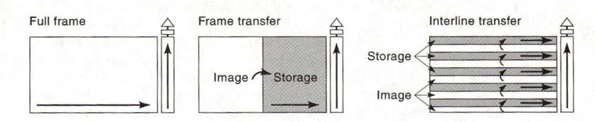
Types of CCDs
Full frame transfer
Frame transfer
Interline transfer
Back thinned (Back illuminated)

Slide 48
Full Frame Transfer
All pixels on the chip are exposed and read
Highest effective resolution
Slow
Require their own shutter

Slide 49
Frame Transfer
Half of the pixels on the chip are exposed and read
  Other half is covered with a mask
Faster
Don’t require their own shutter

Slide 50
Interline Transfer
Half of the pixels on the chip are exposed and read
  Other half is covered with a mask
Fastest
Don’t require their own shutter

Slide 51
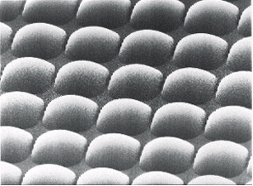
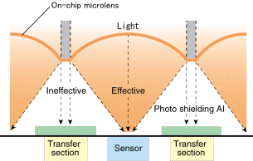
Interline Transfer
Seems like a bad idea to cover every other row of pixels
Lose resolution and information
Clever ways to get around this
Notes:
Microlens as we talked about with LEDs

Slide 52
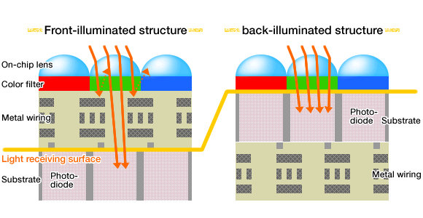
Back Thinned
Expose light to the BACK of the chip
Highest QE’s
Big pixels (need more mag to get full resolution)
Usually frame transfer type
Don’t require their own shutter
Notes:
Expensive
Picture for CMOS
http://www.sony.net/SonyInfo/News/Press/200806/08-069E/

Slide 53
Intensified CCDs
Amplify before the CCD chip
  Traditional intensifiers (phototube type)
  Electron Bombardment
  Each type have limited lifetime, are expensive, and not linear
Amplify during the readout
  Electron multiplication (Cascade) CCD
    Amplify the electrons after each pixel is readout
    Expensive, but linear and last as long as a non- amplified camera
Notes:
EMCCD used most commonly for applications such as spinning disc and light sheet microscopy

Slide 54
Attributes of most CCDs
Binning (example 2 X 2)
  Increases intensity by a factor of 4 without increasing noise
  Lowers resolution 2 fold in x and y
  Speeds up transfer (fewer pixels)

Slide 55
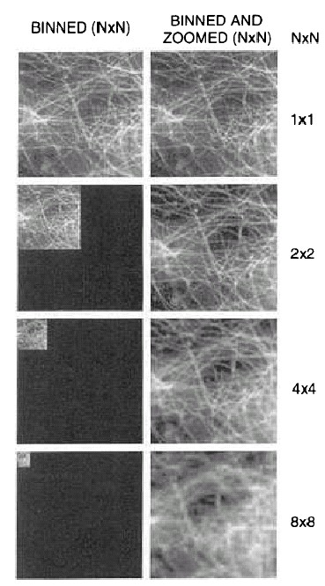
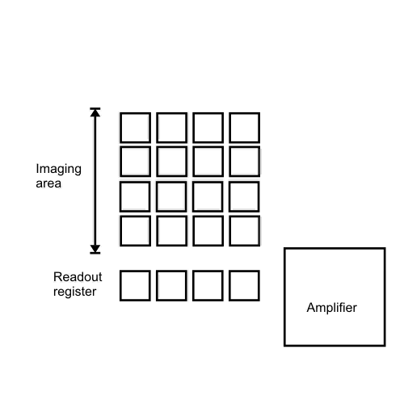
Binning

Slide 56
Magnification and Detector Resolution
Need enough mag to match the detector
  The Nyquist criterion requires a sampling interval equal to twice the highest specimen spatial frequency
  Microscope Magnification = (3*Pixel-width)/resolution = (3*6.7 m) / 0.27 = 74.4x
But intensity of light goes down (by 1/mag^2 !!) with increased mag

Slide 57
Magnification and Detector Resolution
Need enough mag to match the detector
  The Nyquist criterion requires a sampling interval equal to twice the highest specimen spatial frequency
  Microscope Magnification = (3*Pixel-width)/resolution = (3*6.7 m) / 0.27 = 74.4x
But intensity of light goes down (by 1/mag^2 !!) with increased mag

Slide 58
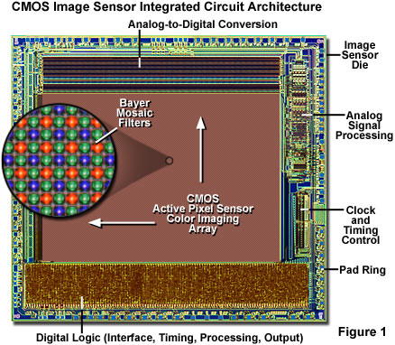
CMOS cameras gaining in popularity
Complementary metal oxide semiconductor (CMOS)
Notes:
Manufacturing easy.
CMOS image sensors are fabricated on well-established standard silicon processes in high-volume wafer plants that also produce related chips such as microprocessors, memory circuits, microcontrollers, and digital signal processors. The tremendous advantage is that digital logic circuits, clock drivers, counters, and analog-to-digital converters can be placed on the same silicon foundation and at the same time as the photodiode array. This enables CMOS sensors to participate in process shrinks that move to smaller linewidths with a minimum of redesign, in a manner similar to other integrated circuits. Even so, in order to guarantee low-noise devices with high performance, the standard CMOS fabrication process must often be modified to specifically accommodate image sensors. For example, standard CMOS techniques for creating transistor junctions in logic chips might produce high dark currents and low blue response when applied to an imaging device. Optimizing the process for image sensors often involves tradeoffs that render the fabrication scenario unreliable for common CMOS devices.

Slide 59
CMOS vs CCD
Both developed in 1970s but CMOS sucked then
Both sense light through photoelectric effect
CMOS use single voltage supply and low power
CCD require 5 or more supply voltages at different clock speeds with significantly higher power consumption
Unlike CCD, CMOS can integrate many processing and control functions directly onto sensor integrated circuit
CCD used to have smaller pixel sizes but CMOS catching up
CMOS faster, can capture images at very high frame rates.
EMCCD still have high QE so more sensitivity than CMOS*
Notes:
Huang et al. Nat. Meth. 10, 653-658 (2013)
Supplementary figure 7 shows that Effective quantum efficiencies in EMCCD and sCMOS simulations were 48% and 73%, respectively.

Slide 60
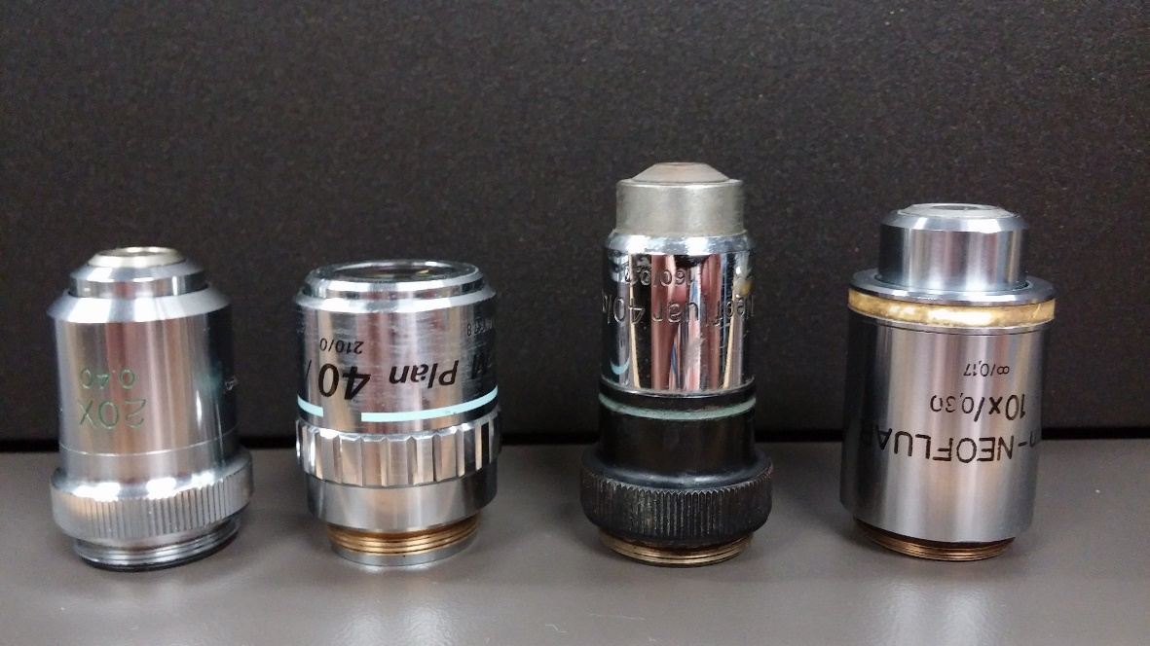
Homework 2: Most modern microscopes are “infinity corrected” while older microscopes had a fixed tube length of 160 or 170 mm. Even when microscopes transitioned to infinity optics, they sometimes maintained the same lens thread size, RMS (Royal Microscopy Society). Why is it not a good idea to use finite lenses on an infinity microscope or another companies lens on a different companies microscope?
Hint - The answer is the same for both. Think of what you learned from homework 1.
Notes:
mounting threads that are 20.32 mm in diameter with a pitch of 0.706, conforming to the RMS standard

Slide 61
Answer to Homework 2
Chromatic aberrations
Other aberrations OK
  Spherical aberrations
  Curvature of field
All these will be worse when using another companies lens on a different companies microscope or finite lenses on infinity microscope

Slide 62
Why are most modern microscopes “infinity corrected”?
Image
Eyepiece
image
Eyepiece
Lens of eye

Slide 63
Why are most modern microscopes “infinity corrected”?
Hint - think of the influence of a piece of glass
Image
Eyepiece
image
Eyepiece
Lens of eye

Slide 64
Take special case:
Glass at right angle to second principle ray
Simplify by removing eyepiece and eye
Image
Eyepiece
image
Eyepiece
Lens of eye

Slide 65
Take special case:
Glass at right angle to second principle ray
Zone of Confusion: Rays fail to intersect at only one place
Image
Eyepiece
image
Refraction of principle rays

Slide 66
“Infinity correction” provides a region in which an optical flat will not create a zone of confusion
Tube lens
Objective
Image
Eyepiece
“Infinity” Domain
Eyepiece
image
Lens of eye

Slide 67
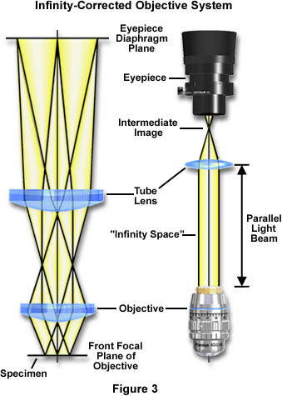
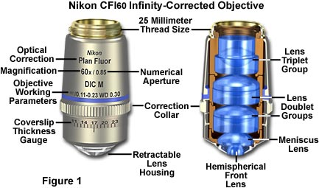
The Compound Microscope (infinity corrected)
Notes:
https://micro.magnet.fsu.edu/primer/anatomy/tubelength.html
http://www.leica-microsystems.com/science-lab/widefield-microscopy/infinity-optical-systems/

Slide 68
Making an infinity lens
Focal
Point

Slide 69
Making an infinity lens
Notes:
CONVERGENCE LENS. Convex lens

Slide 70

Different manufacturers have elected different compromises
  Length of objective lens
  Diameter of objective lens
  Focal length of tube lens
Nikon. Leica
Zeiss
Longer tube lens focal length easier to design,
But requires larger diameter threads.

