Slide 1
Biology 177: Principles of Modern Microscopy
Lecture 04:
Diffraction and resolution
Andres Collazo, Director Biological Imaging Facility
Wan-Rong (Sandy) Wong, Graduate Student, TA

Slide 2
Lecture 4: Diffraction
Wave theory of light
Properties of waves
Review of N.A.
Resolution
Discuss letters on negative refractive index

Slide 3
Questions about last lecture?

Slide 4
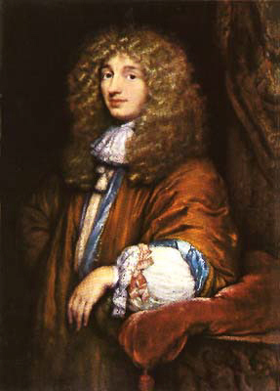
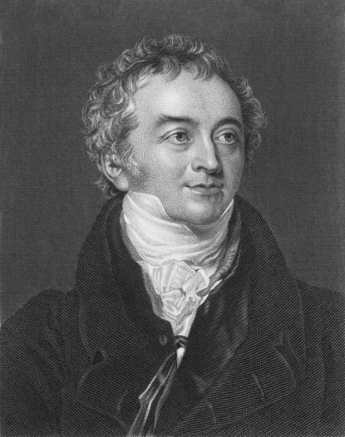
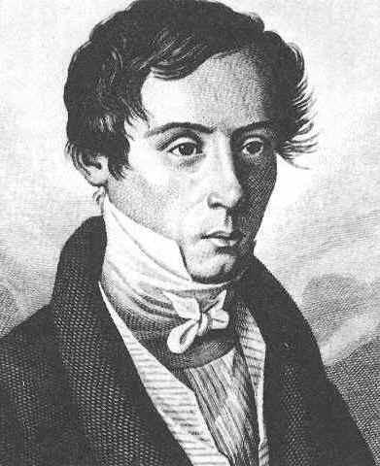
By the 1800’s the wave theory had won out over Newton’s corpuscular theory
First deduced by Robert Hooke and mathematically formulated by Christiaan Hyugens
Thomas Young demonstrated that wave theory best explained interference.
Augustin-Jean Fresnel synthesized the work of Hyugens and Young.
Championed the wave theory in his 1818 memoir on diffraction.
All this finally vanquished the corpuscular theory.*
Christiaan Hyugens
1629-1695
Thomas Young
1773-1829
Augustin-Jean Fresnel
1788-1827
Notes:
*until the 20th century
Thomas Young (13 June 1773 – 10 May 1829) was an English polymath. Young made notable scientific contributions to the fields of vision, light, solid mechanics, energy, physiology, language, musical harmony, and Egyptology. He "made a number of original and insightful innovations"^{[1]} in the decipherment of Egyptian hieroglyphs (specifically the Rosetta Stone) before Jean-François Champollion eventually expanded on his work. He was mentioned by, among others, William Herschel, Hermann von Helmholtz, James Clerk Maxwell, and Albert Einstein.
Augustin-Jean Fresnel (/freɪˈnɛl/ fray-NEL; French: [ɔ.ɡy.stɛ̃ ʒɑ̃ fʁɛ.nɛl]; 1788–1827), was a French engineer and physicist who contributed significantly to the establishment of the theory of wave optics. Fresnel studied the behaviour of light both theoretically and experimentally.
"Augustin Fresnel". Licensed under Public Domain via Wikimedia Commons - https://commons.wikimedia.org/wiki/File:Augustin_Fresnel.jpg#mediaviewer/File:Augustin_Fresnel.jpg
Robert Hooke FRS (/hʊk/; 28 July [O.S. 18 July] 1635 – 3 March 1703) was an English natural philosopher, architect and polymath. Author of the seminal book on microscopy called Micrographia. Coined the word cell.
Christiaan Huygens, FRS (/ˈhaɪɡənz/ or /ˈhɔɪɡənz/; Dutch: [ˈɦœy̆ɣə(n)s] ( listen)) (Latin: Hugenius) (14 April 1629 – 8 July 1695) was a prominent Dutch mathematician and scientist. He is known particularly as an astronomer, physicist, probabilist and horologist. His seminal work titled: Treatise on Light
In which are explained the causes of that which occurs in reflexion, & in refraction and particularly in the strange refraction of Iceland crystal . Available through project Gutenberg: http://www.gutenberg.org/files/14725/14725-h/14725-h.htm

Slide 5
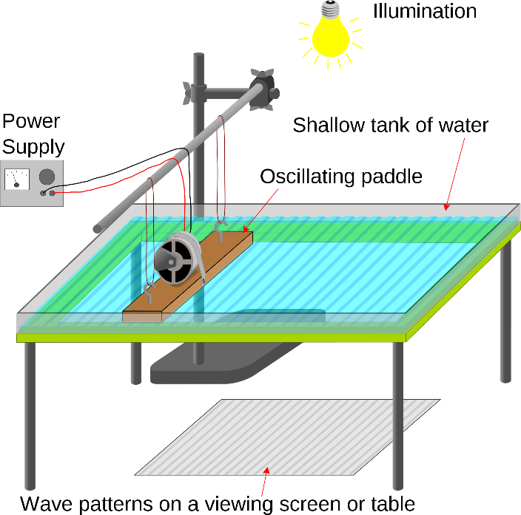
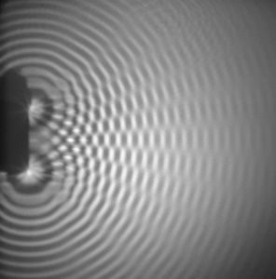
Thomas Young’s talk in 1803 demonstrating interference
"The experiments I am about to relate ... may be repeated with great ease, whenever the sun shines, and without any other apparatus than is at hand to every one."
Notes:
Thomas Young demonstrated the validity of wave theory in a talk to the Royal Society of London on 24 August 1803.

Slide 6
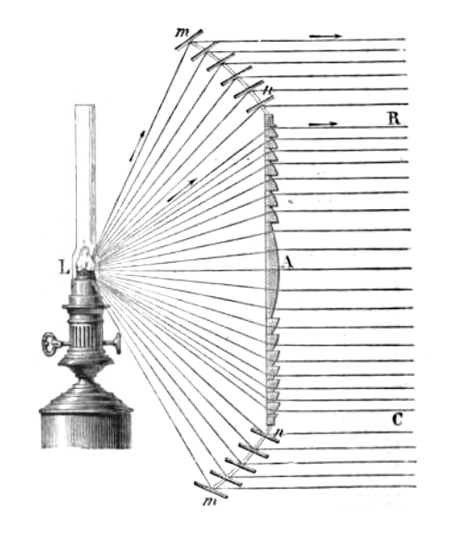
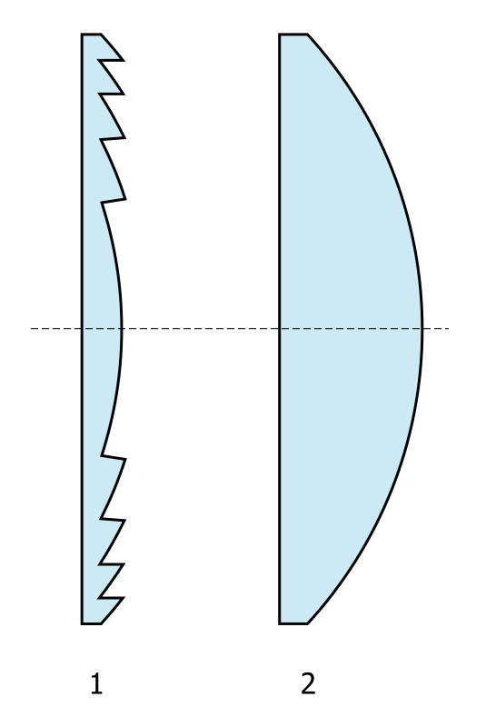
Fresnel best know as the inventor of the Fresnel lens.
Large aperture and short focal in a smaller package
Used for lighthouses
Notes:
Where is the lamp placed? Now understand why from second lecture.
"Fresnel lighthouse lens diagram" by Adolphe Ganot - Downloaded from Adolphe Ganot (1872) Natural Philosophy for General Readers and Young Persons, D. Appleton & Co., New York, p.328, fig.257 (translated with permission from Ganot's Cours Élémentaire de Physique by Edmund Atkinson). Licensed under Public Domain via Wikimedia Commons - https://commons.wikimedia.org/wiki/File:Fresnel_lighthouse_lens_diagram.png#mediaviewer/File:Fresnel_lighthouse_lens_diagram.png
"Fresnel lens" by Pko - own drawing. Licensed under Public Domain via Wikimedia Commons - https://commons.wikimedia.org/wiki/File:Fresnel_lens.svg#mediaviewer/File:Fresnel_lens.svg

Slide 7
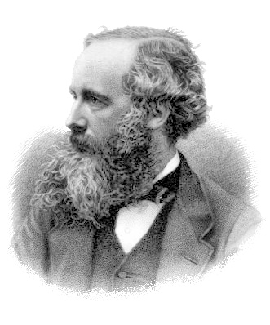
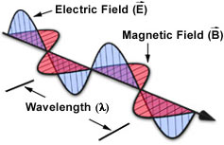
Light is an electromagnetic wave
Scottish Physicist James Maxwell made one of the most important discoveries of 19th century Physics
http://feynmanlectures.caltech.edu/I_28.html
Notes:
BBC: Albert Einstein has been voted the greatest physicist of all time in an end of the millennium poll, pushing Sir Isaac Newton into second place. Maxwell 3rd. The survey was conducted among 100 of today's leading physicists.
The gradually discovered properties of electricity and magnetism, of electric forces of attraction and repulsion, and of magnetic forces, showed that although these forces were rather complex, they all fell off inversely as the square of the distance. Maxwell noted that the equations or the laws that had been discovered up to this time were mutually inconsistent when he tried to put them all together, and in order for the whole system to be consistent, he had to add another term to his equations. With this new term there came an amazing prediction, which was that a part of the electric and magnetic fields would fall off much more slowly with the distance than the inverse square, namely, inversely as the first power of the distance! And so he realized that electric currents in one place can affect other charges far away, and he predicted the basic effects with which we are familiar today—radio transmission, radar, and so on.

Slide 8
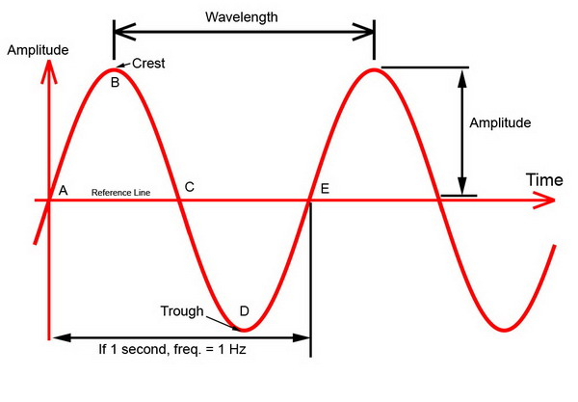
Characteristics of a wave
Wavelength (λ) is distance between crests or troughs
Amplitude is half the difference in height between crest and trough.
Notes:
http://www.billavista.com/atv/Articles/Offroad_Radios_and_Comms/index.html
Source of image.

Slide 9
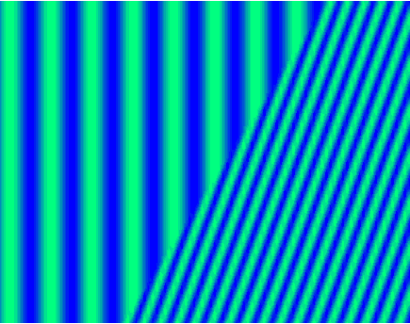
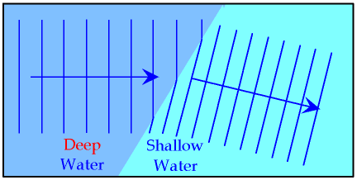
Characteristic of waves: Refraction
Demonstrate in ripple tank that wavelength and velocity decrease during refraction into material with higher refractive index.
Notes:
Frequency remains constant while light travels through different media. Wavelength and speed change.
c = ν λ
http://imgarcade.com/1/refraction-of-waves-animation/

Slide 10
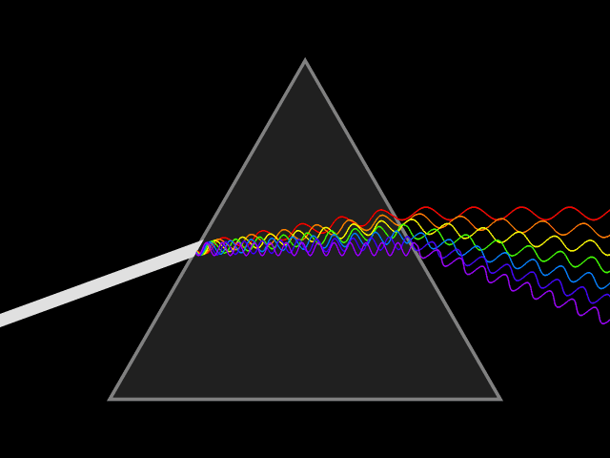
Characteristic of waves: Dispersion
Blue light (shorter wavelengths) bends more than red light (longer wavelengths).
Notes:
Refractive index different for different colors

Slide 11
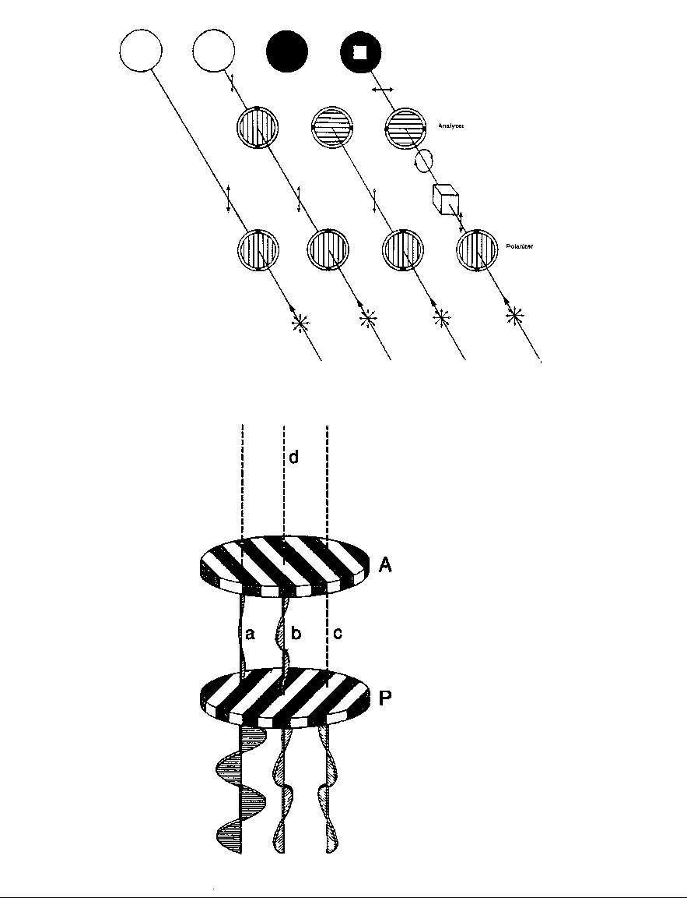
Characteristic of waves: polarization
Property of waves that can oscillate in more than one direction.
By convention, polarization refers to electric field
Notes:
transverse wave—both the electric and magnetic fields are perpendicular to the wave's direction of travel. The oscillation of these fields may be in a single direction (linear polarization), or the field may rotate at the optical frequency (circular or elliptical polarization).
The wave exhibits electric (E) and magnetic (B) fields whose amplitudes oscillate as a sine function over dimensions of space or time.
The amplitudes of the electric and magnetic components at a particular instant or location are described as vectors that vibrate in two planes perpendicular to each other and perpendicular to the direction of propagation.
At any given time or distance the E and B vectors are equal in amplitude and phase.
For convenience it is common to show only the electric field vector (E vector) of a wave in graphs and diagrams and not specify it as such.

Slide 12
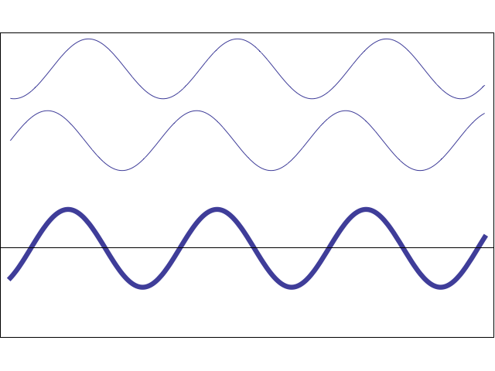
Characteristic of waves: Interference
Constructive Interference
Destructive Interference

Slide 13
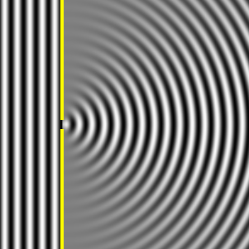
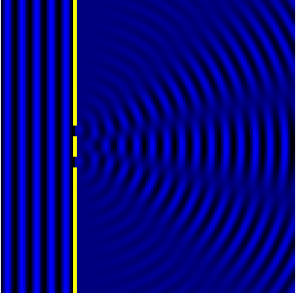
Characteristic of waves: diffraction
Phenomenon resulting from waves encountering obstacles or slits
For Feynman there is no difference between diffraction and interference
In Wikipedia, the diffraction phenomenon is defined as the interference of waves according to the Huygens-Fresnel principle
Notes:
This chapter is a direct continuation of the previous one, although the name has been changed from Interference to Diffraction. No one has ever been able to define the difference between interference and diffraction satisfactorily. It is just a question of usage, and there is no specific, important physical difference between them. The best we can do, roughly speaking, is to say that when there are only a few sources, say two, interfering, then the result is usually called interference, but if there is a large number of them, it seems that the word diffraction is more often used. So, we shall not worry about whether it is interference or diffraction, but continue directly from where we left off in the middle of the subject in the last chapter.

Slide 14
Diffraction model java app
Single slit
Dual slit
Source waves from so far away that they are plane parallel
Diffraction Application will be on website
http://micro.magnet.fsu.edu/primer/java/diffraction/basicdiffraction/index.html
Notes:
This bending of light through slit was biggest problem for Newton. He just said it was refraction.

Slide 15
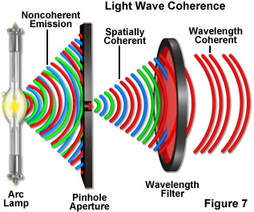
Coherence of light
Lasers provide coherent illumination
Sunlight on cloudy day is noncoherent
Notes:
Brighter and with more Speckles when coherent
For brightfield and reflected microscopy applications, illumination having low coherence is generally desired, while light with higher coherence is required for phase and interference imaging modes. The process of fluorescence involves a sufficient number of steps between excitation and emission that the coherence of the illuminating light is usually unimportant, and the light emitted from the specimen is basically non-coherent.
http://zeiss-campus.magnet.fsu.edu/tutorials/coherence/indexflash.html

Slide 16
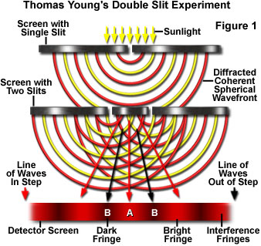
Thomas Young two slit experiment
http://micro.magnet.fsu.edu/primer/java/interference/doubleslit/

Slide 17
Interference of Coherent Waves
2) Same spacing, different wavelength
0
-1
0
+1
-1
+1
-2
+2
+3
+4
-2
+2
+5
Blue “light”
Red “light”
Notes:
For measuring wavelength of light. Note differences in number of diffraction orders

Slide 18
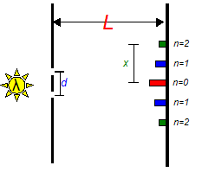

Diffraction using double slits allows us to measure wavelength of monochromatic light
Project diffraction pattern along screen
Use the following measurements
Plug into formula to calculate wavelength
$$λ=\frac{xd}{nL}$$
Notes:
http://www.studyphysics.ca/newnotes/20/unit04_light/chp1719_light/lesson58.htm

Slide 19
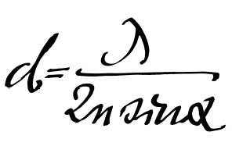
Determining resolution (3 methods)
Using Fermat’s principle of least time
Abbe’s resolution formula using N.A.
Collecting more diffraction orders
d_{min} = 1.22 λ / (NA _{objective} +NA _{condenser})

Slide 20
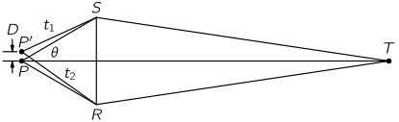
Resolution as explained through Fermat’s principle of least time
Two points can be resolved if light takes different amount of time traveling from these points (P, P’)
From this can derive Abbe’s formula for resolution
t₂−t₁ > 1/ν
D > λ / η sin θ
Feynman Lectures on Physics, Volume I, Chapter 27
http://feynmanlectures.caltech.edu/I_27.html
Notes:
Pierre de Fermat (French: [pjɛːʁ dəfɛʁma]; 17^{[2]} August 1601 or 1607^{[1]} – 12 January 1665) was a French lawyer at the Parlement of Toulouse, France, and an amateur mathematician.

Slide 21
Resolution as explained through Fermat’s principle of least time
Two points can be resolved if light takes different amount of time traveling from these points (P, P’)
From this can derive Abbe’s formula for resolution
Feynman Lectures on Physics, Volume I, Chapter 27
http://feynmanlectures.caltech.edu/I_27.html
Notes:
Pierre de Fermat (French: [pjɛːʁ dəfɛʁma]; 17^{[2]} August 1601 or 1607^{[1]} – 12 January 1665) was a French lawyer at the Parlement of Toulouse, France, and an amateur mathematician.

Slide 22
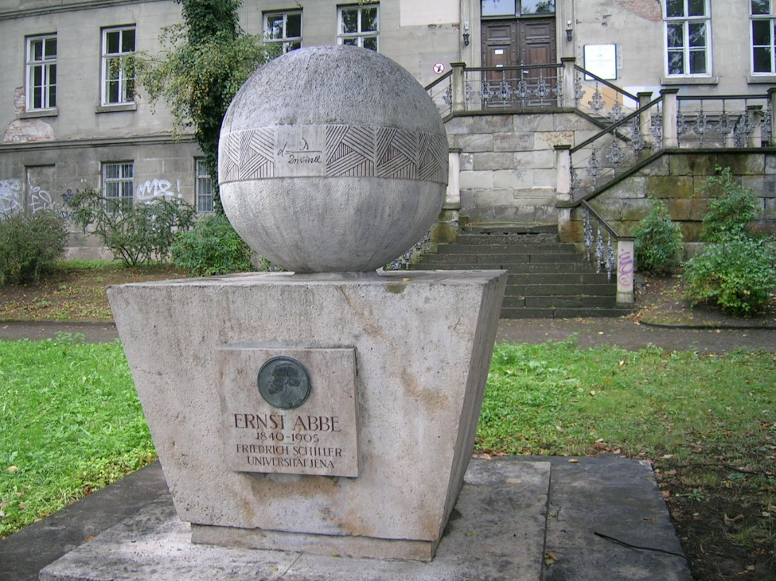
Determining resolution (3 methods)
Using Fermat’s principle of least time
Abbe’s resolution formula using N.A.
Collecting more diffraction orders
Notes:
Ernst Abbe published this formula in 1873

Slide 23
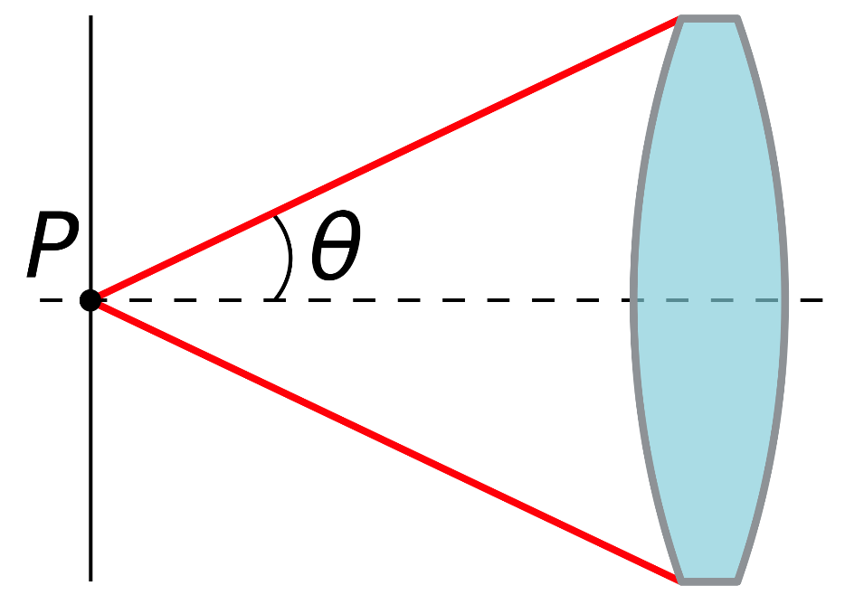
Let’s Review Numerical Aperture (N.A.)
Dimensionless number defining range of angles over which lens accepts light.
Refractive index (η) times half-angle (θ) of maximum cone of light that can enter or exit lens
N.A. = η sin θ
Notes:
In optics, the numerical aperture (NA) of an optical system is a dimensionless number that characterizes the range of angles over which the system can accept or emit light. By incorporating index of refraction in its definition, NA has the property that it is constant for a beam as it goes from one material to another provided there is no optical power at the interface. The exact definition of the term varies slightly between different areas of optics. Numerical aperture is commonly used in microscopy to describe the acceptance cone of an objective (and hence its light-gathering ability and resolution), and in fiber optics, in which it describes the range of angles within which light that is incident on the fiber will be transmitted along it.

Slide 24
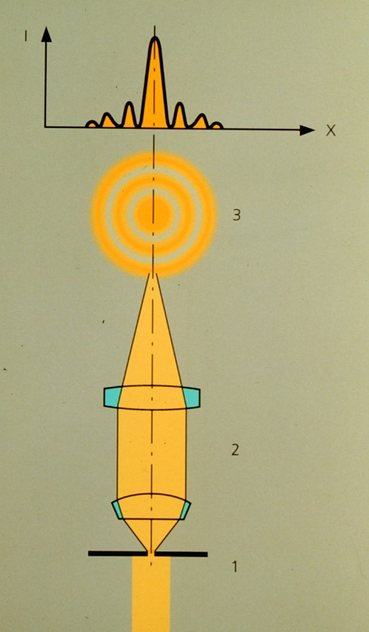
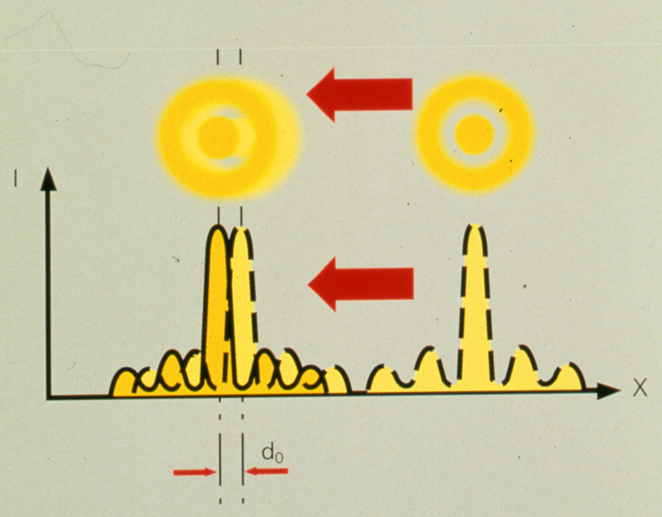
N.A. has a major effect on image resolution
Minimum resolvable distance
d_{min} = 1.22 λ / (NA _{objective} +NA _{condenser})
Notes:
https://en.wikipedia.org/wiki/Bessel_function
Why 1.22

Slide 25
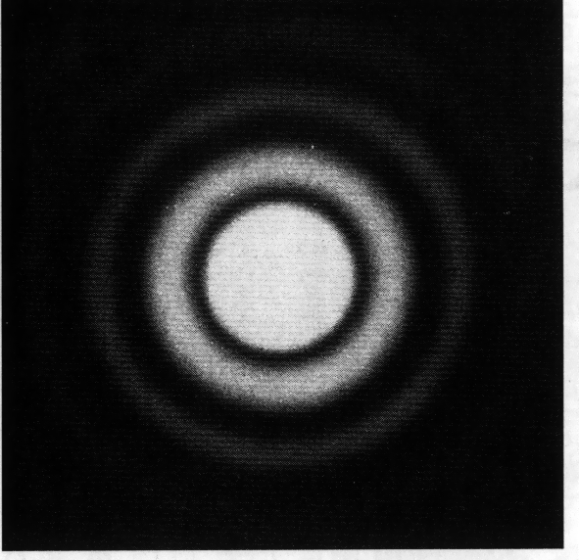
Relationship between diffraction, airy disk and point spread function
One slit diffraction pattern
Airy disk
Notes:
Using two slit diffraction but same idea as single slit

Slide 26
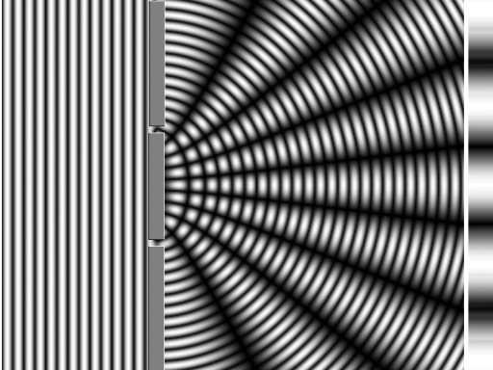
Relationship between diffraction, airy disk and point spread function
Two slit diffraction pattern
Airy disk
Notes:
Using two slit diffraction but same idea as single slit

Slide 27
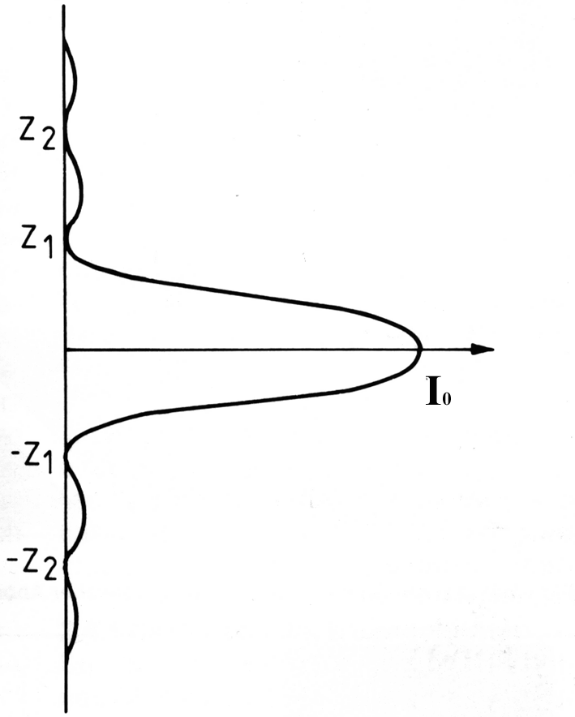
Intensity Distribution of a diffraction-limited spot
Airy Disk
Named after Sir George Biddell Airy English mathematician and astronomer
Notes:
In optics, the Airy disk (or Airy disc) and Airy pattern are descriptions of the best focused spot of light that a perfect lens with a circular aperture can make, limited by the diffraction of light.
The diffraction pattern resulting from a uniformly-illuminated circular aperture has a bright region in the center, known as the Airy disk which together with the series of concentric bright rings around is called the Airy pattern. Both are named after George Biddell Airy.

Slide 28
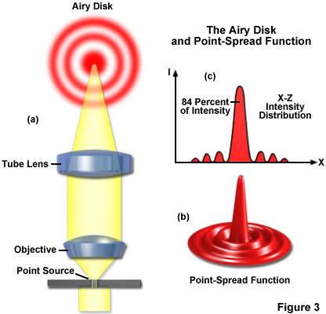
Relationship between diffraction, airy disk and point spread function
Airy disk – 2D
Point spread function -3D
Though often defined as the same that is not quite true
Notes:
http://zeiss-campus.magnet.fsu.edu/articles/basics/resolution.html

Slide 29
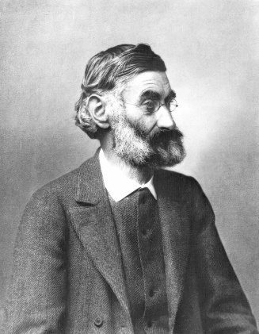
Resolution using diffraction
In 1876, Ernst Abbe who had put the optical properties in a microscope on a scientific basis, presented his findings to the still skeptical Royal Microscopy Society.
To prove his theory, he performed an experiment.
The device which he used, was later produced by the Zeiss company and called the “Abbe Diffraction Apparatus”
Ernst Abbe (1840-1905)

Slide 30
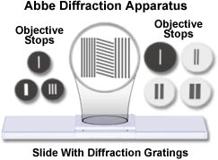
Abbe Diffraction Apparatus consists of the following:
A microscope with an adjustable, small diaphragm serving as light source. While the diaphragm in the base normally controls the size of the illuminated field and is therefore called “luminous field diaphragm”, in our setup this diaphragm acts as “aperture diaphragm”, since there is no condenser used. It serves as our “point source”, creating coherent, essentially parallel wave fronts.
A special slide with various lines and grid patterns. It serves to study the diffraction phenomena
A low-power objective
An intermediate ring, placed between the objective and nosepiece which allows insertion of various components into the back focal plane (exit pupil) of the objective. This is the plane which you see when you take the eyepieces out of your microscope or replace one with a “focusing telescope”.
A variety of little diaphragms which can be inserted into this intermediate ring, superimposing their structures over the image at the back focal plane (BFP) of the objective.
A switchable “Bertrand lens”, essentially a telescope which lets us see the back focal plane of the objective and switch back and forth between image- and diffraction patterns of the image.
A video camera to relay the images to the screen.

Slide 31
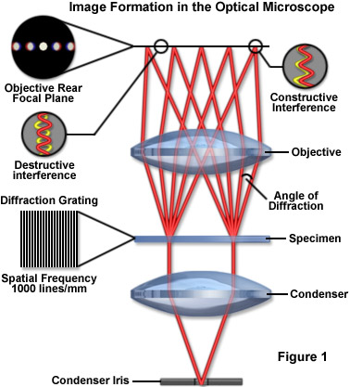
Diffraction and Image Formation
Image formation
Look at back focal plane of objective
Also called the conoscopic image
Can see with a Bertrand lens or phase telescope
Will look at line gratings
Notes:
A phase telescope or Bertrand lens is an optical device used in aligning the various optical components of a light microscope. In particular it allows observation of the back focal plane of the objective lens and its conjugate focal planes. The phase telescope/Bertrand lens is inserted into the microscope in place of an eyepiece to move the intermediate image plane to a point where it can be observed.

Slide 32
Interference of Coherent Waves
1) Different spacing, same wavelength
λ
Wave Crests
λ
Direction of wave propagation
Source (at Infinity)
Solid Arrows show Directions of Constructive Interference

Slide 33
Interference of Coherent Waves
2) Same spacing, different wavelength
0
-1
0
+1
-1
+1
-2
+2
+3
+4
-2
+2
+5
Blue “light”
Red “light”

Slide 34
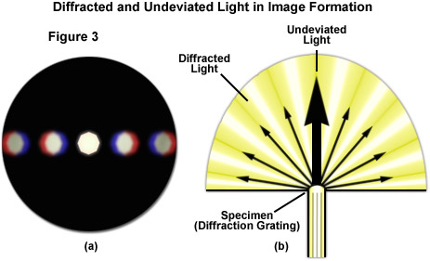
Diffraction and Image Formation
Diffracted and undeviated light
Notes:
The fainter diffracted images of the aperture diaphragm are caused by diffracted wavefronts, spread out in fan shape, at each of the openings of the line grating (Figure 3(b)). The blue wavelengths are diffracted at a lesser angle than the green wavelengths, which are diffracted at a lesser angle than the red wavelengths. At the rear focal plane of the objective, the blue wavelengths from each slit interfere constructively to produce the blue area of the diffracted image of each spectrum or order. The red and green areas (Figure 3(a)) are spaced a bit further, but arise from the same phenomenon. Where the diffracted wavelengths are one-half wave out of step for each of these colors, the waves destructively interfere to give rise to the dark areas between the spectra or orders. At the position of the zeroth order, all wavelengths from each slit add constructively. This produces the bright white light you see as the zeroth order (see Figures 2, 3 and 4) at the center of the rear focal plane of the objective.

Slide 35
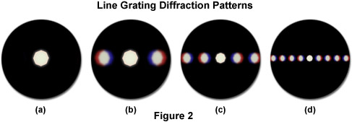
Diffraction and Image Formation
View of the rear focal plane of objective
No specimen
10 X
40 X
63 X
Notes:
Those diffraction spectra that fall near the periphery of the objective are dimmer than those closer to the central spot. The diffraction spectra illustrated in Figure 2 were captured using three different objective magnifications. In Figure 2(b), the diffraction pattern visible at the rear focal plane of the 10x objective contains two diffraction spectra. If the grating is removed from the stage, as illustrated in Figure 2(a), these spectra disappear and only the central image of the aperture diaphragm remains. If the grating is reinserted, the spectra reappear once again. Note that the spaces between the colored spectra appear dark. Only a single pair of spectra can be observed if the grating is examined with the 10x objective. In this case, one diffraction spot appears to the left and one appears to the right of the central aperture opening. If the line grating is examined with a 40x objective (as shown in Figure 2(c)), several diffraction spectra appear to the left and right of the central aperture. When the magnification is increased to 60x or 63x (and assuming it has a higher numerical aperture than the 40x objective), several additional spectra (see Figure 2(d)) appear to the right and left of those that are visible with the 40x objective in place.

Slide 36
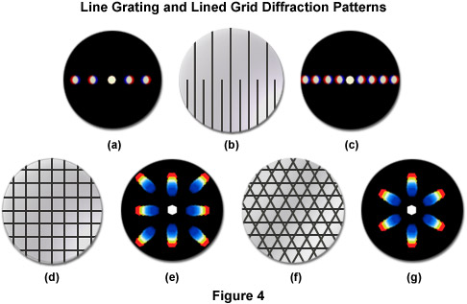
Diffraction and Image Formation
Diffraction patterns of line gratings and other structures (coarse to fine grating)
Notes:
The closer the spacing of a line grating, the fewer the spectra that will be captured by a given objective, as illustrated in Figure 4(a-c). The diffraction pattern illustrated in Figure 4(a) was captured by a 40x objective imaging the lower portion the line grating in Figure 4(b), where the slits are closer together. In Figure 4(c), the objective is focused on the upper portion of the line grating (Figure 4(b)) where the slits are farther apart, and more spectra are captured by the objective. The direct light and the light from the higher order diffraction maxima are focused by the objective to form an image in the intermediate image plane at the fixed diaphragm of the eyepiece. Here the direct and diffracted light rays interfere and are thus reconstituted into the real, inverted image that is seen by the eye lens of the eyepiece and further magnified. This is illustrated in Figure 4(d) through Figure 4(g) with two types of diffraction gratings. The square grid illustrated in Figure 4(d) represents the orthoscopic image of the grid (in effect, the usual specimen image observed through the eyepieces) as seen through the full aperture of the objective. The diffraction pattern derived from this grid is shown as a conoscopic image that would be seen at the rear focal plane of the objective (Figure 4(e)). Likewise, the orthoscopic image of a hexagonally arranged grid (Figure 4(f)) produces a corresponding hexagonally arranged conoscopic image (Figure 4(g)) of first order diffraction patterns.

Slide 37
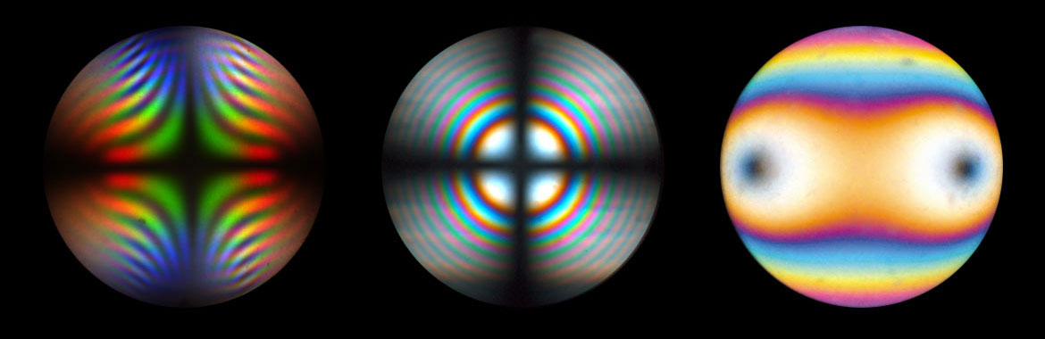
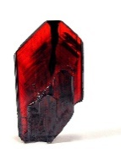
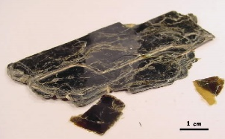
Diffraction and Image Formation
Diffraction patterns for even more complex structures
Plus adding polarized illumination
Notes:
Brookite, TiO2, with strong dispersion colors
Uni-axial interference figure of thick calcite plate, perpendicular to optical axis
Bi-axial interference figure of thin biotite crystal in diagonal position at circular polarized light
Brookite from wikipedia
Biotite from http://www4.uwm.edu/course/geosci-100/Mineral_Rocks/biotite_data.html
http://www.leica-microsystems.com/products/light-microscopes/details/product/leica-dm4-p/

Slide 38
Determining resolution (3 methods)
Using Fermat’s principle of least time
Abbe’s resolution formula using N.A.
Collecting more diffraction orders
Notes:
Ernst Abbe published this formula in 1873

Slide 39
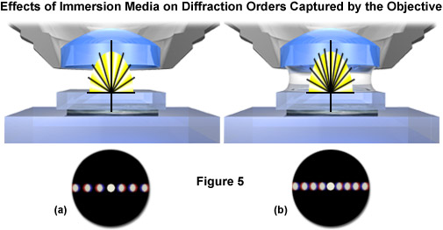
Diffraction and Image Formation
Why does larger N.A. give better resolution?
Abbe: it is all a problem of diffraction
Capturing more orders with immersion lens
Notes:
According to Abbe (his theories are still widely accepted at the present time), the details of a specimen will be resolved if the objective captures 2 orders of light, such as the 0th order of the light and at least the 1st order of diffraction. The greater the number of diffracted orders that gain admittance to the objective, the more accurately the image will represent the original object. Furthermore, if a medium of higher refractive index than air (such as immersion oil) is used in the space between the front lens of the objective and the top of the cover slip (as shown for a dry objective in Figure 5(a)), the angle of the diffracted orders is reduced and the fans of diffracted light will be compressed. As a result, an oil immersion objective can capture more diffracted orders and yield better resolution than a dry objective (Figure 5(b)). Compare the captured orders in Figure 5(a) and 5(b). Moreover, because blue light is diffracted at a lesser angle than green light or red light, a lens of a given aperture may capture more orders of light when the wavelengths are in the blue region of the visible light spectrum. These two principles explain the classic Rayleigh equation often cited as the basis for calculating point-to-point resolution in the microscope

Slide 40
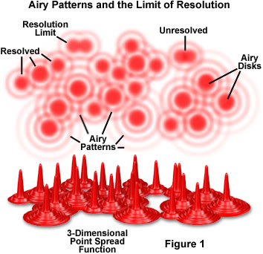
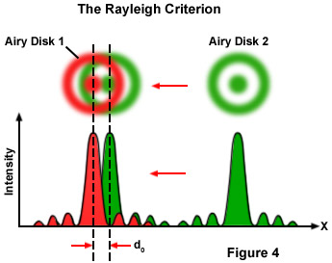
Relationship between airy disk, point spread function (PSF) and resolution
Minimum resolvable distance requires that the two PSF’s don’t overlap
Rayleigh criterion and Full Width Half Maximum (FWHM)
How N.A. and air disk effects resolution
Notes:
The factor 1.220 is derived from a calculation of the position of the first dark circular ring surrounding the central Airy disc of the diffraction pattern. The calculation involves a Bessel function—1.220 is approximately the first zero of the Bessel function of the first kind, of order one (i.e., ), divided by π.
The formal Rayleigh criterion is close to the empirical resolution limit found earlier by the English astronomer W. R. Dawes who tested human observers on close binary stars of equal brightness. The result, θ = 4.56/D, with D in inches and θ in arcseconds is slightly narrower than calculated with the Rayleigh criterion: A calculation using Airy discs as point spread function shows that at Dawes' limit there is a 5% dip between the two maxima, whereas at Rayleigh's criterion there is a 26.3% dip.^{[3]} Modern image processing techniques including deconvolution of the point spread function allow resolution of even narrower binaries.
The angular resolution may be converted into a spatial resolution, Δℓ, by multiplication of the angle (in radians) with the distance to the object. For a microscope, that distance is close to the focal length f of the objective. For this case, the Rayleigh criterion reads:
For airy patten basics jave applet use this zeiss link:
http://zeiss-campus.magnet.fsu.edu/tutorials/basics/airydiskbasics/indexflash.html
.

Slide 41
Relationship between airy disk, point spread function (PSF) and resolution
Notice that Abbe’s original formula did not have the constant currently used.
d_{min} = 1.22 λ / (NA _{objective} +NA _{condenser})
Airy disk
Notes:
The factor 1.220 is derived from a calculation of the position of the first dark circular ring surrounding the central Airy disc of the diffraction pattern. The calculation involves a Bessel function—1.220 is approximately the first zero of the Bessel function of the first kind, of order one (i.e., ), divided by π.
The formal Rayleigh criterion is close to the empirical resolution limit found earlier by the English astronomer W. R. Dawes who tested human observers on close binary stars of equal brightness. The result, θ = 4.56/D, with D in inches and θ in arcseconds is slightly narrower than calculated with the Rayleigh criterion: A calculation using Airy discs as point spread function shows that at Dawes' limit there is a 5% dip between the two maxima, whereas at Rayleigh's criterion there is a 26.3% dip.^{[3]} Modern image processing techniques including deconvolution of the point spread function allow resolution of even narrower binaries.
The angular resolution may be converted into a spatial resolution, Δℓ, by multiplication of the angle (in radians) with the distance to the object. For a microscope, that distance is close to the focal length f of the objective. For this case, the Rayleigh criterion reads:
For airy patten basics jave applet use this zeiss link:
http://zeiss-campus.magnet.fsu.edu/tutorials/basics/airydiskbasics/indexflash.html
.

Slide 42
Diffraction helps explain how an image is broken down to its underlying components
Does this sound familiar?

Slide 43
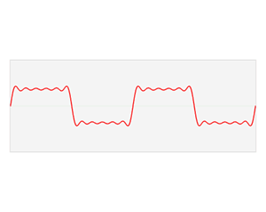
Diffraction helps explain how an image is broken down to its underlying components
Does this sound familiar?
It is what a Fourier transform does.

Slide 44
To make sense of the point spread function, remember that an optical system breaks image down to its underlying spatial components and then reassembles them as an image.
Fourier transform
Inverse fourier transform
i
o

Slide 45
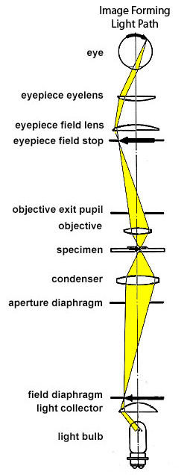
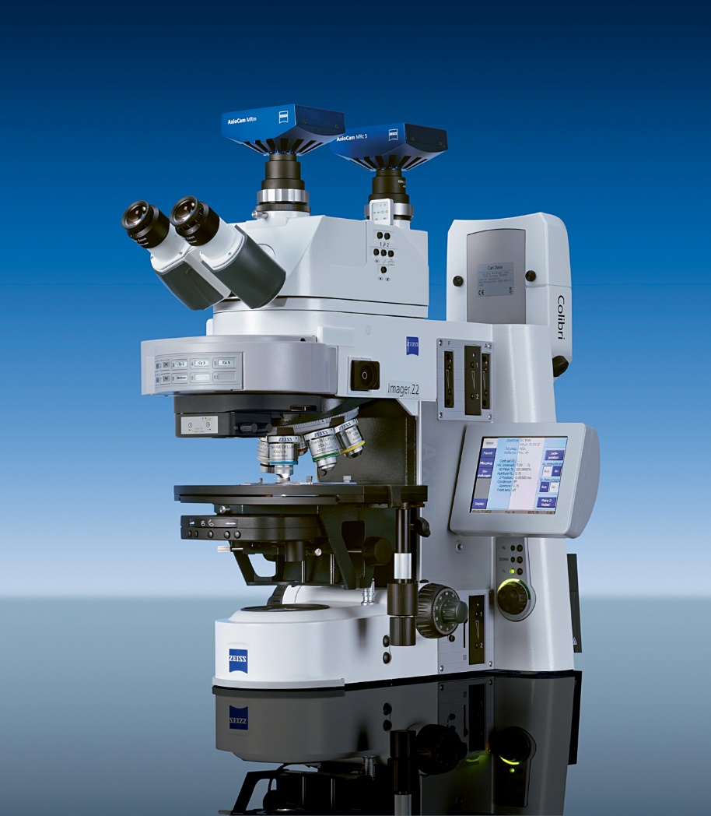
Compound microscope is not 3D, even though binocular

Slide 46


Conjugate Planes (Koehler)
Retina
Eye
Eyepoint
Eyepiece
Intermediate Image
TubeLens
Imaging Path
Objective Back Focal Plane
Objective
Specimen
Condenser
Condenser Aperture Diaphragm
Field Diaphragm
Illumination Path
Collector
Light Source

Slide 47
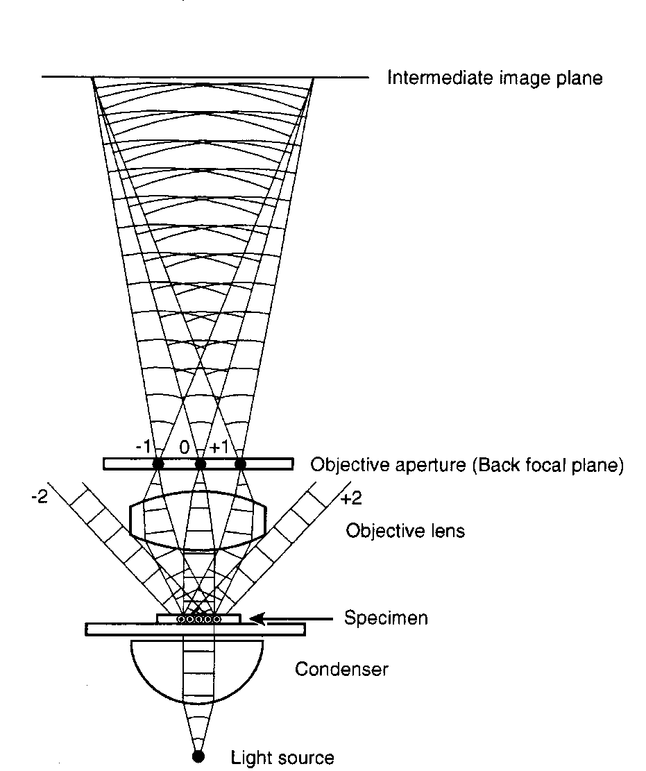
Imaging a linear grating
Intermediate Image: Formed by interfering waves from –1, 0, +1 orders
Back Focal Plane: Diffraction pattern, formed by objective (multiple images of the source as a result of line spacing)
Specimen: Slide with periodic lines. Spacing determines diffraction angles.
Condenser: Produces parallel wave front at 0° (aperture is closed down to a pinhole).
“Illumination Path”

Slide 48
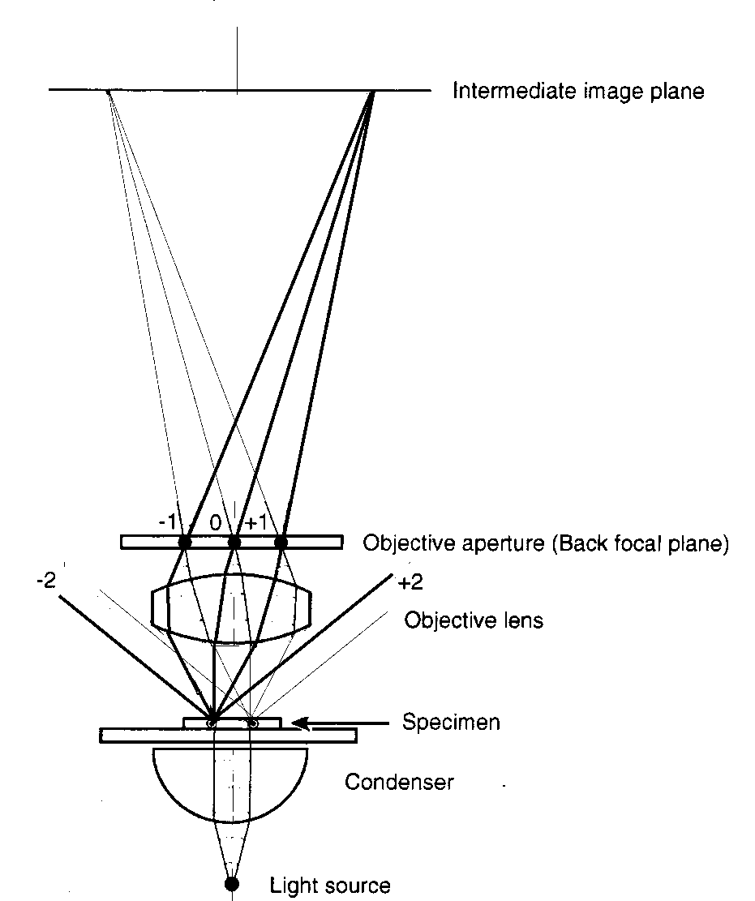
Imaging a linear grating
Intermediate Image Plane: Beams from the –1, 0, +1 orders interfere with each other. Image of specimen appears (upside-down and side reversed)
Objective captures 3 of the 5 diffraction orders.
Specimen: Structure causes diffraction; direction of illumination splits up in non-diffracted and diffracted light (5 different angles)
“Imaging Path”
Condenser: Illumination angle shown at 0°

Slide 49
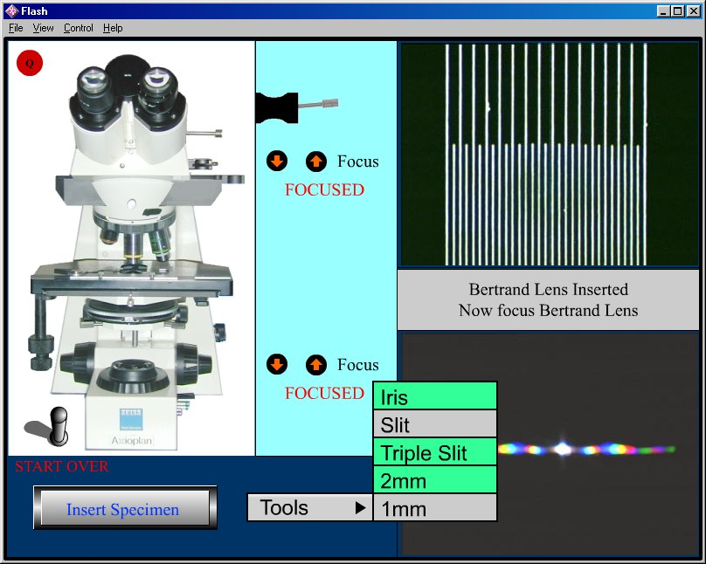
Zeiss Diffraction Kit Simulator
http://www.guycox.com/diffkit/diffkit.htm

Slide 51
Homework 1: The index of refraction changes with wavelength (index is larger in blue than red).
How would you need to modify this diagram of the rays of red light to make it appropriate for blue light?
f
i
o

Slide 52
Higher index of refraction results in shorter f
Chromatic Aberration
Lateral (magnification)
Axial (focus shift)
f
Shift of focus
i
o
Change in magnification

Slide 53
Now to first reading assignment
For historians of science these debates in the letter pages of journal can provide amazing insights about a field.

Slide 54
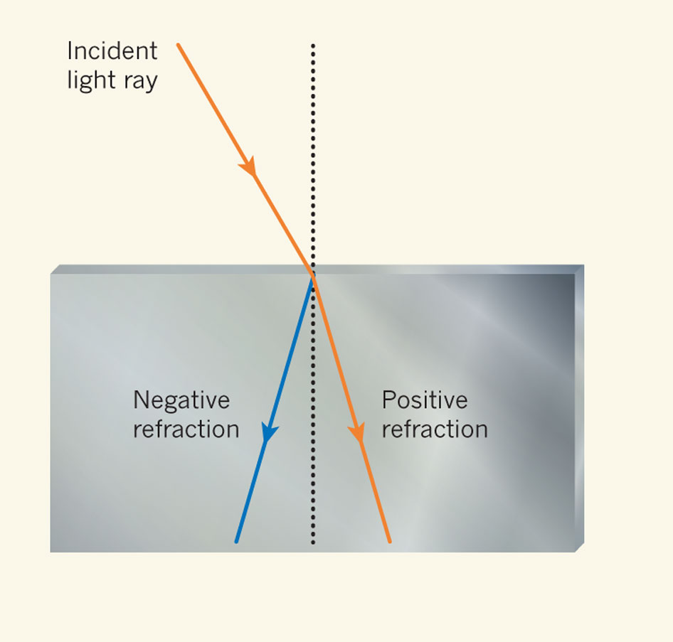


Metamaterials with negative refractive indices would produce bizarre images
Image not real!
Tyc T, Zhang X (2011) Forum Optics: Perfect lenses in focus. Nature 480: 42-43.
Notes:
http://www.nature.com/nature/journal/v480/n7375/full/480042a.html
Straw image from http://www.extremetech.com/extreme/168060-the-first-quantum-metamaterial-raises-more-questions-than-it-answers

Slide 55

Metamaterials with negative refractive indices could be used to make superlenses for super resolution microcopy
Do you need negative refractive index for perfect lens?
Maxwell's fish-eye lens could do it with positive refractive indices
  Refractive index changes across lens (blue shading)
Type of Luneburg lens
Tyc T, Zhang X (2011) Forum Optics: Perfect lenses in focus. Nature 480: 42-43.
Notes:
Darker blue, higher refractive index. Like a gravitational lens
A practical superlens, super lens or perfect lens, is a lens which uses metamaterials to go beyond the diffraction limit. The diffraction limit is an inherent limitation in conventional optical devices or lenses.[1] In nano-optics, a plasmonic lens generally refers to a lens for surface plasmon polaritons (SPPs), i.e. a device that redirects SPPs to converge towards a single focal point. Since SPPs can have very small wavelength, they can converge into a very small and very intense spot, much smaller than the free-space wavelength and the diffraction limit.[1][2] Surface plasmon polaritons (SPPs), are infrared or visible-frequency electromagnetic waves, which travel along a metal-dielectric or metal-air interface. The term "surface plasmon polariton" explains that the wave involves both charge motion in the metal ("surface plasmon") and electromagnetic waves in the air or dielectric ("polariton").[1]
They are a type of surface wave, guided along the interface in much the same way that light can be guided by an optical fiber. SPPs are shorter in wavelength than the incident light (photons).[2]
Metamaterials are artificial materials engineered to have properties that have not yet been found in nature.
https://en.wikipedia.org/wiki/Luneburg_lens

