Slide 1
Biology 177: Principles of Modern Microscopy
Lecture 03:
Microscope optics and the design of microscopes
Andres Collazo, Director Biological Imaging Facility
Wan-Rong (Sandy) Wong, Graduate Student, TA

Slide 2
Lecture 3: Microscope Optics
Applying geometrical optics, the Rochester cloak
Infinity optics
Particle and wave nature of light
Dispersion
Aberrations
Fraunhofer lines
Two Most Important Microscope Components
N.A. and Resolution

Slide 3
Questions about last lecture?

Slide 4
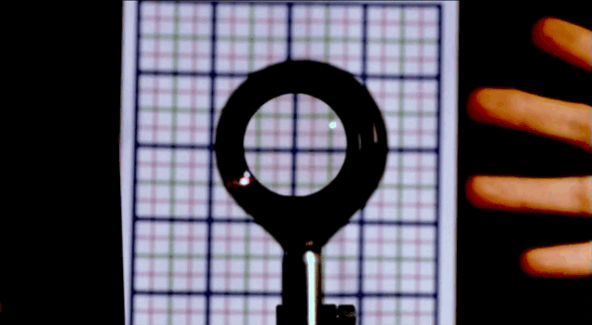
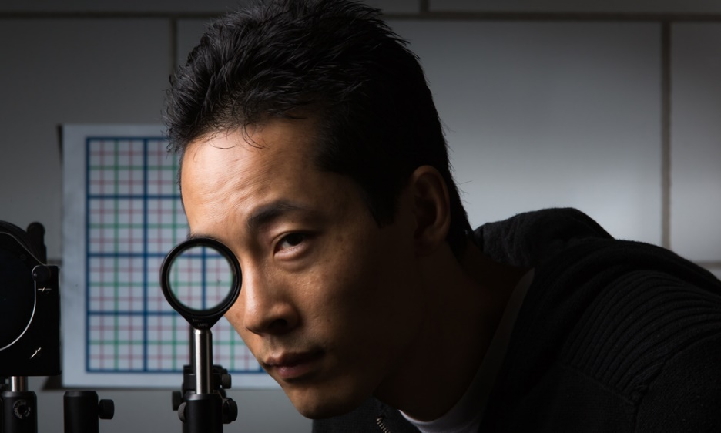
Applying geometrical optics.
Cloaking objects with simple lenses
Making objects invisible
Ray tracing still important for optical research
Paper by Choi and Howell from University of Rochester published 2014
  Choi JS, Howell JC. Paraxial ray optics cloaking. Optics express. 2014; 22(24):29465-78.

Slide 5
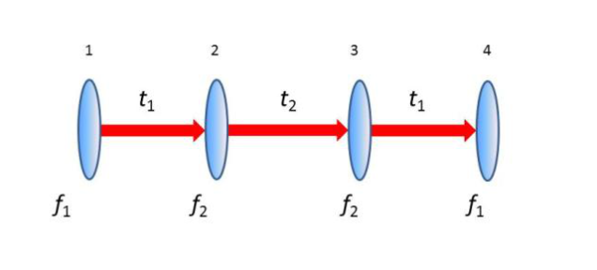
Perfect cloak at small angles using simple optics
Paraxial rays are those at small angles
Uses 4 off the shelf lenses: two with a focal length of f₁ and two with focal lengths of f₂

Slide 6
Perfect cloak at small angles using simple optics
Lens with f₁ separated from lens with f₂ by sum of their focal lengths = t₁.
Separate the two sets by t₂=2 f₂ (f₁+ f₂) / (f₁— f₂) apart, so that the two f₂ lenses are t₂ apart.

Slide 7
Perfect cloak at small angles using simple optics
Lenses used are achromatic doublets
For first and last lenses (1 and 4), 200 mm focal length, 50 mm diameter composed of BK7 and SF2 glass.
For center two lenses (2 and 3), 75 mm focal length, 50 mm diameter composed of SF11 and BAF11 glasses.

Slide 8
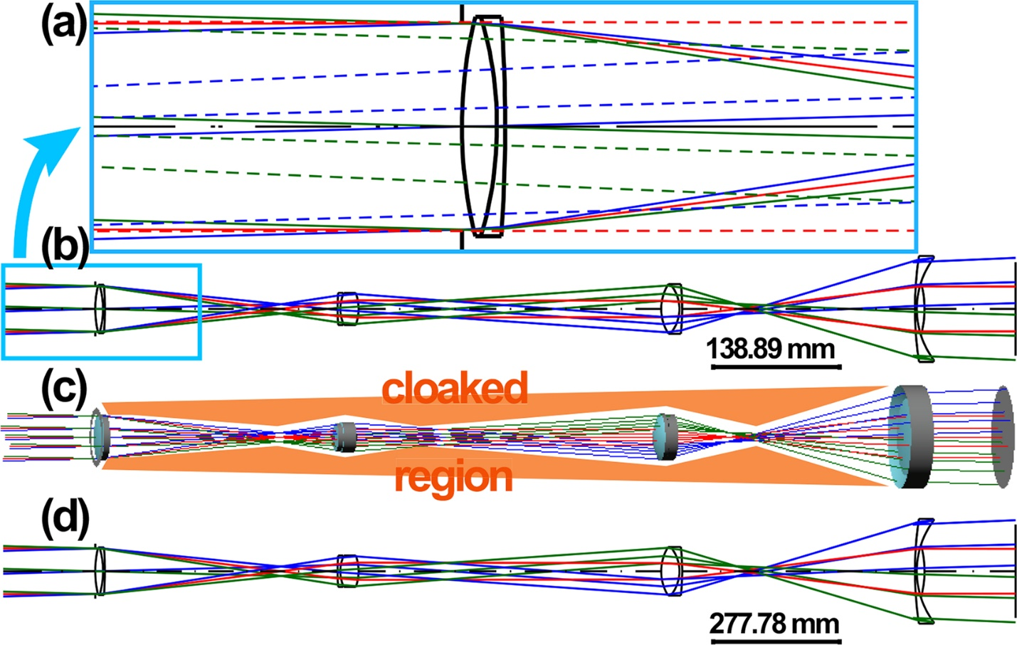
Perfect cloak at small angles using simple optics
Ray diagrams can get complex.
Notes:
Fig. 4 CODE V simulation of a symmetric, perfect paraxial cloak, with four lenses using rays. Four achromatic doublets are placed with separations determined from Eq. (1). Entrance pupil is 50 mm, with −1.5° to 1.5° field-of-view. Simulations are shown with no separate optimization. Object is placed at infinity. (a) Zoomed-in region of (b) with image rays (dashed; traced back to the first lens) added to compare with the original rays (solid). We see that the angles are nearly identical, and the transverse shifts are small. (b) Full simulation using off-the-shelf optics. (c) 3D rendering. The cloaking region (shaded) is a cylindrical region between the first and last lenses. (d) Scaling of (b) by a factor of 2. The cloaking size is doubled in each dimension by doubling the optical curvatures, lengths and entrance pupil. Only the length scales distinguish (d) from (b).

Slide 9

The Finitely Corrected Compound Microscope
B
Eyepiece
A
B
150 mm (tube length = 160mm)
Objective
Objective Mount (Flange)
In most finitely corrected systems, the eyepiece has to correct for the LCA of the objectives, since the intermediate image is not fully corrected.
LCA = lateral chromatic aberration

Slide 10
The Compound Microscope (infinity corrected)
Eyepiece
Tube lens
(Zeiss: f=164.5mm)
Objective
Notes:
Manufacturer Tube Lens
Focal Length
(Millimeters) Parfocal Distance
(Millimeters) Thread Type
Leica 200 45 M25
Nikon 200 60 M25
Olympus 180 45 RMS
Zeiss 165 45 RMS

Slide 11
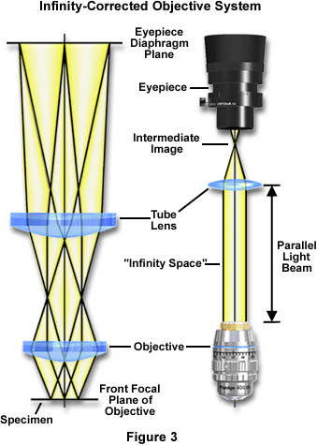
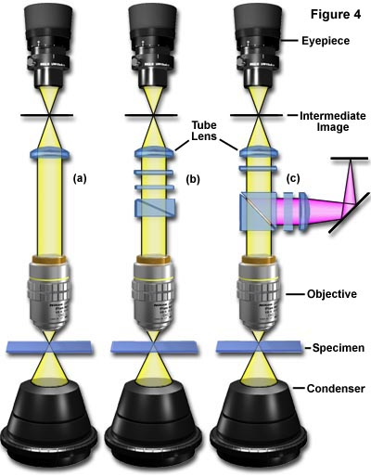
The Compound Microscope (infinity corrected)
Notes:
https://micro.magnet.fsu.edu/primer/anatomy/tubelength.html
http://www.leica-microsystems.com/science-lab/widefield-microscopy/infinity-optical-systems/

Slide 12
From a Microscope to a Telescope
Eyepiece
No “objective”
Objective (previously:Tube Lens)
∞
∞
Objective
∞
Eyepiece
∞
“Galilean” Type Telescope

Slide 13
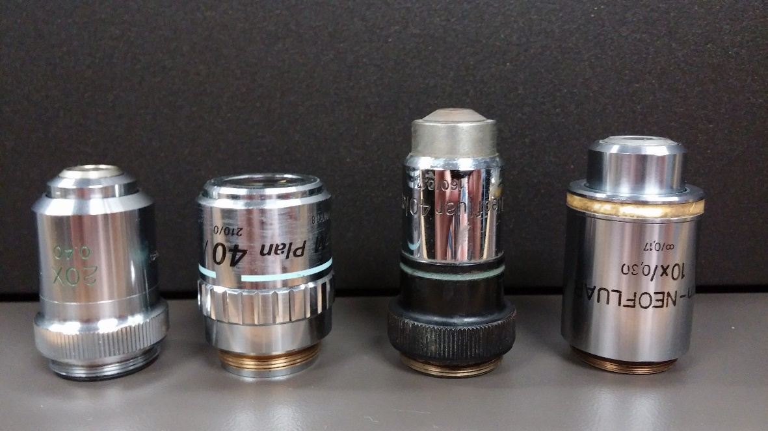
Homework 2: Most modern microscopes are “infinity corrected” while older microscopes had a fixed tube length of 160 or 170 mm. Even when microscopes transitioned to infinity optics, they sometimes maintained the same lens thread size, RMS (Royal Microscopy Society). Why is it not a good idea to use finite lenses on an infinity microscope or another companies lens on a different companies microscope?
Hint - The answer is the same for both. Think of what you learned from homework 1.
Notes:
mounting threads that are 20.32 mm in diameter with a pitch of 0.706, conforming to the RMS standard

Slide 14
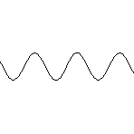
Basic properties of light
Particle Movement
Wave
Either property may be used to explain the various phenomena of light
Notes:
Now either property may be used to explain the various phenomena of light

Slide 15
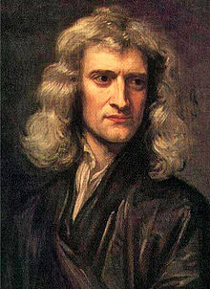
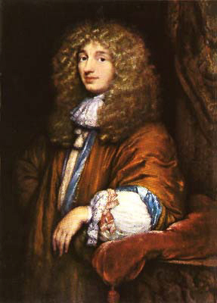
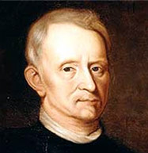
Particle versus wave theories of light in the 17th Century.
Corpuscular theory
Wave theory
Light made up of small discrete particles (corpuscles)
Particles travel in straight line
Sir Isaac Newton was biggest proponent
Different colors caused by different wavelengths
Light spreads in all directions
First deduced by Robert Hooke and mathematically formulated by Christiaan Hyugens
Treatise on Light
Notes:
Isaac Newton (1642-1726/7) argued that the geometric nature of reflection and refraction of light could only be explained if light was made of particles, referred to as corpuscles, because waves do not tend to travel in straight lines. Newton sought to prove Christiaan Huygens' theory that light was made of waves. In his 44th trial in a series of experiments concerning physics of light, he concluded that light is made of particles and not waves by having passed a beam of white light through two prisms which were held at such an angle that the light split into a spectrum after passing through the first prism and then was recomposed, back into white light, by the second prism.
Robert Hooke FRS (/hʊk/; 28 July [O.S. 18 July] 1635 – 3 March 1703) was an English natural philosopher, architect and polymath. Author of the seminal book on microscopy called Micrographia. Coined the word cell. Fought with Hyugens about the invention of the balance spring for watches.
Christiaan Huygens, FRS (/ˈhaɪɡənz/ or /ˈhɔɪɡənz/; Dutch: [ˈɦœy̆ɣə(n)s] ( listen)) (Latin: Hugenius) (14 April 1629 – 8 July 1695) was a prominent Dutch mathematician and scientist. He is known particularly as an astronomer, physicist, probabilist and horologist. His seminal work titled: Treatise on Light
In which are explained the causes of that which occurs in reflexion, & in refraction and particularly in the strange refraction of Iceland crystal . Available through project Gutenberg: http://www.gutenberg.org/files/14725/14725-h/14725-h.htm

Slide 16
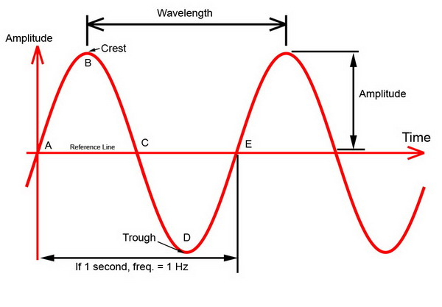
Characteristics of a wave
Wavelength (λ) is distance between crests or troughs
Amplitude is half the difference in height between crest and trough.
Notes:
http://www.billavista.com/atv/Articles/Offroad_Radios_and_Comms/index.html
Source of image.

Slide 17
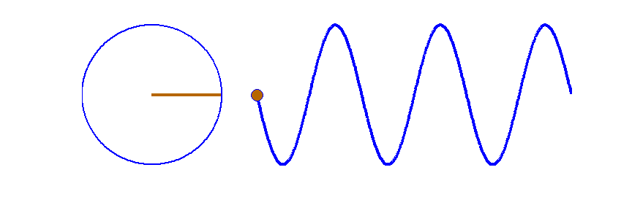
Characteristics of a wave
Period is time it takes two crests or two troughs to travel through the same point in space.
  Example: Measure the time from the peak of a water wave as it passes by a specific marker to the next peak passing by the same spot.
Frequency (ν) is reciprocal of its period = 1/period [Hz or 1/sec]
  Example: If the period of a wave is three seconds, then the frequency of the wave is 1/3 per second, or 0.33 Hz.
Notes:
Fig. 7. A travelling sinusoidal wave. Each point along the wave executes SHM as shown by the circle. The waveform advances to the right one wavelength in a time of one period. Matlab script: ag_sine_circle.m. Animated gif: ag_sineC.gif
http://www.physics.usyd.edu.au/teach_res/mp/doc/wm_string_1.htm
Gif is from Matlab tutorial.

Slide 18
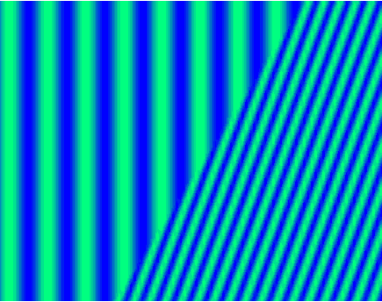
Characteristics of a wave
Velocity (or speed) at which a wave travels can be calculated from the wavelength and frequency.
Velocity in Vacuum (c) = 2.99792458 • 10⁸ m/sec
Frequency remains constant while light travels through different media. Wavelength and speed change.
c = ν λ
Notes:
http://imgarcade.com/1/refraction-of-waves-animation/

Slide 19
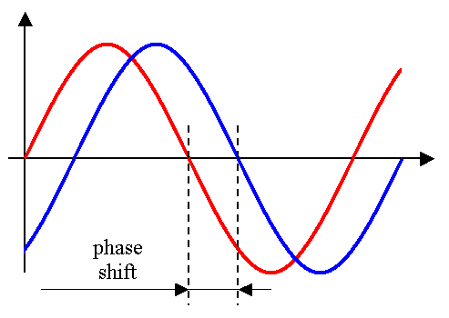
Characteristics of a wave
Phase shift is any change that occurs in the phase of one quantity, or in the phase difference between two or more quantities
Small phase differences between 2 waves cannot be detected by the human eye

Slide 20
Refraction as explained through Fermat’s principle of least time
Light takes path that requires shortest time
Wave theory explains how light “smells” alternate paths
θ1
θ2
η1
η2
Feynman Lectures on Physics, Volume I, Chapter 26
http://feynmanlectures.caltech.edu/I_26.html
Notes:
Pierre de Fermat (French: [pjɛːʁ dəfɛʁma]; 17^{[2]} August 1601 or 1607^{[1]} – 12 January 1665) was a French lawyer at the Parlement of Toulouse, France, and an amateur mathematician.

Slide 21
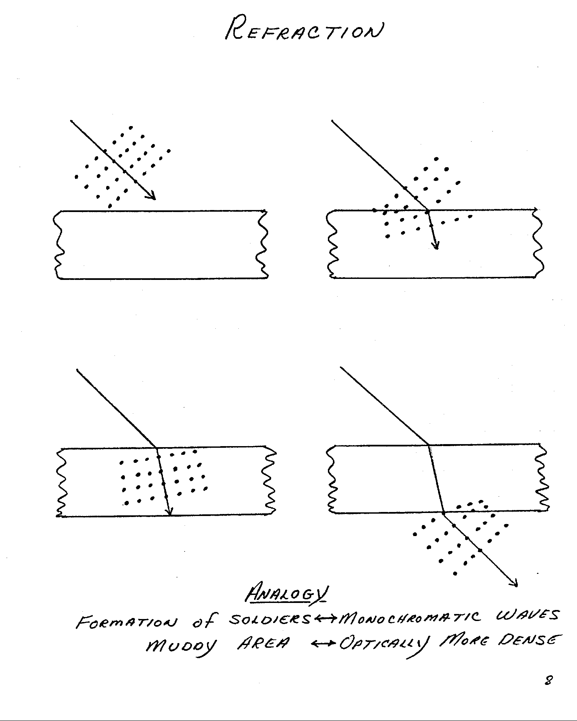
Refraction (Marching Band Analogy)
Notes:
Christiaan Hyugens thought Refraction best understood through wave theory: waves traveled more slowly in a dense medium (like waves in shallow water). Newton explained refraction poorly via changes in acceleration due to gravity.

Slide 22
Refraction (Marching Band Analogy)

Slide 23
Refraction (Marching Band Analogy)

Slide 24
Refraction (Marching Band Analogy)

Slide 25
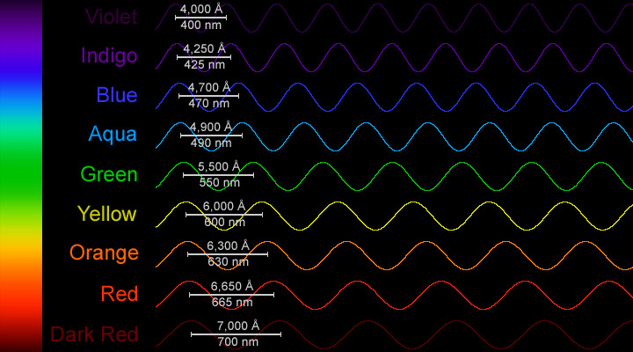
What is white light?
A combination of all wavelengths originating from the source
Notes:
https://www.windows2universe.org/physical_science/magnetism/images/visible_spectrum_waves_big_jpg_image.html

Slide 26
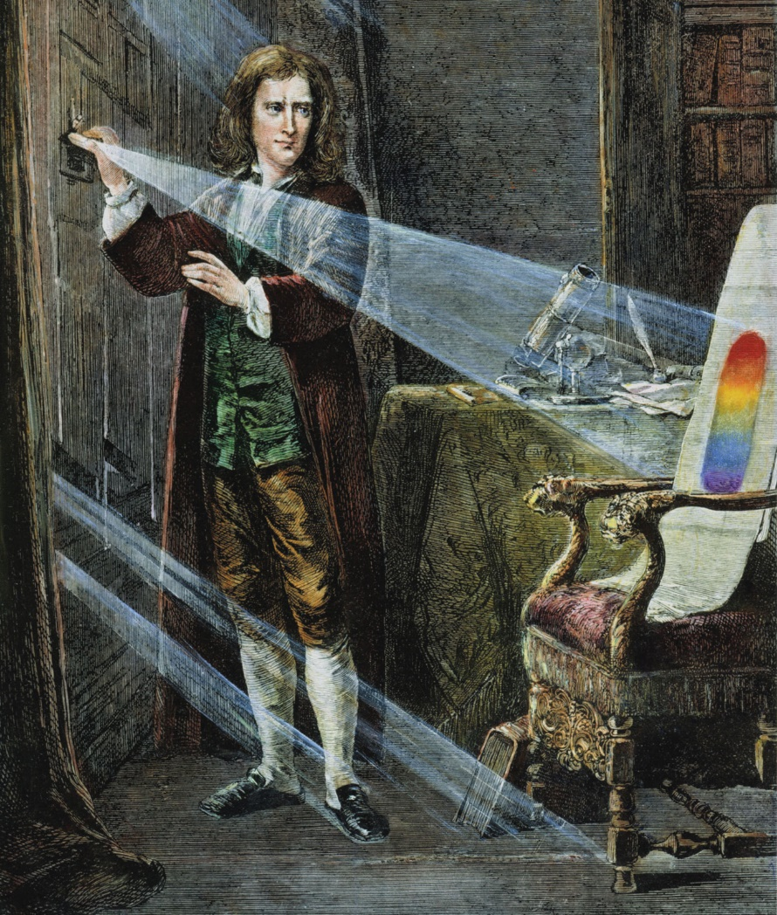
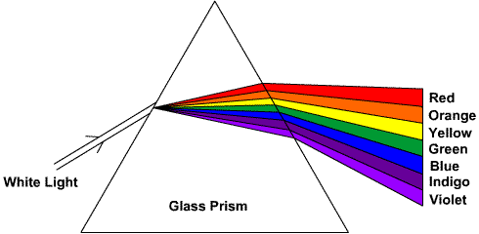
Dispersion: Separation of white light into spectral colors as a result of different amounts of refraction by different wavelengths of light.
Dispersive prisms typically triangular
Back to Sir Isaac Newton

Slide 27
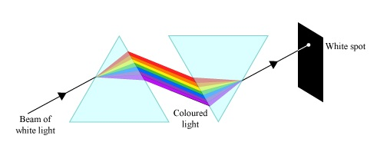
Why Isaac Newton did not believe the wave theory of light
Experiment with two prisms
If light was wave than should bend around objects
Color did not change when going through more glass
Notes:
Advocates of the wave theory had previously stated that light waves are made of white light, and that the colour spectrum, which can be seen through a prism, is formed because of corruption within the glass. This means that the more glass the light travels through, the more corrupt it will become. In order to prove that this was false, Newton passed a beam of white light through two prisms, which were held at such an angle that it split into a spectrum when passing through the first prism and was recomposed, back into white light, by the second. This showed that the spectrum was not caused by glass corrupting the light. Newton claimed that this was a 'crucial experiment'.
Newton claimed that Grimaldi's diffraction was simply a new kind of refraction. He argued that the geometric nature of the laws of reflection and refraction could only be explained if light was made of particles, which he referred to as corpuscles, as waves do not tend to travel in straight lines. After joining the Royal Society of London in 1672, Newton stated that the 44th trail in a series of experiments he had conducted earlier that year had proven that light is made of particles and not waves.
http://www.thestargarden.co.uk/NewtonAndLight.html
http://thefishbowlnetwork.com/blog/tag/isaac-newton/

Slide 28
Dirty little secret about lenses
Simple lens law hides a major problem about lenses
To paraphrase Feynman, we fool ourselves by concentrating on paraxial rays near the optical axis
Notes:
Feynman lecture 27 on geometrical optics

Slide 29
Optical Aberrations: Imperfections in optical systems
Chromatic (blue = shorter focal length)
Spherical
Curvature of field

Slide 30
Dispersion in a plane-parallel glass plate (e.g. slide, cover slip, window of a vessel)
Chromatic Aberration can be defined as “unwanted” dispersion.
“White” Light

Slide 31
Spherical Aberration
Zone of Confusion
Notes:
Everything great with paraxial rays

Slide 32
Curvature of field: Flat object does not project a flat image
(Problem: Cameras and Film are flat)
f
i
o
Notes:
Retina image is curved. Another reason your eyes see more than the camera.

Slide 33
Optical Aberrations: Imperfections in optical systems
Chromatic (blue = shorter focal length)
Spherical (rays near edge of lens bent more)
Curvature of field (worse near edges)
Potential Solution: Stop down lens

Slide 34
Spherical Aberration is reduced by smaller aperture
Less confused “Zone of Confusion”

Slide 35
Optical Aberrations: Imperfections in optical systems
Chromatic (blue = shorter focal length)
Spherical (rays near edge of lens bent more)
Curvature of field (worse near edges)
Potential Solution: Stop down lens
Problem: Brightness and Resolution

Slide 36
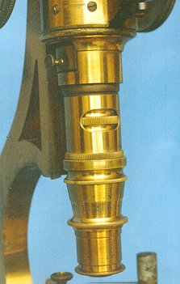
The most important microscope component
The Objective
Here is where good optical engineering really pays off

Slide 37
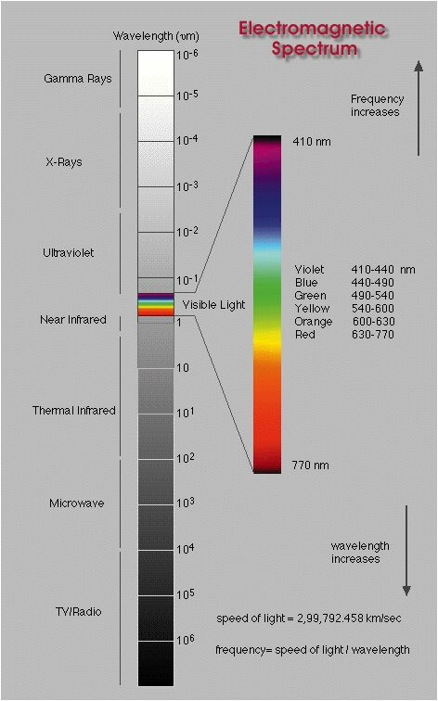
Named Spectral Lines
404.7 h Violet Hg
435.8 g Blue Hg
480.0 F‘ Blue Cd
486.1 F Blue H
546.1 e Green Hg
587.6 d Yellow He
589 D Sodium
643.8 C‘ Red Cd
656.3 C Red H
706.5 nm r Red He
Energy
Where did these named lines come from?
Notes:
Back to electromagnetic spectrum.

Slide 38
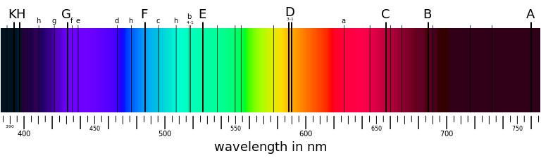
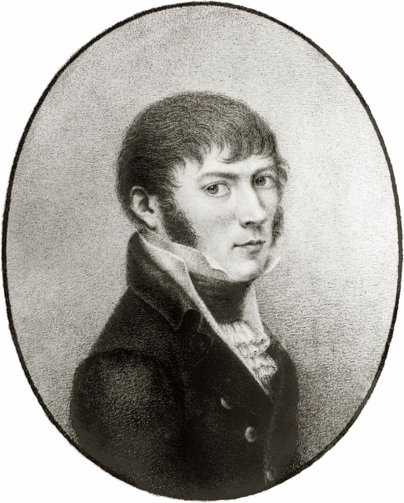
Fraunhofer lines
Dark lines in solar spectrum
First noted by William Wollaston in 1802
Independently discovered by Joseph Fraunhofer in 1814
Absorption by chemical elements (e.g. He, H, Na)
"Hiding in the Light"
Joseph Fraunhofer 1787-1826
Notes:
In 1802, the English chemist William Hyde Wollaston^{[1]} was the first person to note the appearance of a number of dark features in the solar spectrum.^{[2]} In 1814, Fraunhofer independently rediscovered the lines and began a systematic study and careful measurement of the wavelength of these features. In all, he mapped over 570 lines, and designated the principal features with the letters A through K, and weaker lines with other letters.
On episode 5 of Neil deGrasse Tyson’s Cosmos.

Slide 39
Why do we care about Fraunhofer lines?

Slide 40
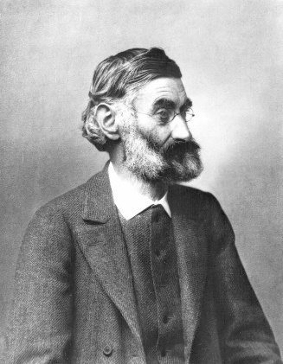
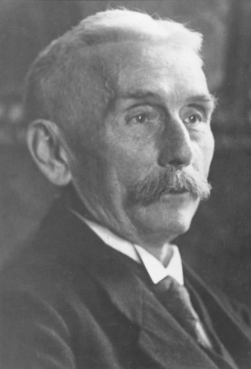
Why do we care about Fraunhofer lines?
Fraunhofer was a maker of fine optical glass
Special glass he made allowed him to see what Newton did not
Ernst Abbe, working with Otto Schott, would use these named spectral lines to characterize glass for microscope optics
Ernst Abbe (1840-1905)
Otto Schott (1851-1935)

Slide 41

Abbe number (V)
Measure of a material’s dispersion in relation to refractive index
Refractive indices at wavelengths of Fraunhofer D-, F- and C- spectral lines (589.3 nm, 486.1 nm and 656.3 nm respectively)
Instead of Na line can use He (V_{d}) or Hg (V_{e}) lines
High values of V indicating low dispersion (low chromatic aberration)
$$V_{D}=\frac{η_{D} − 1}{η_{F} − η_{C}}$$
Notes:
In physics and optics, the Abbe number, also known as the V-number or constringence of a transparent material, is a measure of the material's dispersion (variation of refractive index with wavelength) in relation to the refractive index, with high values of V indicating low dispersion (low chromatic aberration). It is named after Ernst Abbe (1840–1905), the German physicist who defined it.
Due to the difficulty and inconvenience in producing sodium and hydrogen lines, alternate definitions of the Abbe number are used in some contexts (ISO 7944).

Slide 42
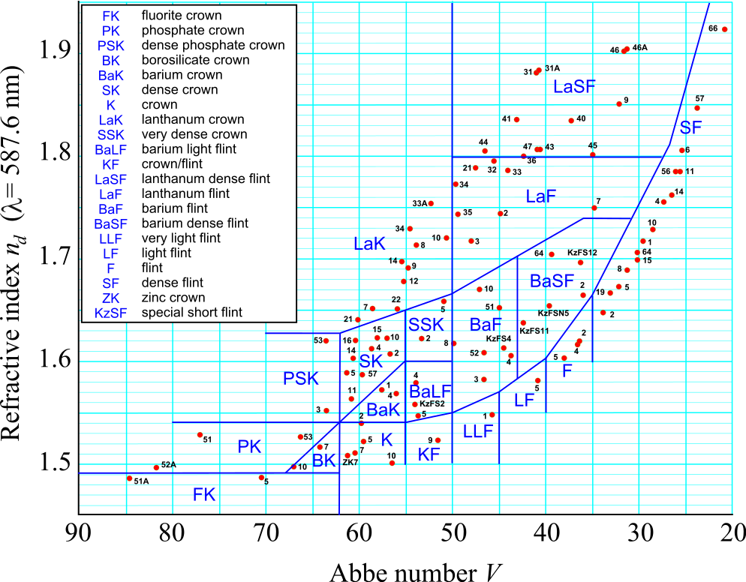
Abbe number (V)
Notes:
For first and last lenses (1 and 4), 200 mm focal length, 50 mm diameter composed of BK7 and SF2 glass.
For center two lenses (2 and 3), 75 mm focal length, 50 mm diameter composed of SF11 and BAF11 glasses
The most common types of glasses used in optics are crown glasses and flint glasses, designations based on their dispersions. Flint glasses contain lead. For example, a strong positive crown lens with its low dispersion may be used in a doublet with a weaker negative lens of flint glass (high dispersion) to correct for chromatic aberration.
http://hyperphysics.phy-astr.gsu.edu/hbase/geoopt/glass.html
In physics and optics, the Abbe number, also known as the V-number or constringence of a transparent material, is a measure of the material's dispersion (variation of refractive index with wavelength) in relation to the refractive index, with high values of V indicating low dispersion (low chromatic aberration). It is named after Ernst Abbe (1840–1905), the German physicist who defined it.
Due to the difficulty and inconvenience in producing sodium and hydrogen lines, alternate definitions of the Abbe number are used in some contexts (ISO 7944).

Slide 43
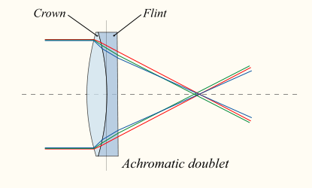
Example: Achromat doublet
Convex lens of crown glass: low η and high Abbe number
Concave lens of flint glass: high η and low Abbe number
Notes:
Flint glass is optical glass that has relatively high refractive index and low Abbe number (high dispersion). Flint glasses are arbitrarily defined as having an Abbe number of 50 to 55 or less. The currently known flint glasses have refractive indices ranging between 1.45 and 2.00. A concave lens of flint glass is commonly combined with a convex lens of crown glass to produce an achromatic doublet lens because of their compensating optical properties, which reduces chromatic aberration (colour defects).
With respect to glass, the term flint derives from the flint nodules found in the chalk deposits of southeast England that were used as a source of high purity silica by George Ravenscroft, circa 1662, to produce a potash lead glass that was the precursor to English lead crystal.
Traditionally, flint glasses were lead glasses containing around 4–60% lead oxide; however, the manufacture and disposal of these glasses were sources of pollution. In many modern flint glasses, the lead can be replaced with other additives such as titanium dioxide and zirconium dioxide without significantly altering the optical properties of the glass.
Flint glass can be fashioned into rhinestones which are used as diamond simulants.
Electric Bulbs and Spectacle glasses are made of Flint glass.
Crown glass is a type of optical glass used in lenses and other optical components. It has relatively low refractive index (≈1.52) and low dispersion (with Abbe numbers around 60). Crown glass is produced from alkali-lime (RCH) silicates containing approximately 10% potassium oxide and is one of the earliest low dispersion glasses.
As well as the specific material named crown glass, there are other optical glasses with similar properties that are also called crown glasses. Generally, this is any glass with Abbe numbers in the range 50 to 85. For example, the borosilicate glass Schott BK7^{[1]} is an extremely common crown glass, used in precision lenses. Borosilicates contain about 10% boric oxide, have good optical and mechanical characteristics, and are resistant to chemical and environmental damage. Other additives used in crown glasses include zinc oxide, phosphorus pentoxide, barium oxide, fluorite and lanthanum oxide.
An achromatic doublet, which combines crown glass and flint glass.
A concave lens of flint glass is commonly combined with a convex lens of crown glass to produce an achromatic doublet. The dispersions of the glasses partially compensate for each other, producing reduced chromatic aberration compared to a singlet lens with the same focal length.

Slide 44
Optical Aberrations: Imperfections in optical systems
Chromatic (blue = shorter focal length)
Spherical (rays near edge of lens bent more)
Curvature of field (worse near edges)
BAD Potential Solution: Stop down lens
Problem: Brightness and Resolution
Real Solution: Good Optical Engineering

Slide 45
Good optical Engineering
What to look for when buying a new microscope
Minimize number of lenses, prisms and mirrors
  Do you agree?

Slide 46
Good optical Engineering
What to look for when buying a new microscope
Minimize number of lenses, prisms and mirrors
  Do you agree?
But the best lenses may have the most optical elements
Can you see one trend in designing new objectives?

Slide 47
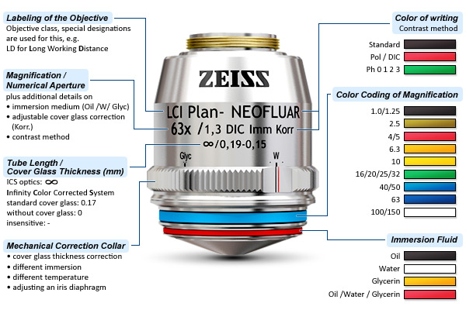
Deciphering an objective
http://zeiss-campus.magnet.fsu.edu

Slide 48
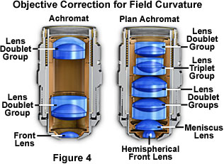
Internal structure of objectives
The Objective
http://www.microscopyu.com/articles/optics/objectiveintro.html

Slide 49
Example: Achromat doublet
Second lens creates equal and opposite chromatic aberration
BUT - at only one or two wavelength(s)

Slide 50
Objective names and corrections
Corrections: | Chromatic | Spherical | Other
Achromat | 2λ | -
Apochromat | 3λ | 2λ
PlanApochromat | 4-7λ | 3λ | Flat field
Fluor or Fluar | fewλ | fewλ | Max light
Neo Fluar | 2-3λ | 2-3λ

Slide 51
Definitions: Color Correction (axial)
Corrected Wavelength (nm):
UV VIS IR
Plan Neofluar - - (435) 480 546 - 644 - -
Plan Apochromat - - 435 480 546 - 644 - -
C-Apochromat 365 405 435 480 546 608 644 - -
IR C-Apochromat - - 435 480 546 608 644 800 1064
Notes:
Based on Fraunhofer line letters. For example 644 is red cadmium C’

Slide 52
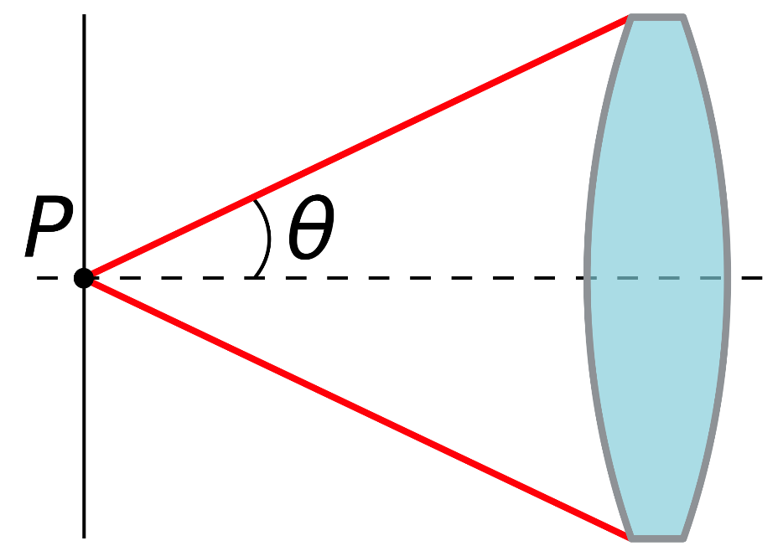
Need to Understand Numerical Aperture (N.A.)
Dimensionless number defining range of angles over which lens accepts light.
Refractive index (η) times half-angle (θ) of maximum cone of light that can enter or exit lens
N.A. = η sin θ
Notes:
In optics, the numerical aperture (NA) of an optical system is a dimensionless number that characterizes the range of angles over which the system can accept or emit light. By incorporating index of refraction in its definition, NA has the property that it is constant for a beam as it goes from one material to another provided there is no optical power at the interface. The exact definition of the term varies slightly between different areas of optics. Numerical aperture is commonly used in microscopy to describe the acceptance cone of an objective (and hence its light-gathering ability and resolution), and in fiber optics, in which it describes the range of angles within which light that is incident on the fiber will be transmitted along it.

Slide 53
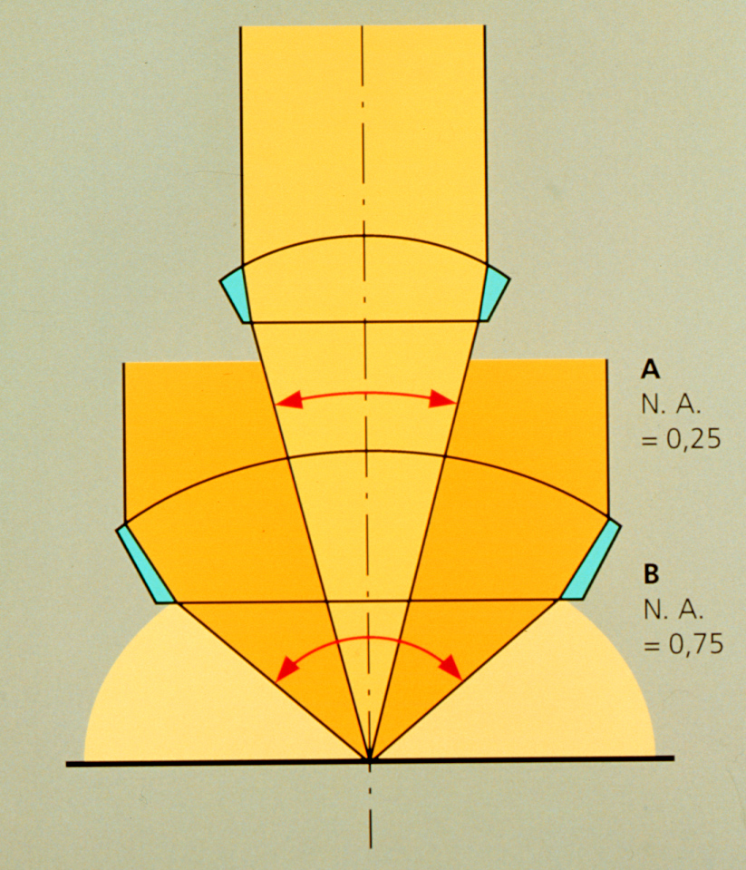
Larger Aperture collects more light
θ
N.A. = η sin θ
Notes:
In optics, the numerical aperture (NA) of an optical system is a dimensionless number that characterizes the range of angles over which the system can accept or emit light. By incorporating index of refraction in its definition, NA has the property that it is constant for a beam as it goes from one material to another provided there is no optical power at the interface. The exact definition of the term varies slightly between different areas of optics. Numerical aperture is commonly used in microscopy to describe the acceptance cone of an objective (and hence its light-gathering ability and resolution), and in fiber optics, in which it describes the range of angles within which light that is incident on the fiber will be transmitted along it.

Slide 54
N.A. = η sin θ
η = index of refraction
Material Refractive Index
Air 1.0003
Water 1.33
Glycerin 1.47
Immersion Oil 1.515
Note: sin θ ≤1, therefore N.A. ≤ η

Slide 55
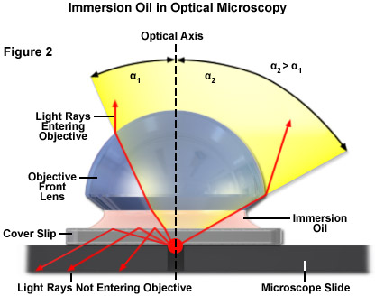
N.A. and immersion important for resolution and not loosing light to internal reflection.

Slide 56
How immersion medium affects the true N.A. and, consequently, resolution
No immersion (dry)
Max. Value for α = 90° (sin = 1)
Attainable: sinα = 0.95 (α = 72°)
Actual angle α₁:
Beampath
Snell’s Law:
n₁ sin β1 = n₂ sin β2
No oil
Oil
α₁
α₂
1
3
With immersion oil (3) n=1.518
No Total Reflection
Objective aperture fully usable
N.A._{max} = 1.45 > Actual angle α₂ :
α₁
α₂
2
Objective
Cover Slip, on slide
Immersion Oil
Notes:
Note 72 degree angle max for dry objective

Slide 57
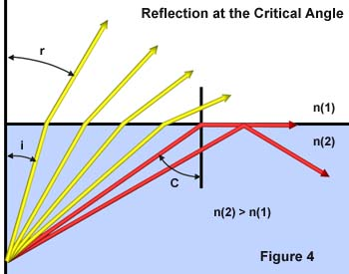
Internal reflection depends on refractive index differences
sin θ critical = η1 / η2
Notes:
Matching refractive indices can eliminate internal reflection. Internal reflection depends on refractive index differences

Slide 58
N.A. has a major effect on image brightness
Transmitted light
Brightness = fn (NA² / magnification²)
10x 0.5 NA is 3 times brighter than 10x 0.3NA
Epifluorescence
Brightness = fn (NA⁴ / magnification²)
10x 0.5 NA is 8 times brighter than 10x 0.3NA

Slide 59
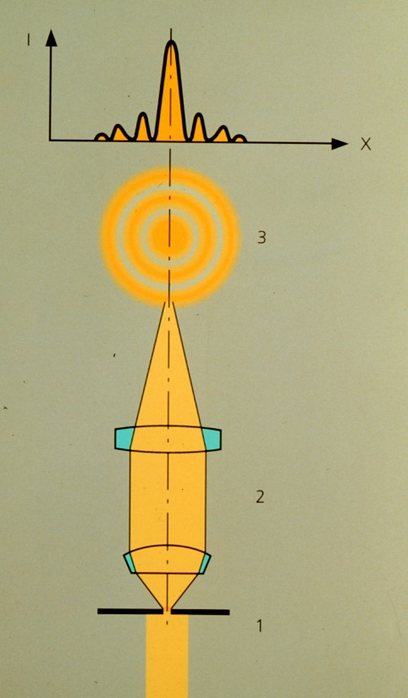
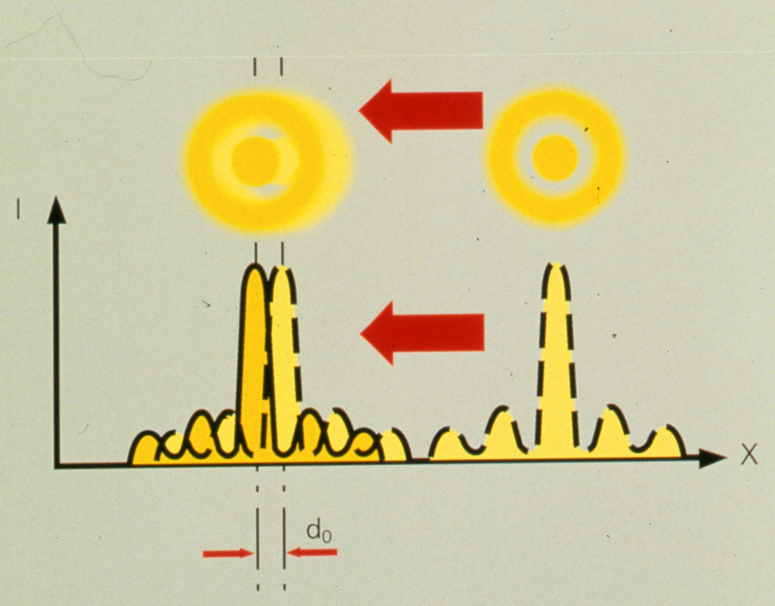
N.A. has a major effect on image resolution
Minimum resolvable distance
d_{min} = 1.22 λ / (NA _{objective} +NA _{condenser})

Slide 60
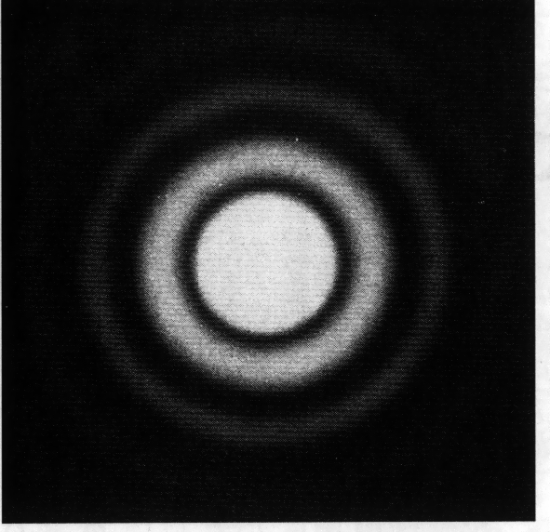
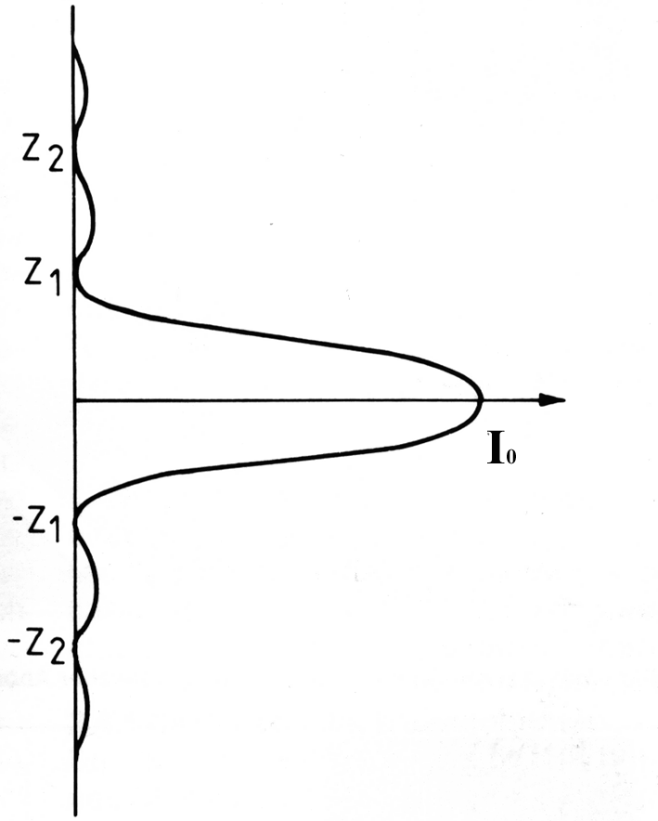
Intensity Distribution of a diffraction-limited spot
Airy Disk
Named after Sir George Biddell Airy English mathematician and astronomer
Notes:
In optics, the Airy disk (or Airy disc) and Airy pattern are descriptions of the best focused spot of light that a perfect lens with a circular aperture can make, limited by the diffraction of light.
The diffraction pattern resulting from a uniformly-illuminated circular aperture has a bright region in the center, known as the Airy disk which together with the series of concentric bright rings around is called the Airy pattern. Both are named after George Biddell Airy.

Slide 61
Airy disks and resolution
Minimum resolvable distance requires that the two airy disks don’t overlap
d_{min} = 1.22 λ / (NA _{objective} +NA _{condenser})

Slide 62
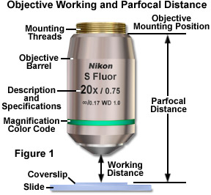
Relationship between N.A. and working distance of objective
Working distance: measure of the space between objective and cover-slip where specimen is in focus
Parfocality: When changing objectives, specimen remains in focus.
Let’s see how this works.

Slide 63
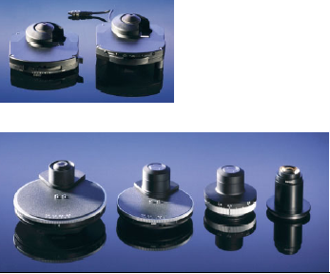
The second most important microscope component
The Condenser

Slide 64
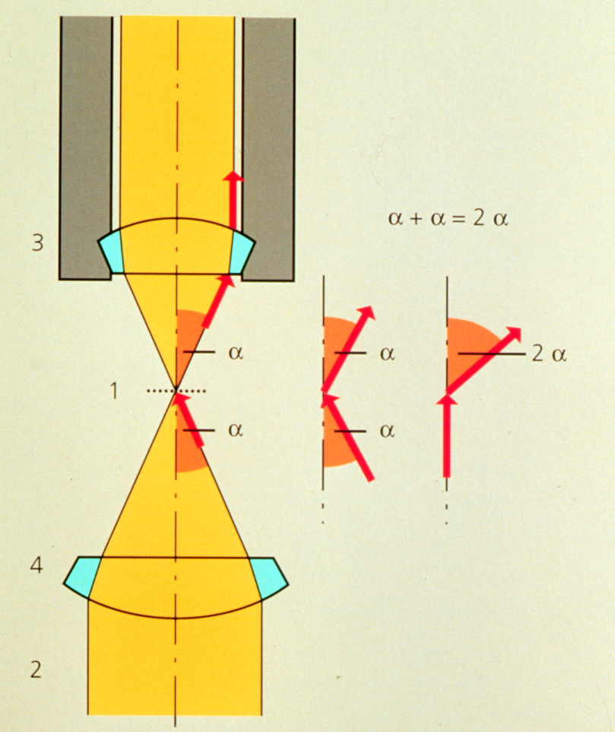
Condenser maximizes resolution
d_{min} = 1.22 λ / (NA _{objective} +NA _{condenser})
Kohler Illumination: Condenser and objective focused at the same plane

Slide 65
Condenser N.A. and resolution
If NA is too small, there is no light at larger angles. Resolution suffers.
If NA is too large, scattering of out-of-field light washes out features. Bad contrast
Notes:
Will talk about how to correct condenser issues in future lecture, Koehler illumination.

Slide 66
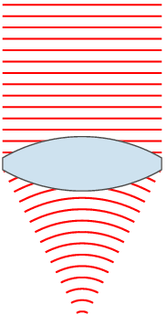
Collapse of Newton's corpuscular theory and the rise of the wave theory
By the 1800’s the wave theory was required to explain such phenomenon as diffraction, interference and refraction.
Airy disk is an intensity distribution of a diffraction limited spot helpful for defining resolution.

