Slide 1
Biology 177: Principles of Modern Microscopy
Lecture 02:
Geometrical Optics
Andres Collazo, Director Biological Imaging Facility
Wan-Rong (Sandy) Wong, Graduate Student, TA

Slide 2
Lecture 2: Geometrical Optics
Speed of light and refractive index
Thin lens law
Simple optical system
Compound microscope I
Refractive indices and super lenses

Slide 3
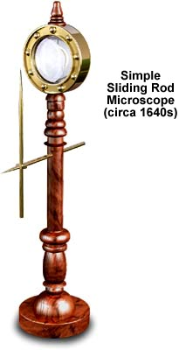
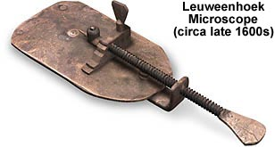
Simple microscope
How does it magnify?
By how much does it magnify?
Will the image be upright?
Why can’t this work for mag>100?
Why does the image have color halos?
Notes:
Magnification ?
Right side up or upside down?
Why is metal creating pupil?

Slide 4
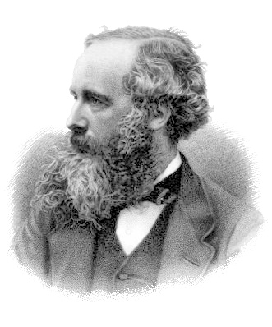
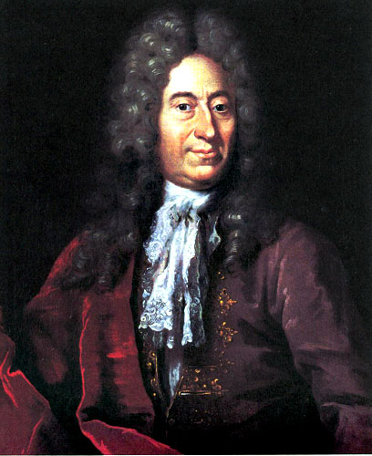
The speed of light
299,792,458 metres per second in a vacuum
The meter is now defined by the speed of light (1983)
First measured by the Danish Astronomer Ole Rømer in 1676
James Clerk Maxwell proposed all electromagnetic waves move at the speed of light (1865)
Ole Rømer
James Clerk Maxwell
Notes:
BBC: Albert Einstein has been voted the greatest physicist of all time in an end of the millennium poll, pushing Sir Isaac Newton into second place. Maxwell 3rd. The survey was conducted among 100 of today's leading physicists.

Slide 5
How did we learn that the speed of light was finite?

Slide 6
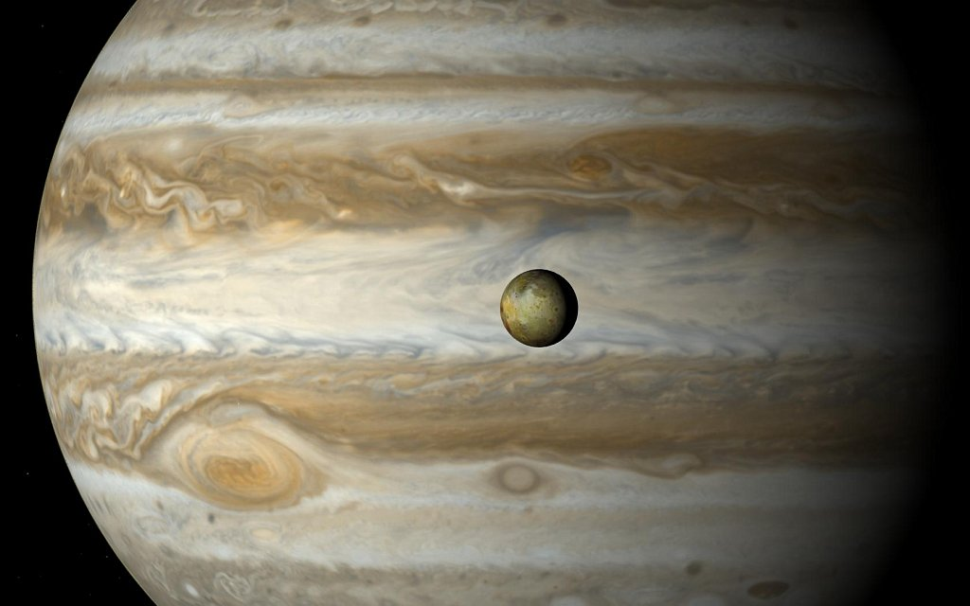
How did we learn that the speed of light was finite?
Hint

Slide 7
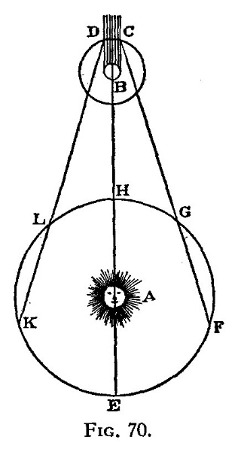
How did we learn that the speed of light was finite?
Hint
Ole Rømer in 1676
Notes:
Looked at orbit of Io around Jupiter. Io just discovered by Galileo in 1610. Io orbits at a good plane from earth so that it is eclipsed by Jupiter.

Slide 8
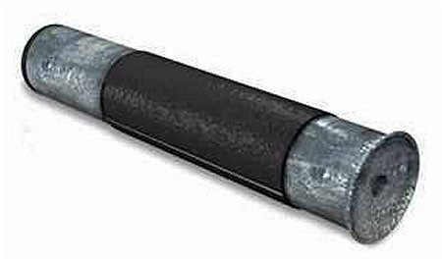
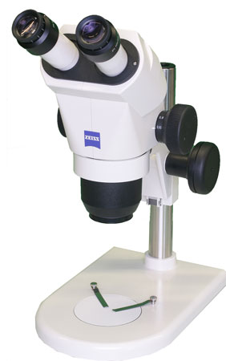
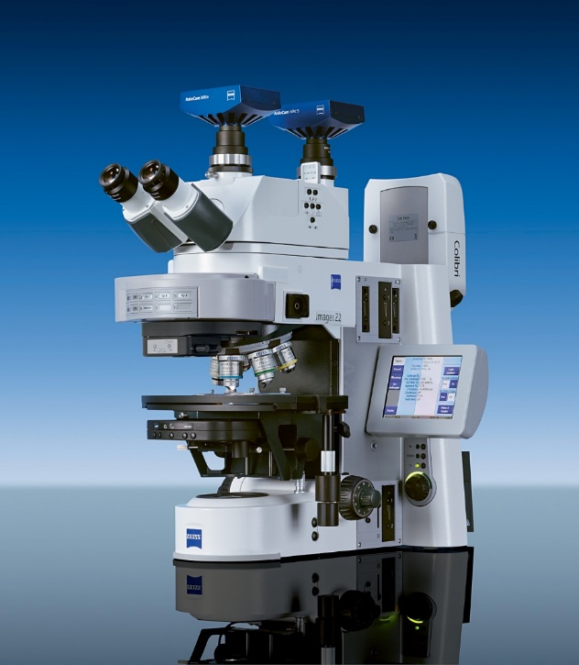
Let’s review some of the concepts from last lecture
Simple vs.
Compound microscopes
Refraction
Notes:
Discussed why we use visible light and its being perfect for analysis via geometrical optics.

Slide 9
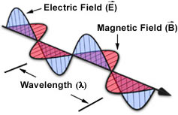
For most of today, will ignore the wave nature and concentrate on the particle nature.
Define the index of refraction, η
η = speed of light in vacuum /speed in medium
η = λ in vacuum / λ in medium
c = ν λ
Notes:
Frequency does not change with medium.

Slide 10
Refractive index η
Medium Refractive Index
Air 1.0003
Water 1.33
Glycerin 1.47
Immersion Oil 1.518
Glass 1.56 – 1.46
Diamond 2.42
Velocity in medium
299203
225032
203600
197162
191854 - 204995
123675

Slide 11
COMPLICATION: η Depends on the wavelength
Material Blue (486nm) Yellow (589nm) Red (656nm)
Crown Glass 1.524 1.517 1.515
Flint Glass 1.639 1.627 1.622
Water 1.337 1.333 1.331
Cargille Oil 1.530 1.520 1.516
(more on this next lecture)

Slide 12
Refraction - the bending of light as it passes from one material to another.
Snell’s Law: η1 sin θ1 = η2 sin θ2
θ1
Normal (perpendicular to interface of different materials)
θ2
Optical axis
η1
η2

Slide 13
Light beam through a plane-parallel glass plate
Snell’s Law: η1 sin θ1 = η2 sin θ2
θ1
θ2
??
n₁
n₂
n₁

Slide 14
Light beam through a plane-parallel glass plate
Snell’s Law: η1 sin θ1 = η2 sin θ2
θ1
θ2
θ1
n₁
n₂
n₁

Slide 15
Geometrical optics: Light as collection of rays
Refraction: light bends as it passes from one material to another
Snell’s Law: η1 sin θ1 = η2 sin θ2
θ1
θ2
θ1
n₁
n₂
n₁

Slide 16
Refractive index η
Medium Refractive Index
Air 1.0003
Water 1.33
Glycerin 1.47
Immersion Oil 1.518
Glass 1.56 – 1.46
Diamond 2.42
Velocity in medium
299203
225032
203600
197162
191854 - 204995
123675

Slide 17
Could apply Snell’s Law to something as complex as a lens
η1 sin θ1 = η2 sin θ2 = η3 sin θ3 = ….
η1
η2

Slide 18
Thin lens laws
1. Ray through center of lens is straight

Slide 19
Thin lens law 2
2. Light rays that enter the lens parallel to the optical axis leaves through Focal Point
Focal
Point
Notes:
CONVERGENCE LENS. Convex lens

Slide 20
Convex (biconvex) lens
This is a converging lens
Focal
Point
Notes:
CONVERGENCE LENS. Convex lens

Slide 21
Thin lens law 3
3. Light rays that enter the lens from the focal point exit parallel to the optical axis.
f
Focal
Point

Slide 22
Using the thin lens laws to predict the behavior of imaging systems (principle ray technique)
Mark Focal Pt
f
f

Slide 23
Applying thin lens law to our object, a gold can

Slide 24
Ray through center of lens is straight

Slide 25
Ray through center of lens is straight
Light rays that enter the lens parallel to the optical axis leaves through Focal Point

Slide 26
Ray through center of lens is straight
Light rays that enter the lens parallel to the optical axis leaves through Focal Point
Light rays that enter the lens from the focal point, exit parallel to the optical axis.

Slide 27
Where the three lines intersect is where that point of the object is located
Notes:
Note that the object is magnified and inverted. Real Image.

Slide 28
Ray tracing convention for optics generally uses arrows to represent the object.
Notes:
Note that the object is magnified and inverted. Real Image.

Slide 29
Same three rules can be applied for each point along the object.

Slide 30
Thin Lens Equation
1/f = 1/o + 1/i
f
i
o

Slide 31
Thin Lens Equation
1/f = 1/o + 1/i
Magnification = i/o
f
i
o

Slide 32
For object directly on focal point, rays focused to infinity.
Where would this be useful?
∞
Notes:
Object located at greater than 2 x the focal distance result in small image. How cameras work.

Slide 33
For object within the focal point, a virtual image is created.
Only need two rays to locate object.
Notes:
Virtual images are located on side of lens opposite to viewer. Bad naming conventions as virtual images are as “real” as a real image.

Slide 34
Of course can use all three rules to trace three rays.

Slide 35
So why can’t a simple lens magnify more than ~ 100X?

Slide 36
What happens when you are at 2 x focal length?

Slide 37
What happens when you are at 2 x focal length?

Slide 38
What happens when you are greater than 2 x focal length?
Think of a camera

Slide 39
What happens when you are greater than 2 x focal length?
Think of a camera

Slide 40
Thin lens law (Concave Lenses)
Concave (biconcave) lens
This is a diverging lens
Notes:
CONVERGENCE LENS. Convex lens

Slide 41
Thin lens law (Concave Lenses)
Light rays that enter the lens parallel to the optical axis exit as if they came from the focal point on the opposite side.
Notes:
CONVERGENCE LENS. Convex lens

Slide 42
Thin lens law (Concave Lenses)
Focal length is defined as negative
Images are virtual
Notes:
CONVERGENCE LENS. Convex lens

Slide 43
Same three rules can be applied to a concave lens.
Notes:
All concave lenses make virtual images that are smaller no matter where the object is located.
DISPERSION LENS

Slide 44
But again two rays are enough to locate virtual image.

Slide 45
Concave lens makes virtual image that is smaller no matter where object is located.
Notes:
All concave lenses make virtual images that are smaller no matter where the object is located.

Slide 46
Principle ray approach works for complex lens assemblies.
Notes:
Focal lengths add as reciprocals:
1/f(total) = 1/f1 + 1/f2 + ... + 1/fn - Remember: for concave lens f is negative
Problem: Two thin lenses together don’t make a thin lens. Notice that the central ray misses the image.
Solution: Use principle rays to define image from first lens. Then use the first image as the object for the second lens.

Slide 47
Principle ray approach works for complex lens assemblies.
Focal lengths add as reciprocals:
1/f(total) = 1/f1 + 1/f2 + ... + 1/fn Remember: for concave lens f is negative
Notes:
Focal lengths add as reciprocals:
1/f(total) = 1/f1 + 1/f2 + ... + 1/fn - Remember: for concave lens f is negative
Problem: Two thin lenses together don’t make a thin lens. Notice that the central ray misses the image.
Solution: Use principle rays to define image from first lens. Then use the first image as the object for the second lens.

Slide 48
Problem: Two thin lenses together don’t make a thin lens.
Notice that the central ray misses the image
Notes:
Focal lengths add as reciprocals:
1/f(total) = 1/f1 + 1/f2 + ... + 1/fn - Remember: for concave lens f is negative
Problem: Two thin lenses together don’t make a thin lens. Notice that the central ray misses the image.
Solution: Use principle rays to define image from first lens. Then use the first image as the object for the second lens.

Slide 49
Solution: Use principle rays to define image from first lens. Then use the first image as the object for the second lens
Notice that the central ray misses the image
Notes:
Focal lengths add as reciprocals:
1/f(total) = 1/f1 + 1/f2 + ... + 1/fn - Remember: for concave lens f is negative
Problem: Two thin lenses together don’t make a thin lens. Notice that the central ray misses the image.
Solution: Use principle rays to define image from first lens. Then use the first image as the object for the second lens.

Slide 50
To avoid reciprocals: Define Diopter (D)
D = 1/focal length (in meters)
D(total) = D1 + D2 + ... + Dn Remember: for concave lens D is negative
Notes:
Focal lengths add as reciprocals:
1/f(total) = 1/f1 + 1/f2 + ... + 1/fn - Remember: for concave lens f is negative
Problem: Two thin lenses together don’t make a thin lens. Notice that the central ray misses the image.
Solution: Use principle rays to define image from first lens. Then use the first image as the object for the second lens.

Slide 51
Another example: Begin with one convex lens.

Slide 52
Another example: Add a second convex lens.

Slide 53
Another example: Can determine real image formed by two convex lenses.
Notes:
Note that two convex lenses make a smaller image

Slide 54
Image in the eye are different sizes (different magnifications) depending on their distance from the eye.
Accommodation of the lens changes f to make it possible.
M_{B} ~ 2x M_{A}
A
B

Slide 55
Conventional Viewing Distance
?
1x
250 mm

Slide 56
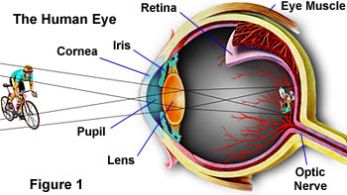
Could get a larger retinal image if object were closer
Limited accommodation (especially with age)
Limited range
Solution: Add a “loupe” in front of eye
Allow eye to focus at infinity for o ≤ 250mm
Notes:
Focal length of eye is approximately 17 mm

Slide 57
“Magnification” 1x
1x
f = 250 mm
1x

Slide 58
Magnification via Single Lens
1x
f = 250 mm
Magnifying Glass (Loupe)
5x
Example: f=50mm
Notes:
Why can’t this work for mag>100? Lens gets more spherical and closer to focal point.

Slide 59
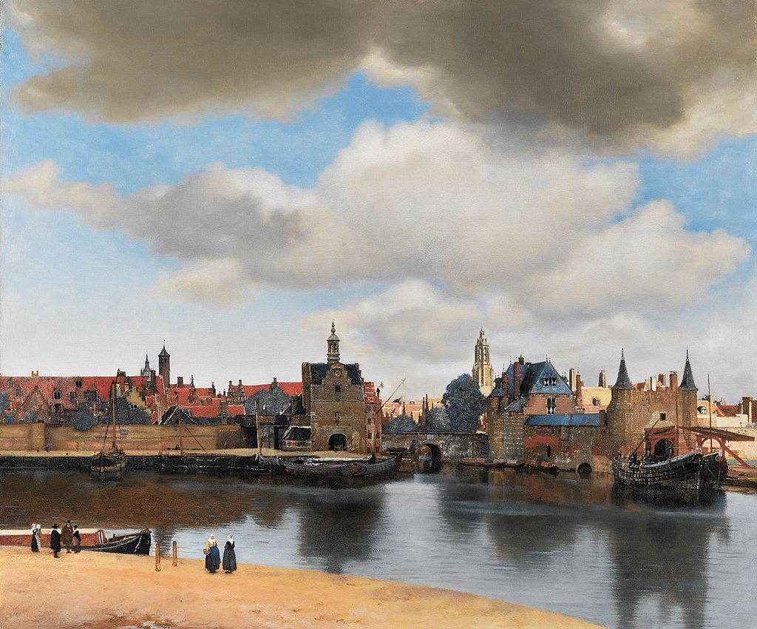
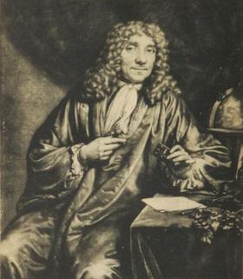
Magnification??
Delft
Antonie van Leeuwenhoek
1632-1723
Notes:
The Leewenhoek microscope was simplicity in itself. It had a single lens mounted on a metal plate with screws to move the specimen across the field of view and to focus its image. The lens was the key and permitted magnification of 70 to 270. (web site seems incorrect on magnification range)
http://www.asu.edu/courses/phs208/patternsbb/PiN/rdg/elmicr/optical.shtml

Slide 60
How to get magnification > 100??
Compound microscope
  Objective lens (next to the object)
Objective Lens
Real image
Magnification = I/O
I=160mm (old microscopes)
Image

Slide 61
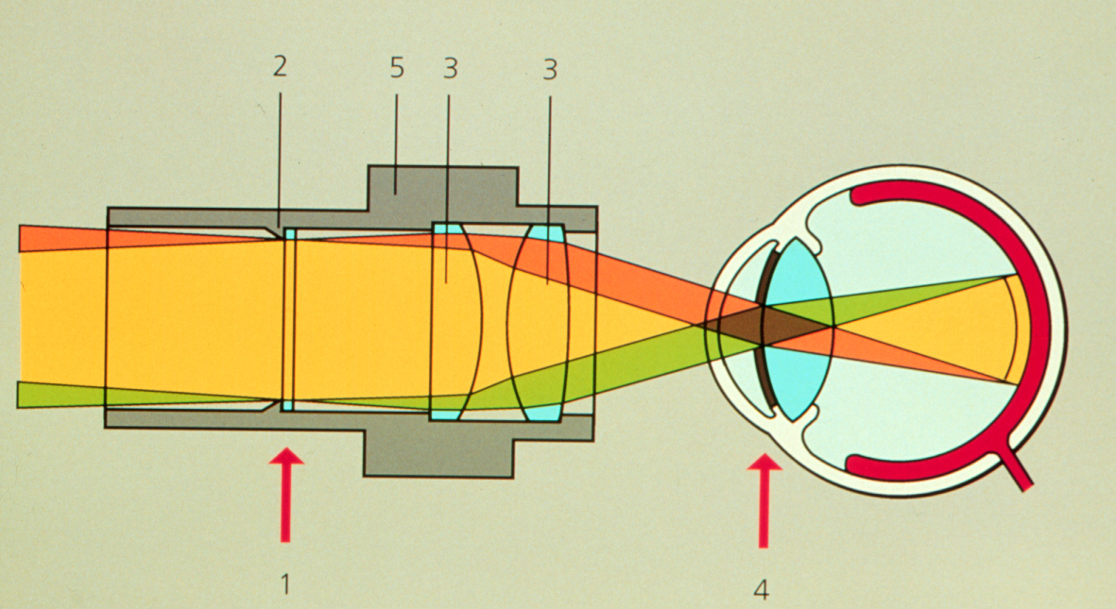
How to get magnification > 100??
Compound microscope
Objective lens (next to the object)
Eyepiece (f = 25mm; 10x)
Reticle position
(in focus for eye)
Note rays are parallel

Slide 62
How to get magnification > 100??
Compound microscope
Objective lens (next to the object)
Eyepiece (f = 25mm; 10x)
Objective Lens
Image
Eyepiece
image
Eyepiece
Lens of eye

Slide 63
How to get magnification > 100??
Compound microscope
Objective lens (next to the object)
Eyepiece (f = 25mm; 10x)
Objective Lens
Image
Eyepiece
image
Eyepiece
Lens of eye

Slide 64
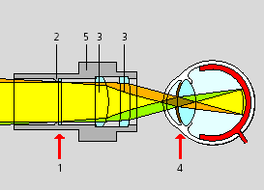
The Eyepiece (Ocular)
Intermediate Image
Eyepoint (Exit Pupil)
Note: If you need a magnifier, turn eyepiece
upside down and move close to eye

Slide 65
The Eyepiece (Ocular)
Question: why does the eye need to be at the focus of the eyepiece?
Intermediate Image
Eyepoint (Exit Pupil)

Slide 66
Eye at focal point because…
…it maximizes field of view.

Slide 67
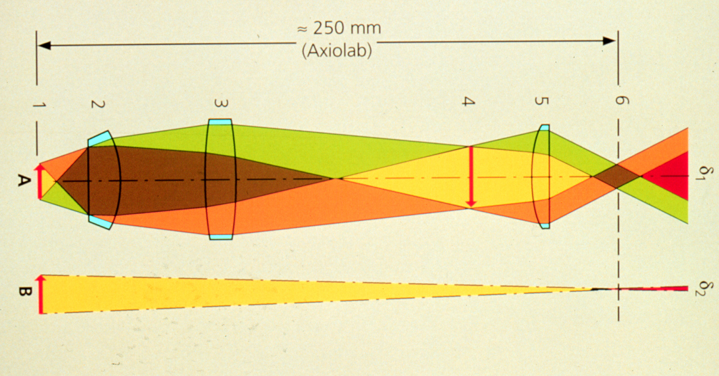
Object viewed through microscope vs the unaided eye
(250 mm from eye)
Compound microscope
Large image on retina
1x view
Small image on retina

Slide 68
Homework 1: The index of refraction changes with wavelength (index is larger in blue than red).
How would you need to modify this diagram of the rays of red light to make it appropriate for blue light?
f
i
o
Hint: higher index of refraction results in shorter f

Slide 69
Let’s come back to refractive index (η)
Material | Refractive Index
Air | 1.0003
Water | 1.33
Glycerin | 1.47
Immersion Oil | 1.515
Glass | 1.52
Diamond | 2.42
η = speed of light in vacuum /speed in medium
Notes:
What do you notice about the values?

Slide 70
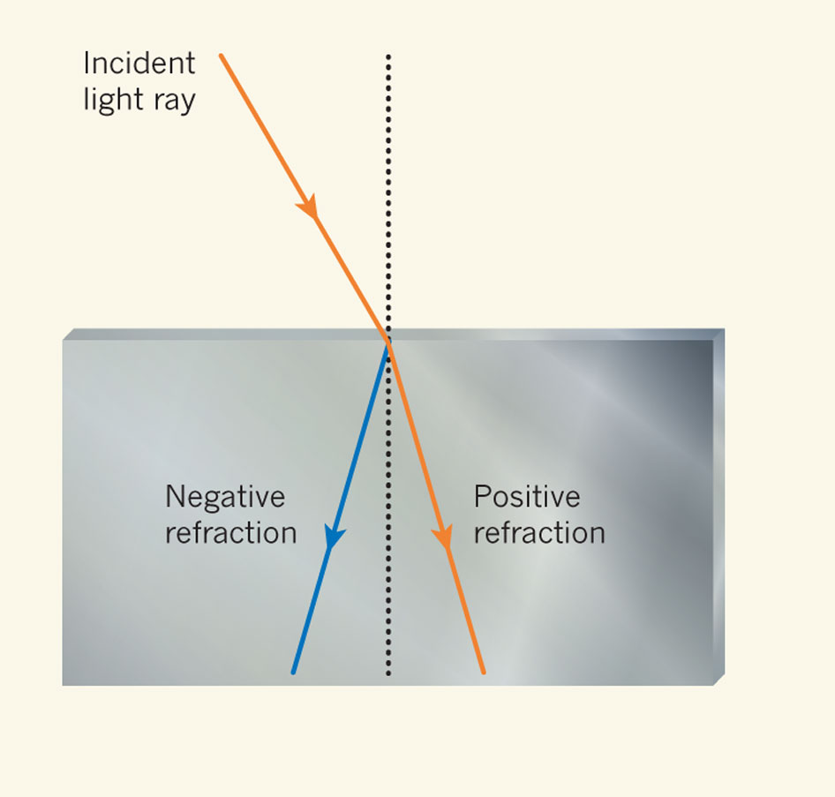
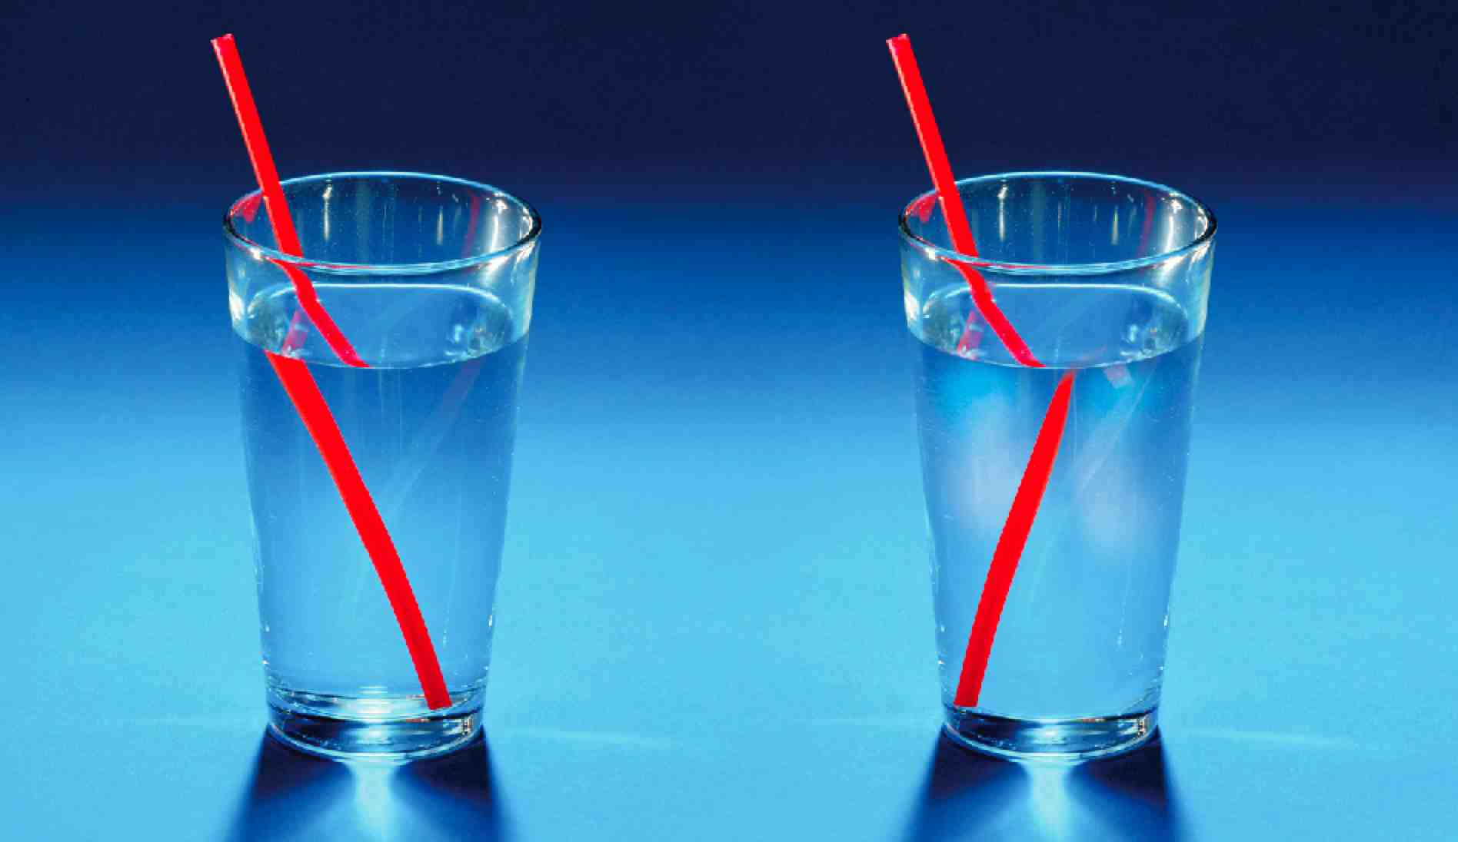
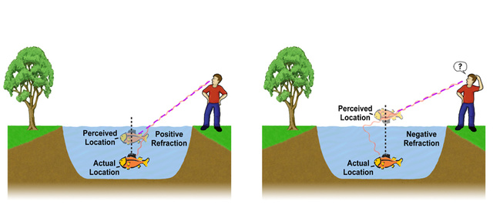
Metamaterials with negative refractive indices would produce bizarre images
Image not real!
Tyc T, Zhang X (2011) Forum Optics: Perfect lenses in focus. Nature 480: 42-43.
Notes:
http://www.nature.com/nature/journal/v480/n7375/full/480042a.html
Straw image from http://www.extremetech.com/extreme/168060-the-first-quantum-metamaterial-raises-more-questions-than-it-answers

Slide 71
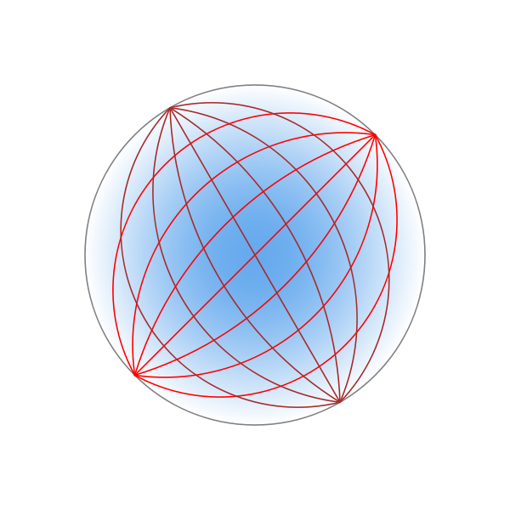
Metamaterials with negative refractive indices could be used to make superlenses for super resolution microcopy
Do you need to perfect lens?
Maxwell's fish-eye lens could do it with positive refractive indices
  Refractive index changes across lens (blue shading)
Luneburg lens
Tyc T, Zhang X (2011) Forum Optics: Perfect lenses in focus. Nature 480: 42-43.
Notes:
Darker blue, higher refractive index. Like a gravitational lens
A practical superlens, super lens or perfect lens, is a lens which uses metamaterials to go beyond the diffraction limit. The diffraction limit is an inherent limitation in conventional optical devices or lenses.[1] In nano-optics, a plasmonic lens generally refers to a lens for surface plasmon polaritons (SPPs), i.e. a device that redirects SPPs to converge towards a single focal point. Since SPPs can have very small wavelength, they can converge into a very small and very intense spot, much smaller than the free-space wavelength and the diffraction limit.[1][2] Surface plasmon polaritons (SPPs), are infrared or visible-frequency electromagnetic waves, which travel along a metal-dielectric or metal-air interface. The term "surface plasmon polariton" explains that the wave involves both charge motion in the metal ("surface plasmon") and electromagnetic waves in the air or dielectric ("polariton").[1]
They are a type of surface wave, guided along the interface in much the same way that light can be guided by an optical fiber. SPPs are shorter in wavelength than the incident light (photons).[2]
Metamaterials are artificial materials engineered to have properties that have not yet been found in nature.

